Slide 1
Arduino Case
Andrew Fawcett
DESN 204

Slide 2
What is Arduino?
Arduino is an open-source hardware platform that can monitor the environment by receiving input from a variety of sensors and can affect its surroundings by controlling lights, motors, and other actuators.

Slide 3
What is Arduino
The microcontroller on the board is programmed using the Arduino programming language and the Arduino development environment. Arduino projects can be stand-alone or they can communicate with software running on a computer.

Slide 4
Arduino Case: Why?
The Arduino Uno is intended to be used in a prototyping environment.
The electrical components on the Arduino are exposed and can be damaged easily.
Not meant to be thrown in a backpack

Slide 5
Rapid Prototyping
Version 1
The Arduino did not fit because the tolerances were too tight
Wanted a more exciting design

Slide 6
Rapid Prototyping
Version 2
Red = more exciting
Removed posts because the Arduino could be friction fit.
Beveled corners
Added a lid
Did not fit
Use assemblies in SolidWorks

Slide 7
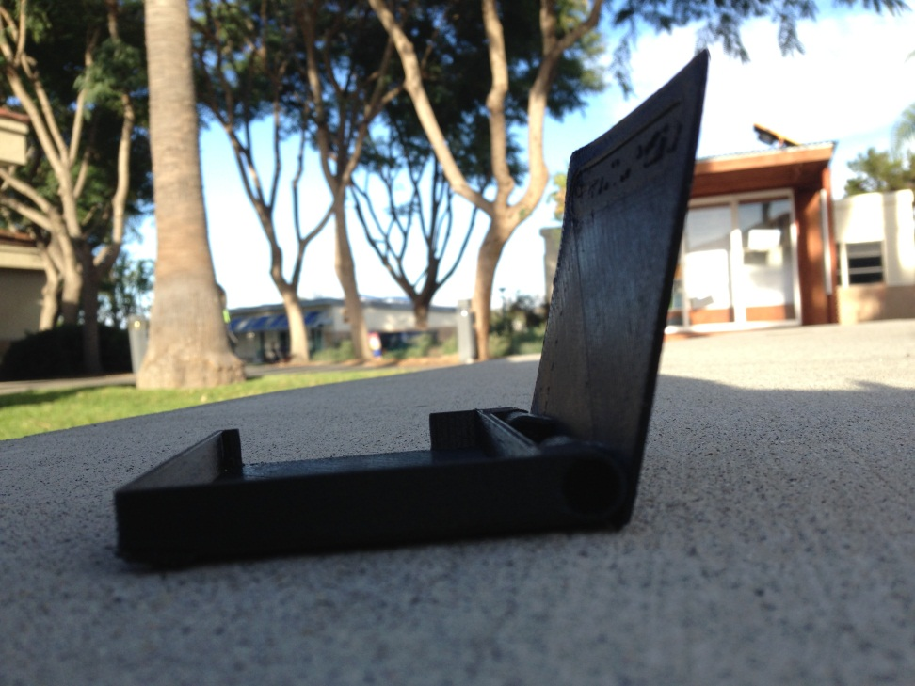
Rapid Prototyping
Version 3
Lid fit but the case is to shallow
Attempted to add my name

Slide 9
Final Model

Slide 10
Final Model

Slide 11
Final Model

Slide 12
Finishing
The final model was treated with acetone to give a polished finished.
The model was too big for the jar so it had to be rotated to cover the entire surface area.
Note the corners yet to be finished are not pure black.

Slide 13
Final Model
Friction fit
Beveled corners
Opens and shuts
Acetone treated finish
Backpack resistant ☺

