Slide 1
Rodent Cage
By: Ruben Aguilar

Slide 2
About The Part
Q: Why I made the Part?
A: Because It’s a chance to get creative try something, challenging, new and put my Solidworks Skills to the test.
Q: What’s intriguing?
A: A cage could help anyone with a rodent infestation especially an exterminator.
Q: Why would you produce this part?
A: A cage could help anyone in need especially families with a rodent infestations, If I were to produce this part maybe places like home Depot, and Lowes could sell them. A cage could help anyone to contain a rodent.
Q: What is the Material Finish?
A: All Bars are Chromium Steel, Screws are Polished Steel, and Platform is Plastic PW-MT11130.

Slide 3
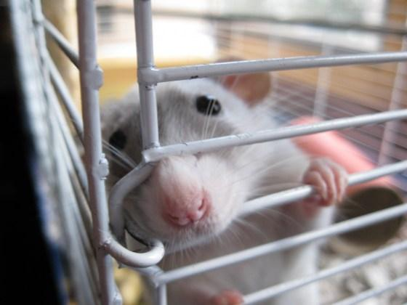
Sample

Slide 4
Biggest Challenges
This part was very hard and challenging and it took about 20 parts.
My biggest struggle was fixing my assembly right for them to attach together in order to 3d print it.

Slide 5
PDFS
There’s a total amount of 20 parts to make this Cage.
AC BAR
AC BAR ATTACHMENT
AC BAR ATTACHMENT MIDDLE
AC BAR ATTACHMENT TOP
AC BAR CURVE
AC BAR DOOR HOLDER 2
AC BAR DOOR HOLDER 2 CURVE
AC BAR DOOR HOLDER
AC BAR DOOR HOLDER CURVE
AC BAR HALF
AC BAR HALF CURVE
AC CORNER BAR
AC CORNER BAR CURVE
AC PLATFORM
CURVE
CURVE SHORTEN
DOOR
DOOR KNOB
SCREW
SMALL SCREW

Slide 6
AC BAR

Slide 7
AC BAR ATTACHMENT

Slide 8
AC BAR ATTACHMENT MIDDLE

Slide 9
AC BAR ATTACHMENT TOP

Slide 10
AC BAR CURVE

Slide 11
AC BAR DOOR HOLDER 2

Slide 12
AC BAR DOOR HOLDER 2 CURVE

Slide 13
AC BAR DOOR HOLDER

Slide 14
AC BAR DOOR HOLDER CURVE

Slide 15
AC BAR HALF

Slide 16
AC BAR HALF CURVE

Slide 17
AC CORNERBAR

Slide 18
AC CORNERBAR CURVE

Slide 19
AC PLATFORM

Slide 20
Curve

Slide 21
CURVE SHORTEN

Slide 22
DOOR

Slide 23
DOOR KNOB

Slide 24
SCREW

Slide 25
SMALL SCREW

Slide 26
CAGE ASSEMBLY

