Slide 1
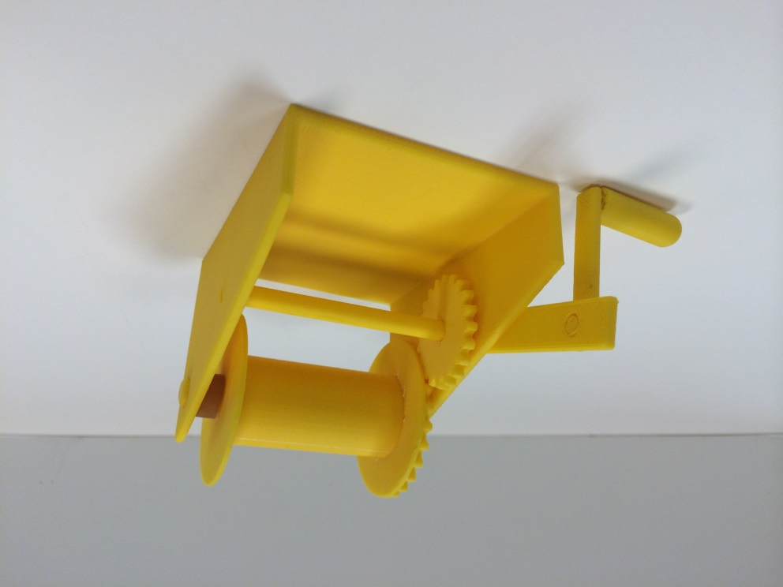
Hand Winch
DESN 204
By: Mark Santos

Slide 2
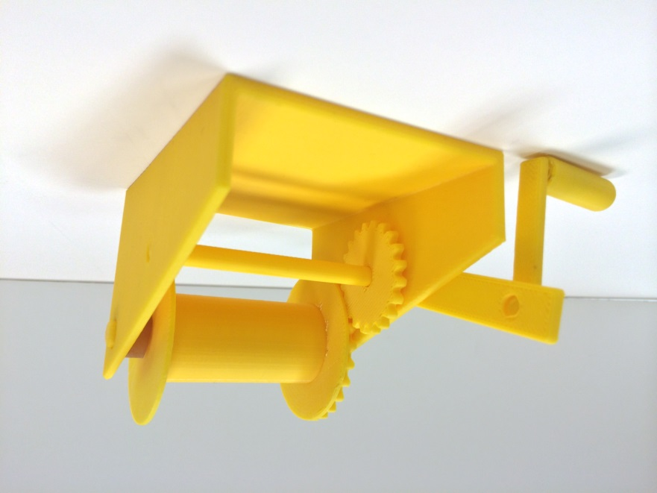
Why the Hand Winch
Challenges
Gears
Tolerances
Doing the hand winch from eye site with no actual measurements.

Slide 3
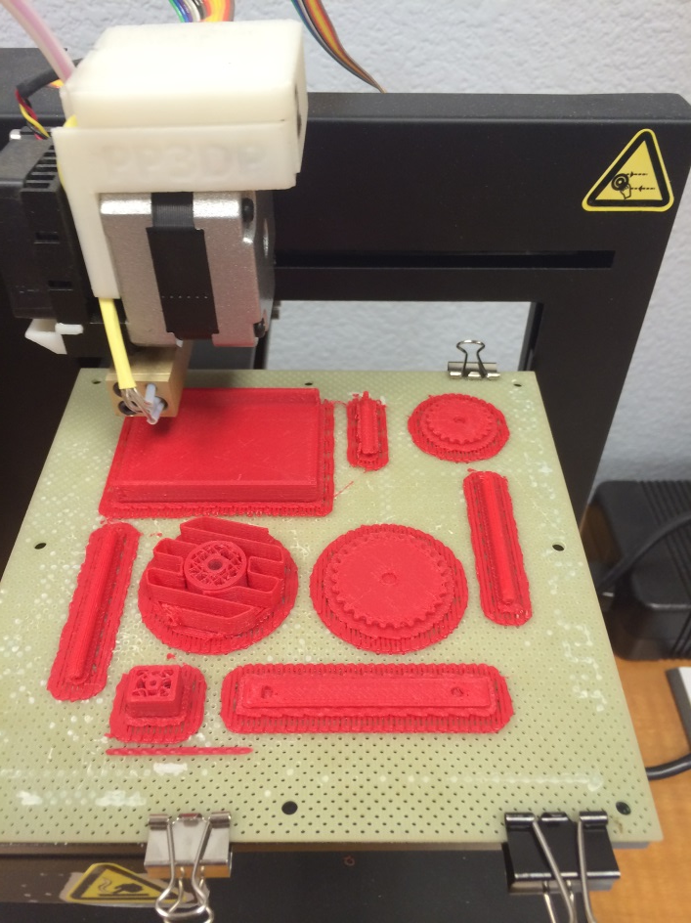
Prototype

Slide 4
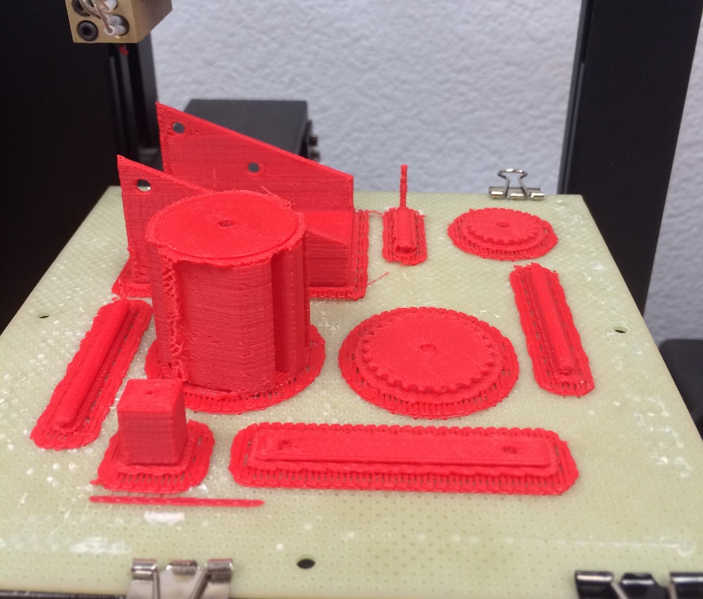
Prototype

Slide 5
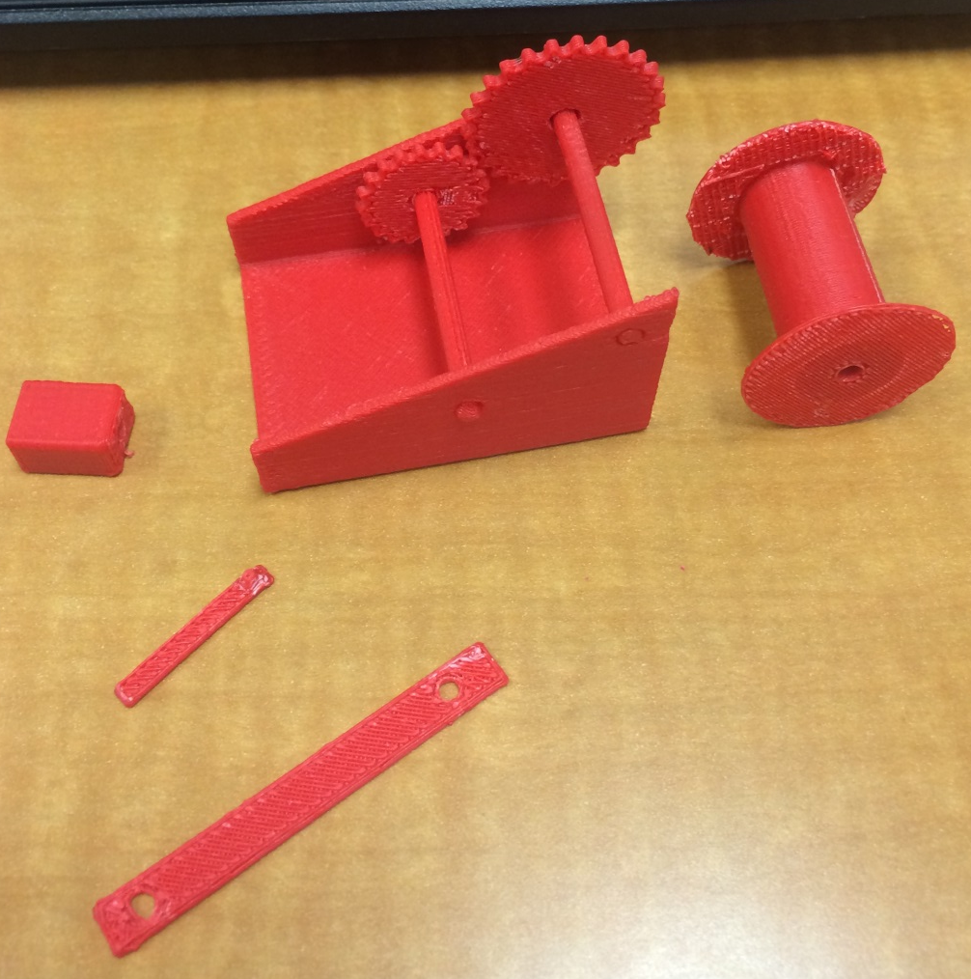
Adjustments
Redesigned handle
Changed tolerances from .025 to .050
Shortened and thicker handle

Slide 6
Drawing

Slide 7
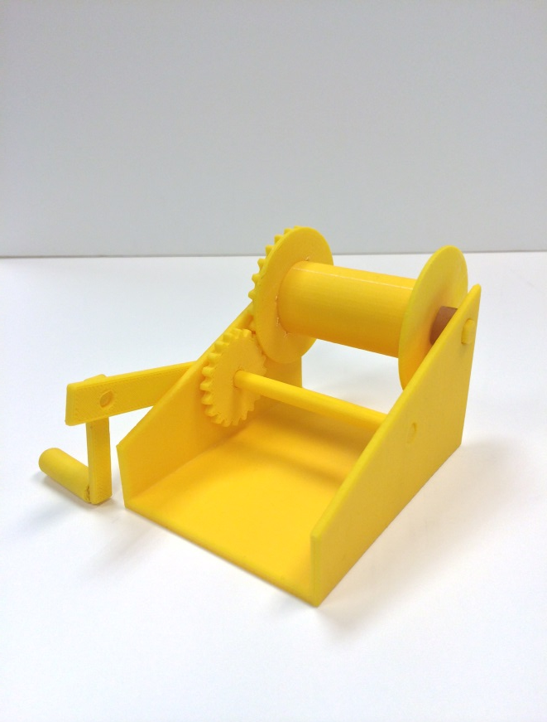
Digital Image

