Slide 1
Rapid Prototyping
Matthew Redden

Slide 2
Design Challenges
Replicate door handles for digital scale used in chemistry classroom
Prototype Millikan Rings for oil drop experiment
Machine frame and print bed for RepRap 3D printer

Slide 3
From start to finish
Create 3D models in SolidWorks
Fabricate prototypes employing both 3D printing and CNC technology
Test prototypes for fit and functionality
Finalize design and create final product

Slide 4
Door handle

Slide 6
before

Slide 7
after

Slide 8
issues
Snug Fit
Rough prototype had too small of post
Small posts were hard to die thread, resulting in breakage

Slide 9
MILLIKAN RINGS

Slide 11
The experiment

Slide 12
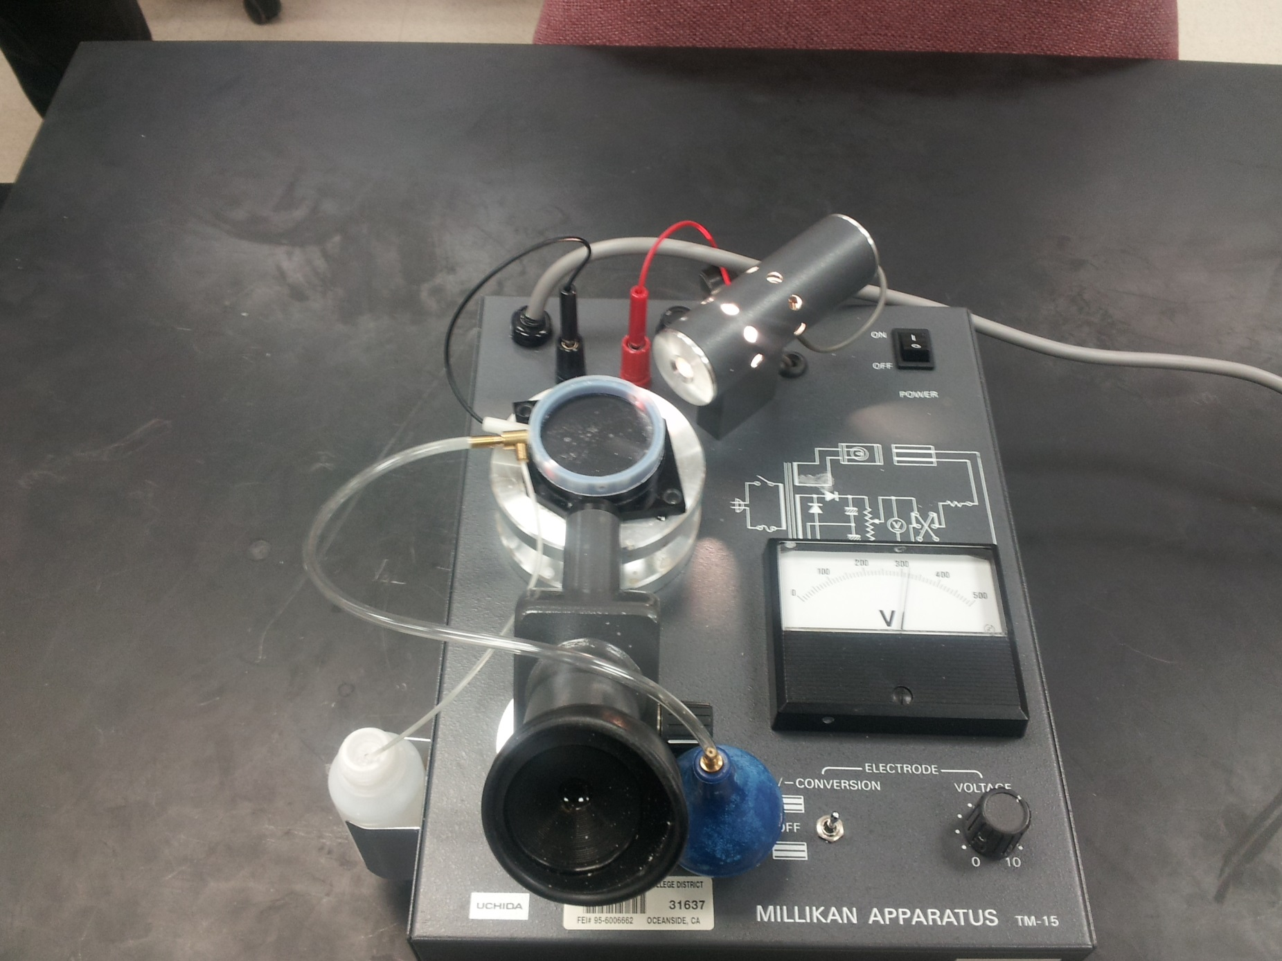

Slide 13
The results
Hernandez, Larry <lhernandez@miracosta.edu>
Oct 21
to me
Hi Matt,
I just wanted to let you know that our physics class used the ring you made for the Millikan apparatus and it worked perfectly! I guess the only concern was that using the opaque printing material, we would not get enough light into the chamber, but when you reamed out the hole for the lamp, it worked great! Maybe we can print a couple more just have some backups for our cheesy plastic ones.
Thanks,
Larry H.

Slide 14
Issues
Almost none!
Material type resulted in obstruction of light
Fit was perfect to that of a slip to press fit
Hole diameter worked great as well

Slide 15
PRINT BED & fRAME

Slide 18
TOOLING PROGRAMS
%
O001
(FIXTURE PLATE DOWEL HOLES)
(TOOL 1 - . 375 DIA SPOT)
(TOOL 2 - .228 DRILL)
(TOOL 3 - .187 E.M.)
G17 G40 G80 G90
T1 M6 (.375 SPOT)
S6500 M3
G0 G90 G54 X-0.5 Y-0.1969
G43 Z0.1 H1 M8
G81 G98 X-0.5 Y-0.1969 Z-0.125 R0.1 F30.
X0.1969 Y0.5 R0.1
G00 Z1.0
T2 M6 (.228 DRILL)
G0 G90 G54 X-0.5 Y-0.1969 S6500 M3
G43 Z1. H2 M8
G83 G98 X-0.5 Y-0.1969 Z-0.5 Q0.125 R0.1 F30.
X0.1969 Y0.5 R0.1
G00 Z1.0
T3 M6 (.187 E.M)
G0 G90 G54 X-0.2812 Y-0.1969 S8500 M3
G43 Z1. H3 M8

Slide 19
%
O002
(FIXTURE TOOLING)
(TOOL 1 - .375 DIA SPOT)
(TOOL 2 - .228 DRILL)
(TOOL 3 - 1/4-20 ROLL TAP)
T1 M6 (.375 SPOT)
S6000 M3
G0 G90 G54 X2.7559 Y-12.2047
G43 Z0.1 H1 M8
G81 G98 X2.7559 Y-12.2047 Z-0.129 R0.1 F30.
X4.9627 R0.1
X7.2835 R0.1
X9.5472 R0.1
X11.811 R0.1
Y-9.1732 R0.1
X7.2835 Y-9.252 R0.1
X2.7559 Y-9.9606 R0.1
Y-7.0866 R0.1
X5.3149 R0.1
X9.0551 R0.1
X11.811 R0.1
Y-5. R0.1
X7.2835 Y-4.9212 R0.1
X2.7559 Y-4.2126 R0.1
X4.7814 Y-2.6575 R0.1
X7.2835 R0.1
X9.8425 R0.1
G00 Z1.0
T2 M6 (.228 DRILL)
G0 G90 G54 X2.7559 Y-12.2047 S6500 M3
G43 Z0.1 H2 M8

Slide 20
FINAL PART PROGRAM
%
O003
(FRAME AND BED)
(TOOL 1 - .375 SPOT)
(TOOL 2 - .265 DRILL)
(TOOL 3 - .250 DRILL)
(TOOL 4 - .250 SPOT)
(TOOL 5 - .118 DRILL)
(TOOL 6 - .250 E.M.)
(TOOL 7 - .187 AEROMILL)
T1 M6 (.375 SPOT)
S5500 M3
G0 G90 G54 X5.2165 Y-12.8161
G43 Z0.1 H1 M8
G0 X5.2165 Y-12.8161
G81 G98 X5.2165 Y-12.8161 Z-0.1375 R0.1 F30.
X7.2835 Y-10.609 R0.1
Y-9.8633 R0.1
X3.9578 Y-8.4449 R0.1
X5.3149 Y-7.8948 R0.1
X9.0551 R0.1
X10.6508 Y-7.1117 R0.1
X3.9578 Y-5.6887 R0.1
X7.2835 Y-5.5326 R0.1
G0 X2.7559 Y-12.2047
X2.7559 Y-12.2047

Slide 24
Work in progress

Slide 25
Next steps
Obtain stepper motors, electronics, and precision ground rounds
Anodize and engrave frame
Assemble and calibrate
Print!

Slide 26
When I started
Little 3D design and no SolidWorks experience
Little experience CNC programming with CAM software
Oblivious to the uses of 3D printing

Slide 27
Where I am now
Solid foundation in SolidWorks
Pathway created for more opportunities in CNC programming through my place of work
Mind open to the possibilities of 3D printing and where the industry may be going

Slide 28
The future
Continued education through Mira Costa
Advance modeling skills
Enhance CNC programming skills
Home-based printing of lots of little trinkets

Slide 29
Thanks!

