Slide 1
Drum Pedalboard
Matthew Redden
Taylor Knight

Slide 2
Objective:
Consult with Professor Coobatis regarding pedalboard design
Create 3D models of pedalboard
Submit Design
Receive Feedback
Prototype Pedalboard

Slide 3
Initial Contact:
Pedalboard Idea
Matt Redden <mattredden1@gmail.com>
Aug 22
To: christy
Hello, my name is Matthew Redden and I am in Professor Clarke's Desn 204 3D Modeling and Prototyping course. My partner, Taylor Knight, and I are the lucky ones that chose your idea for our group project for the semester. I was able to review the email that you sent Professor Clarke and believe we can come up with a really nice prototype for you. I am already juggling around ideas as to what materials and style we may be able to incorporate, but seeing how neither one of us has much of a musical background, we are going to have some questions. I am available to come to campus weekdays after 4:30 and would like the opportunity to sit down with you and discuss a few details about your proposed project. If you could please let me know what kind of availability you will have in the coming weeks, it would be greatly appreciated. Thank you and I look forward to hearing from you.
-Matt

Slide 4
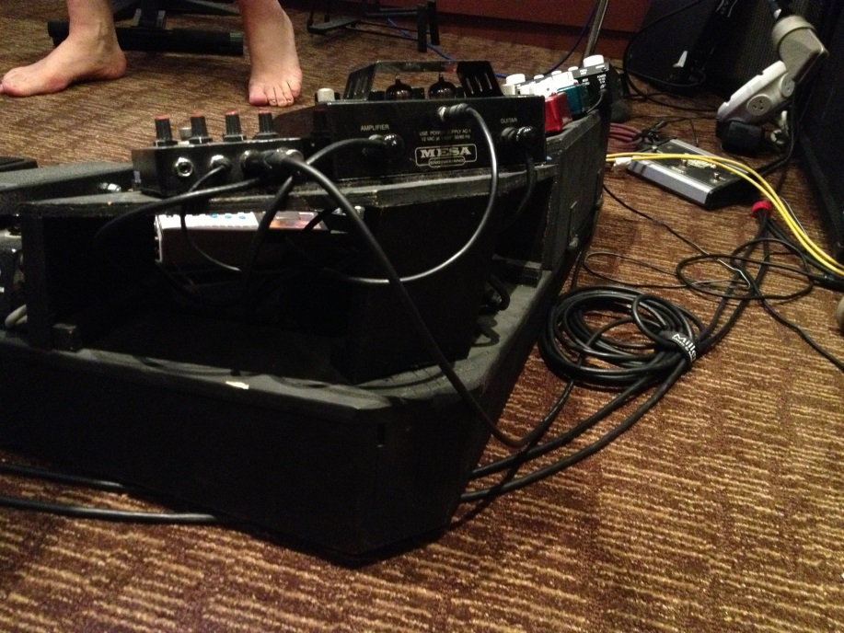
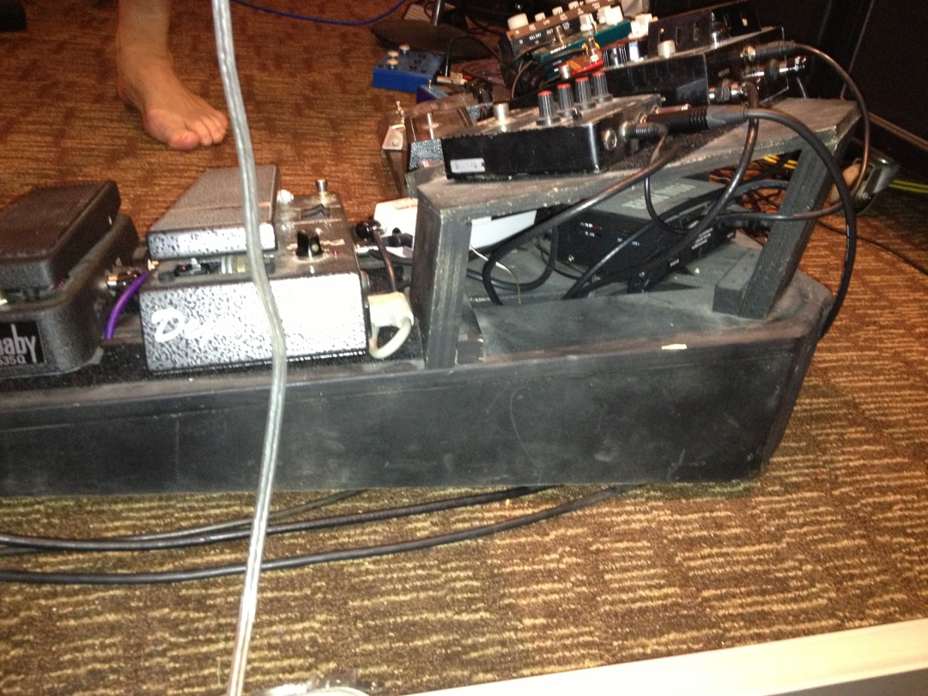
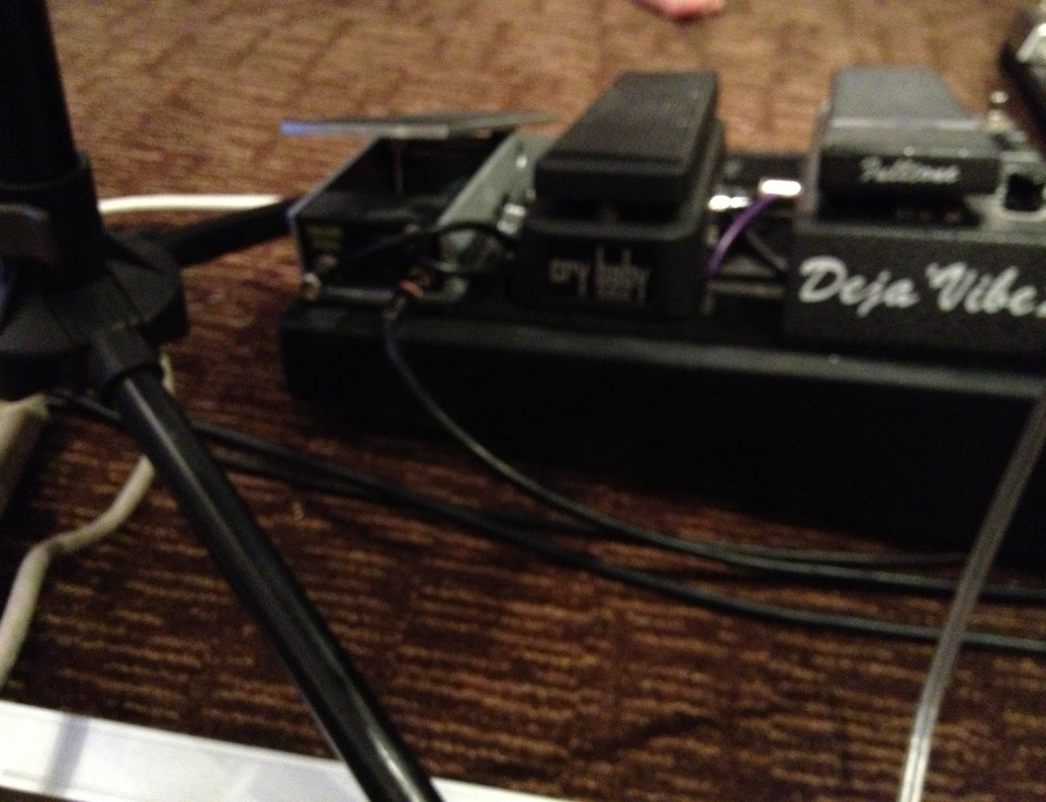

Slide 5
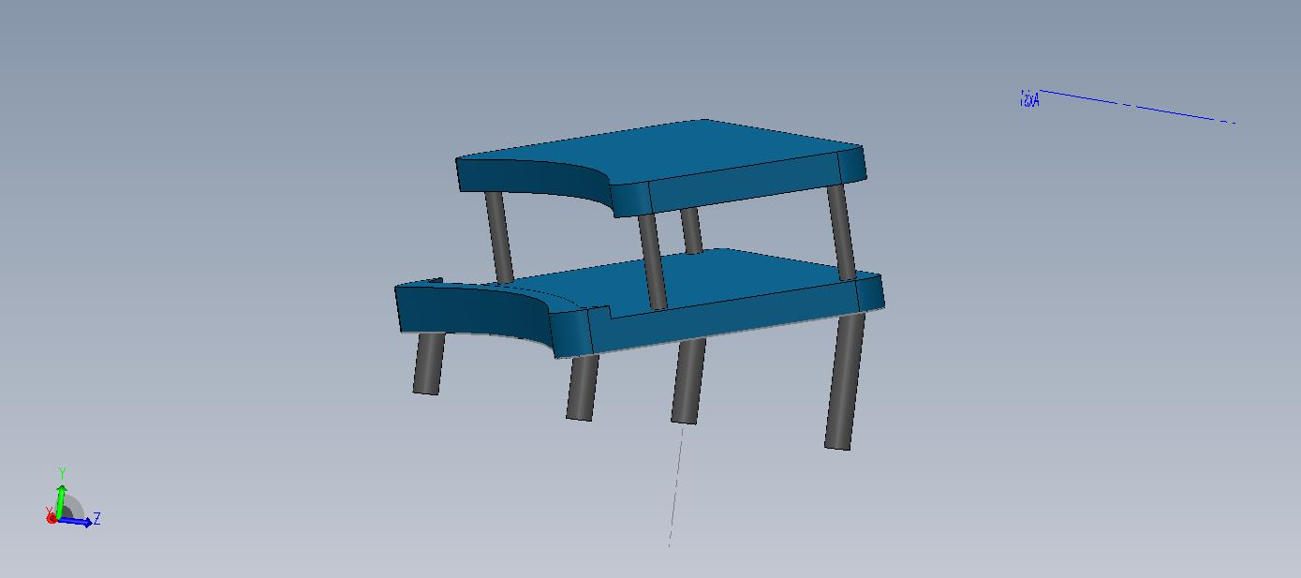
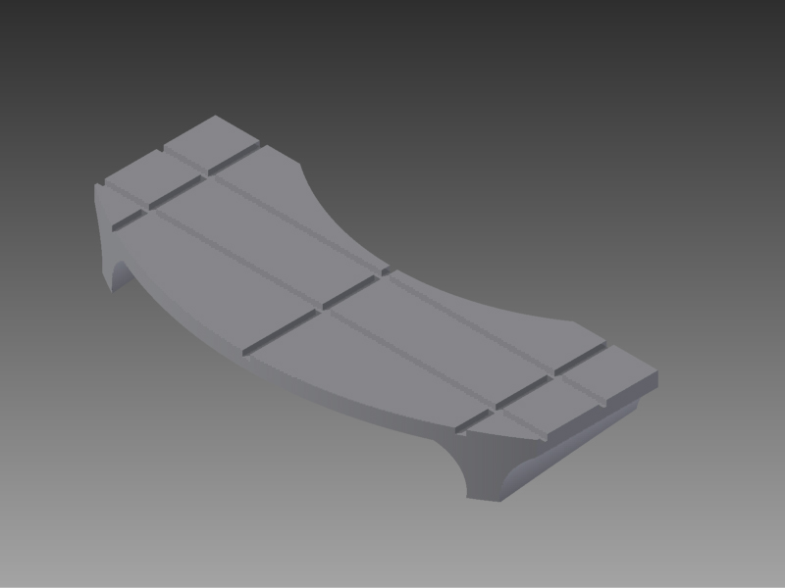
First Attempt:

Slide 6
Feedback:
Coobatis, Christy
Nov 11
To: me
Matt,
I hope you got my dimensions to correct what you have.
My comments are
Pedalboard 1:
Good arc. could use more pass throughs.
Should be angled forward as in the dimensions sent earlier.
Pedalboard 2:
needs more of an arc.
angle looks ok
needs pass throughs

Slide 7
Issues:
Not enough arc toward from end to end
Need more pass thru
Not sitting at three point flat
Not at correct dimensions
Not sitting at correct angle from bottom to top

Slide 8
Client Dimensioning:

Slide 9
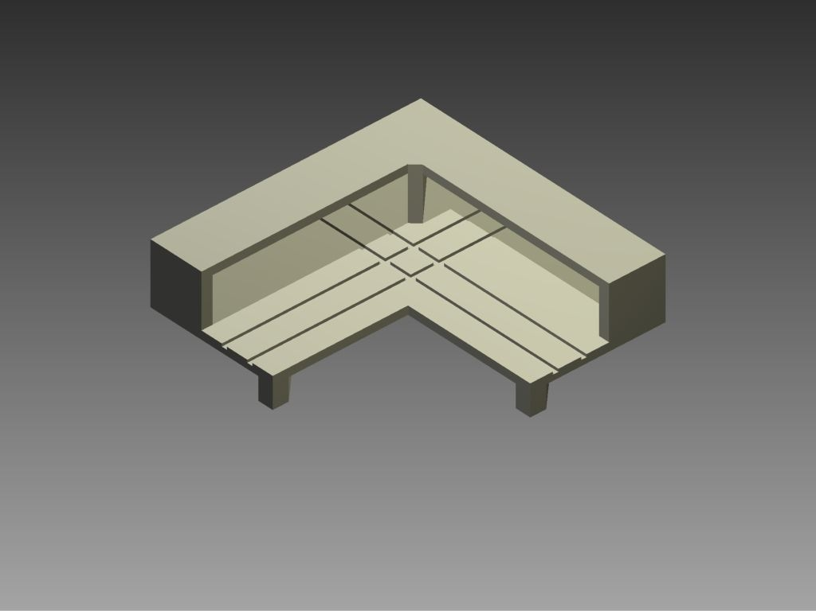
Our Rebuttal:

Slide 11
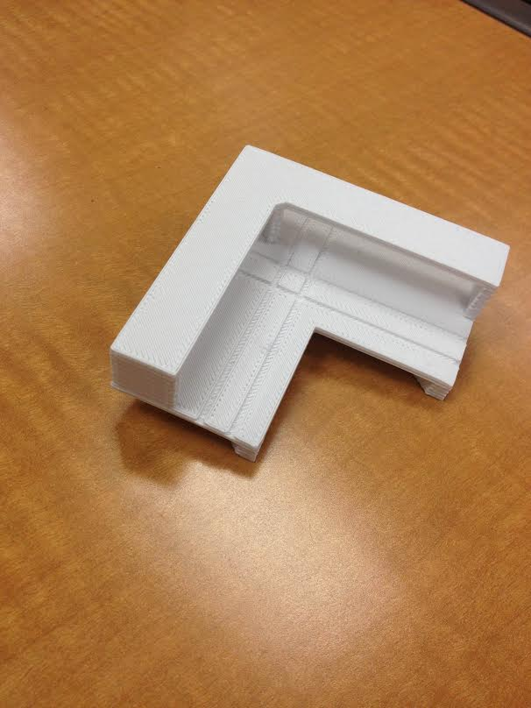
Final Prototype:

Slide 12
What we learned?
Improved 3D Modeling Skills
Client Relations
Teamwork
Prototyping Process
Project Management

