Slide 1
Decorative Clock Partially Manufactured with 3D Printing
Final Individual
Project
DESN204 MiraCosta College
Fall 2013
Stephen Gallant

Slide 2
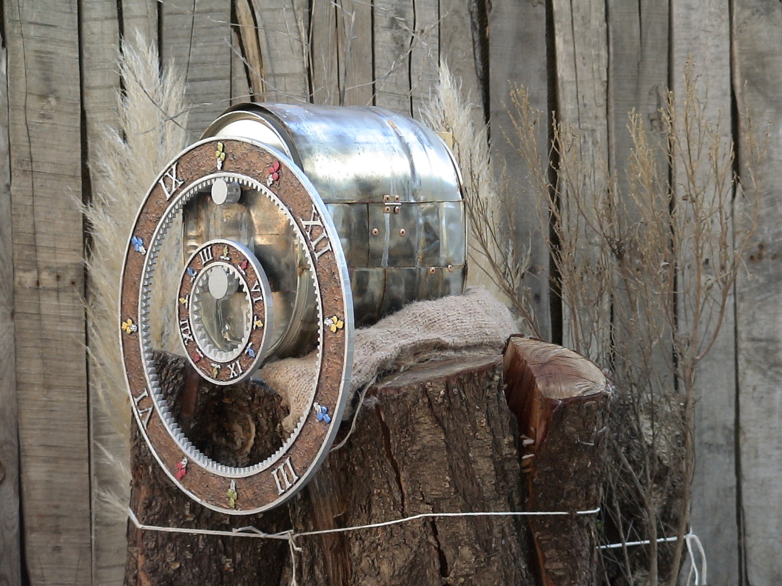
The Clock

Slide 3
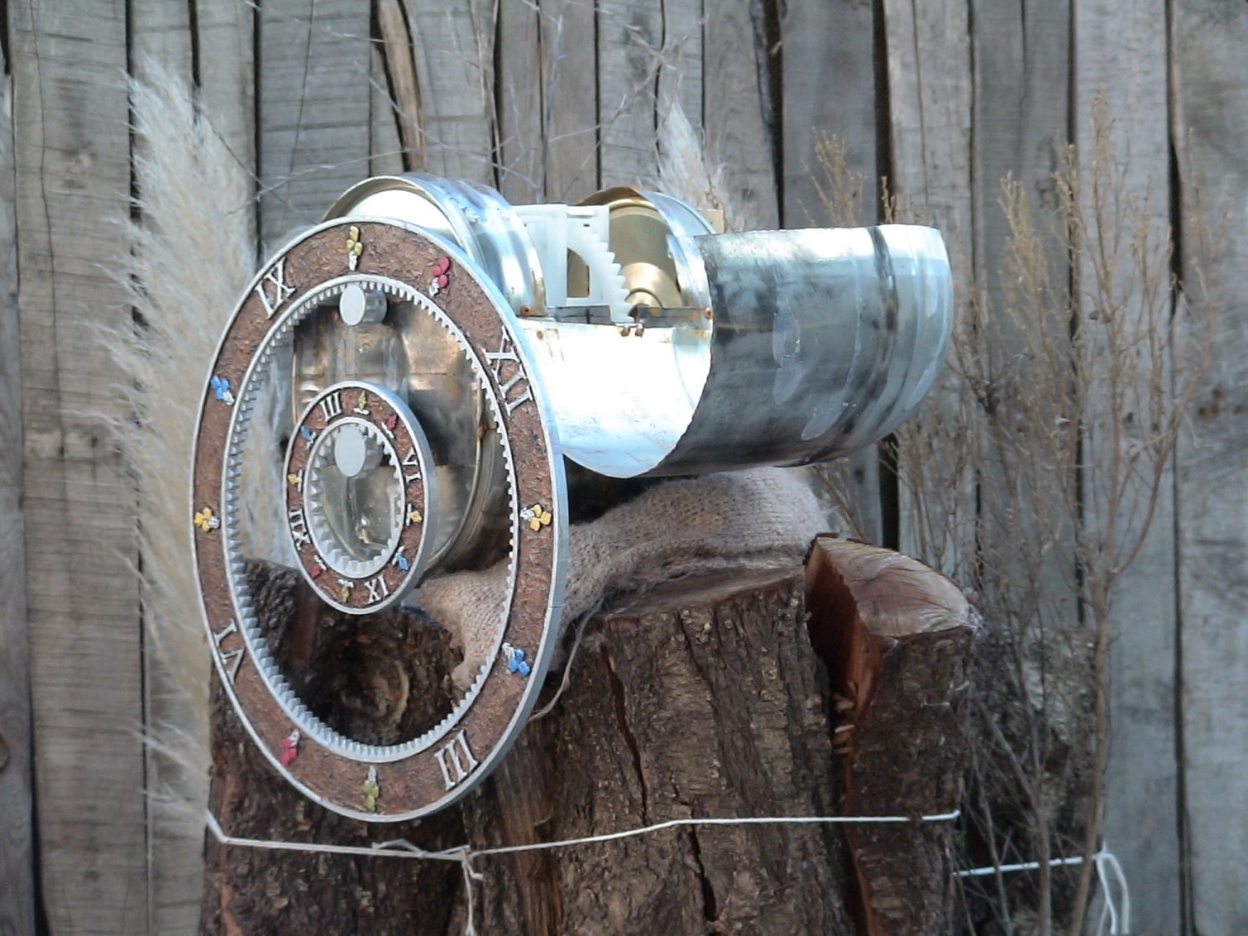
The Clock Inside

Slide 4
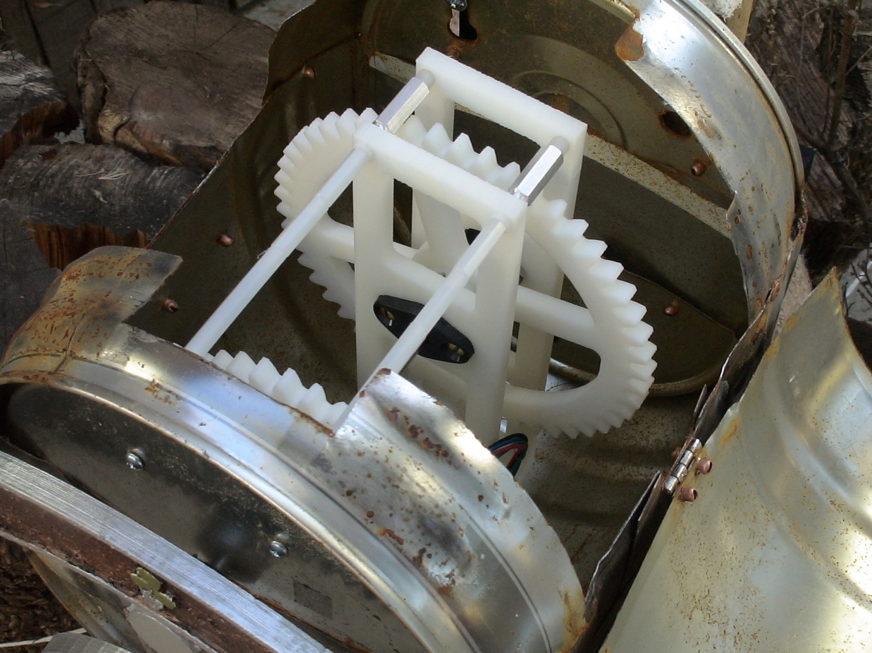

Slide 5
Project Summary
A decorative clock is manufactured using, metal, plastic, and electronics.
Metal
  Hand crafted sheet metal with weathering techniques. Off the shelf fasteners, machined rods, and bearings.
Plastic
  Gears and gear case designed using Solidworks, and 3D printed in Dimension printer.
Electronics
  Circuit designed using Altium, Atmel microcontroller programmed in C using Atmel Studio. Off the shelf motor driver, and stepper motor..

Slide 6
Details
Minute Hand
  With the microcontroller pulsing at 3 1/3 step/s, the motor step/rot of 200, and the gear gains of 10/50, 10/40, and 10/30 we have,
  (3 1/3 step/s)(60 s/min)(1/200 rot/step)(10/50)(10/40)(10/30) = 1/60 rot/min .
  Thus, for one motor rot/min we have 1/60 rot/min for the minute hand.

Slide 7
Details Continued
Hour Hand
  With the microcontroller pulsing at 3 1/3 step/s, the motor step/rot of 200, and the gear gains of 10/50, 10/40, 10/30, and 10/120 we have,
  (3 1/3 step/s)(60 s/min)(1/200 rot/step) (10/50)(10/40)(10/30) )(10/120) = 1/720 rot/min .
  Thus, for one motor rot/min we have 1/720 rot/min for the hour hand. Or (1 rot/min)(60 min/hr) is 60 motor rotations in an hour giving (1/720 rot/min)(60 min/hr) = 1/12 rot/hr for the hour hand.

Slide 8
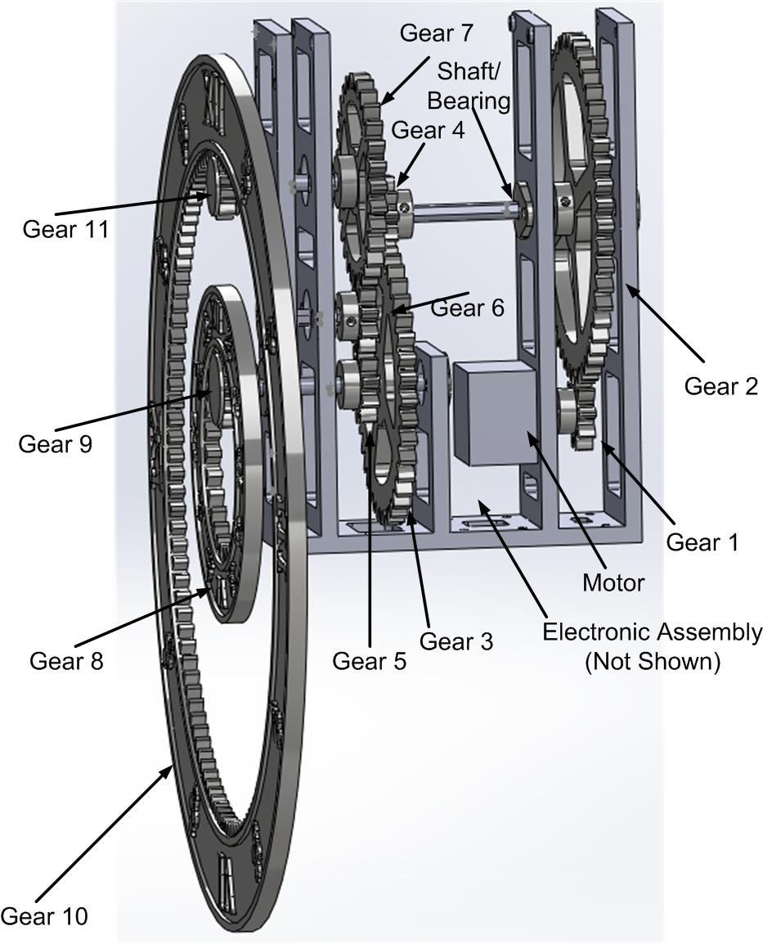
Gear Case and Hands

