Slide 1
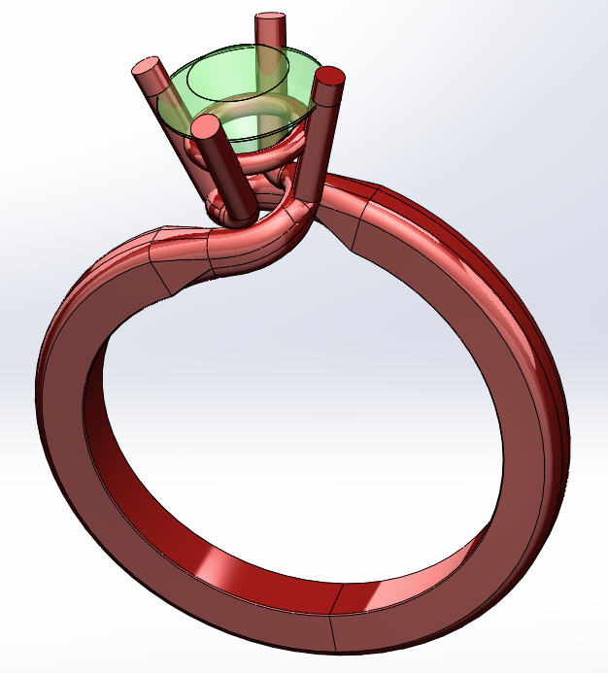
Final individual project
DESN204 MiraCosta College
Fall 2013
Stephen Gallant

Slide 2
Requirements
Status Updates
Status update on Oct 23, 2013 with printed plastics demonstrated.
Supplier Relations
Cordial and productive supplier relationship with Chris Boehm of Boehm 3D Printing.
Image
Screen captures and photographs included in Update Presentation and Final Presentation on Oct 23, 2013 and Dec 2, 2013 respectively.
Web Page
Web page created including Update Presentation, Final Presentation Power Point, and images. Web page structure consists of main directory including the HTML file and web page resource directory, where the resource directory contains the Power Point, images, and presentation files.

Slide 3
Requirements Continued
Power Point
Final Presentation Power Point summarizing the Update Presentation on Dec 2, 2013.
File Organization
The file organization consists of two parts. The design files, part one, consists of files submitted manually via a binder and, part two, the presentation files structured as noted in the previous slide.
Presentation
MS Word Document with detailed project description included in the file organization.
On-time Submission
Submitted on Dec 2, 2013 one week early.

