Slide 1
The Prusa I2 mega
By Taylor Knight

Slide 2
Project goals
Direct drive extruder
Larger build area
Space for second extruder
Faster print speeds

Slide 3
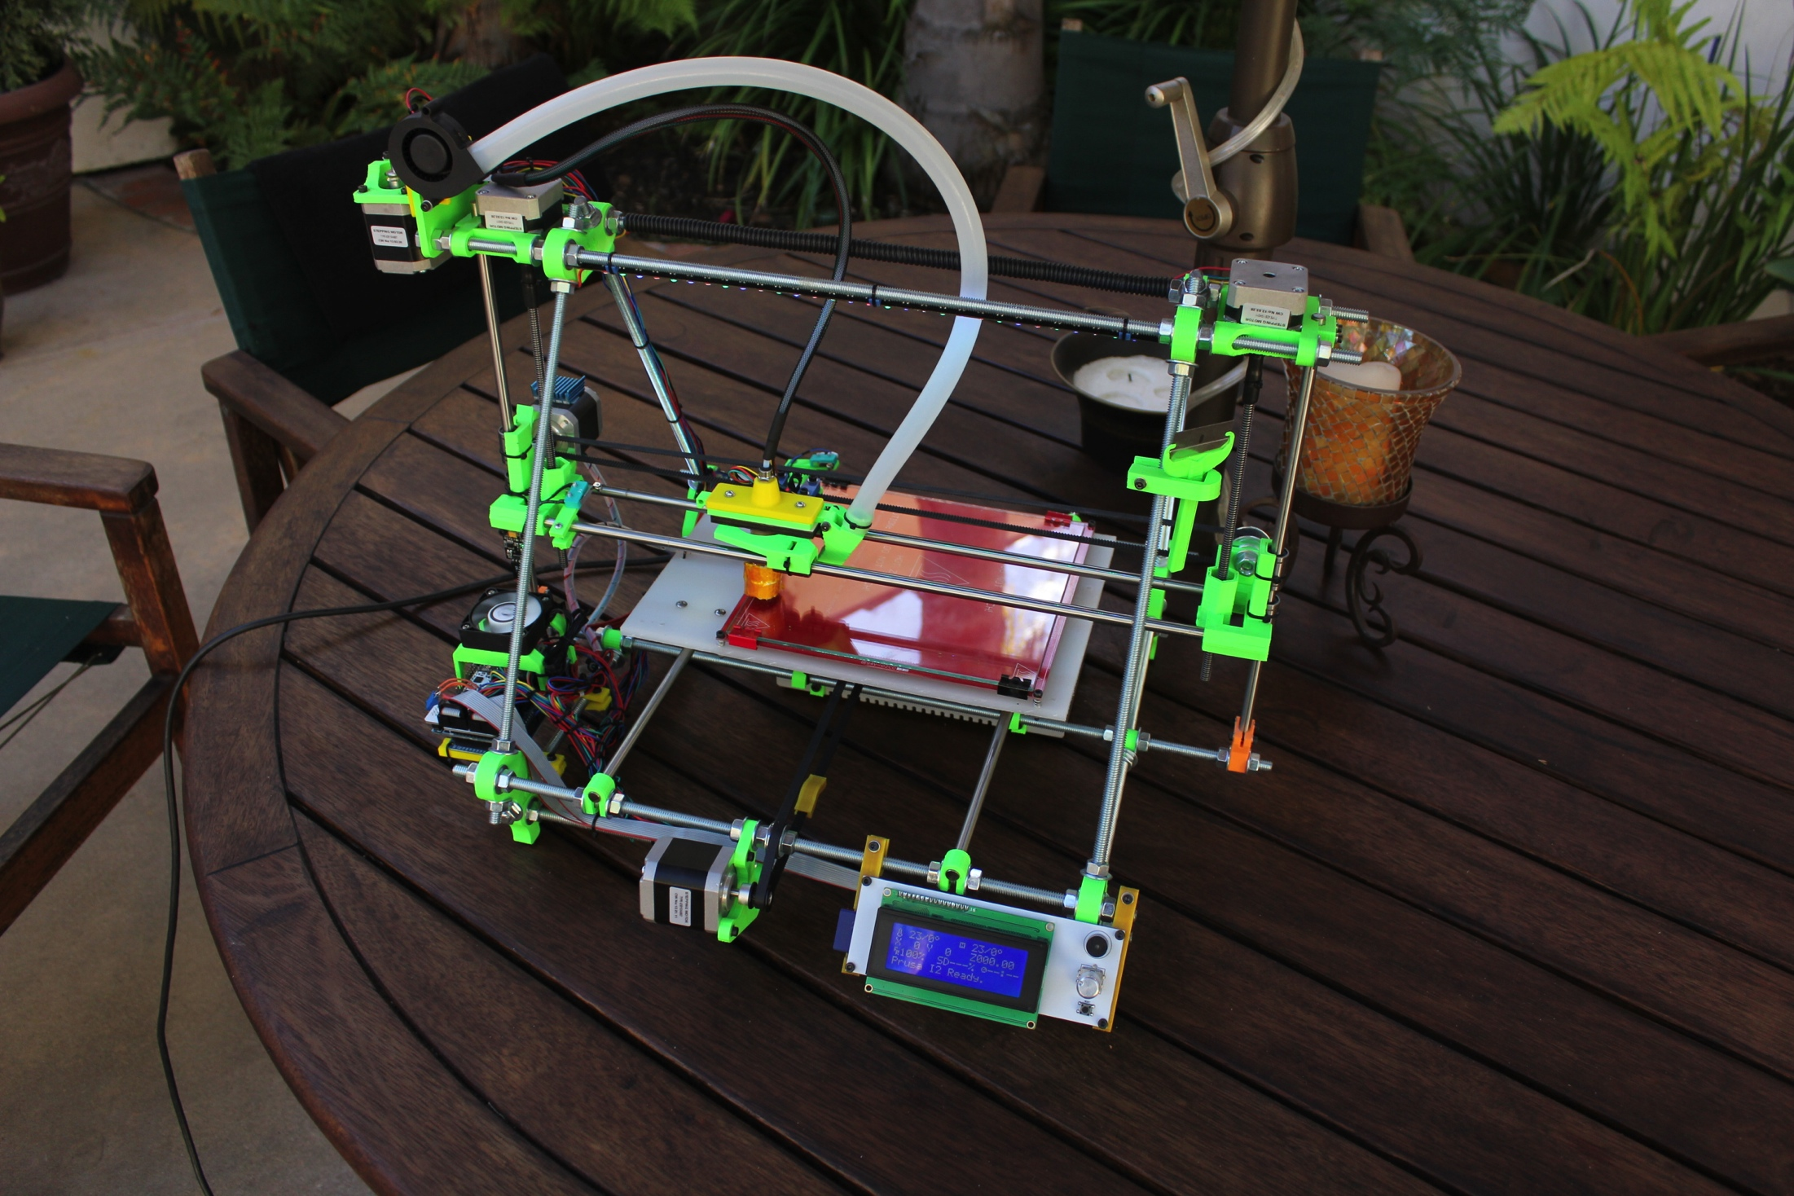
Specs
5in wider
Bowden style extruder
Remote fan
ACME rod
LCD display
GT2 Belts

Slide 4
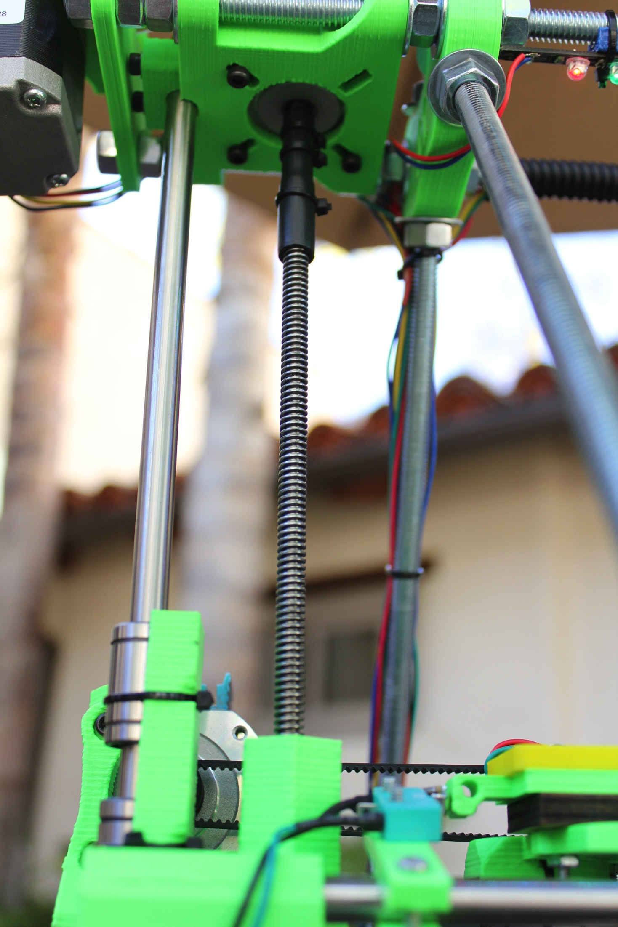
Acme threaded Rod
ACME threaded rod used for lead screw
More precise than standard threaded rod

Slide 5
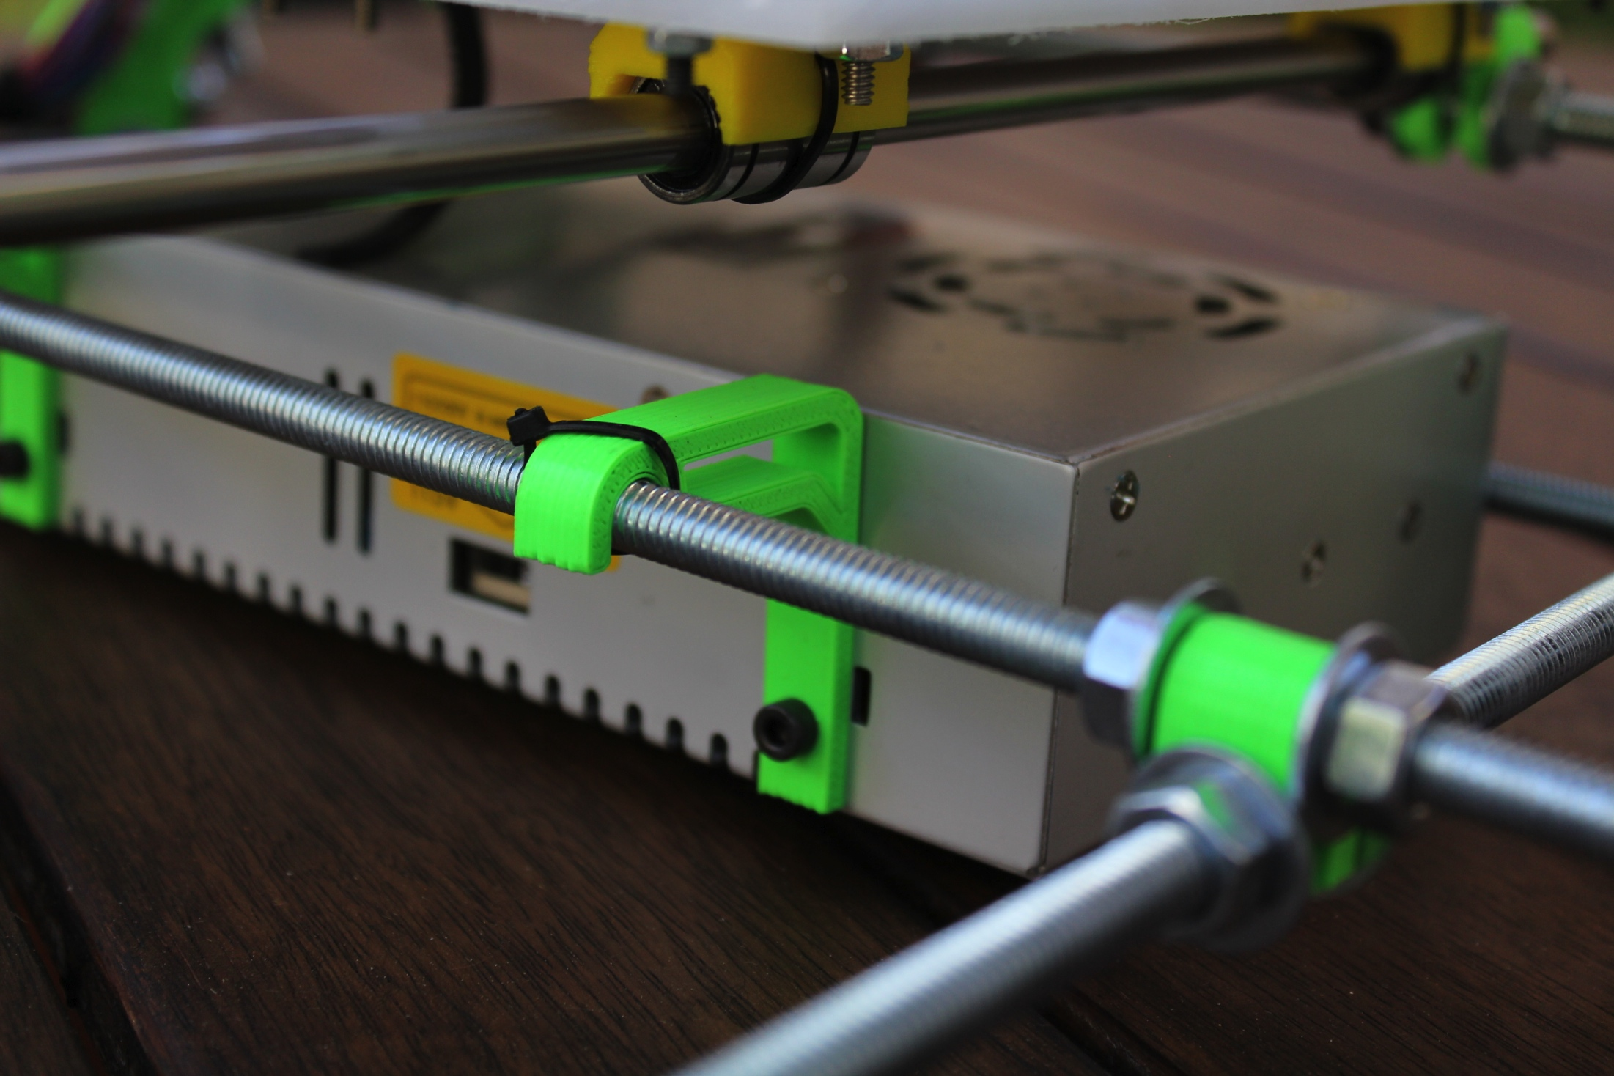
Power supply Brackets
Holds the power supply
under the heat bed

Slide 6
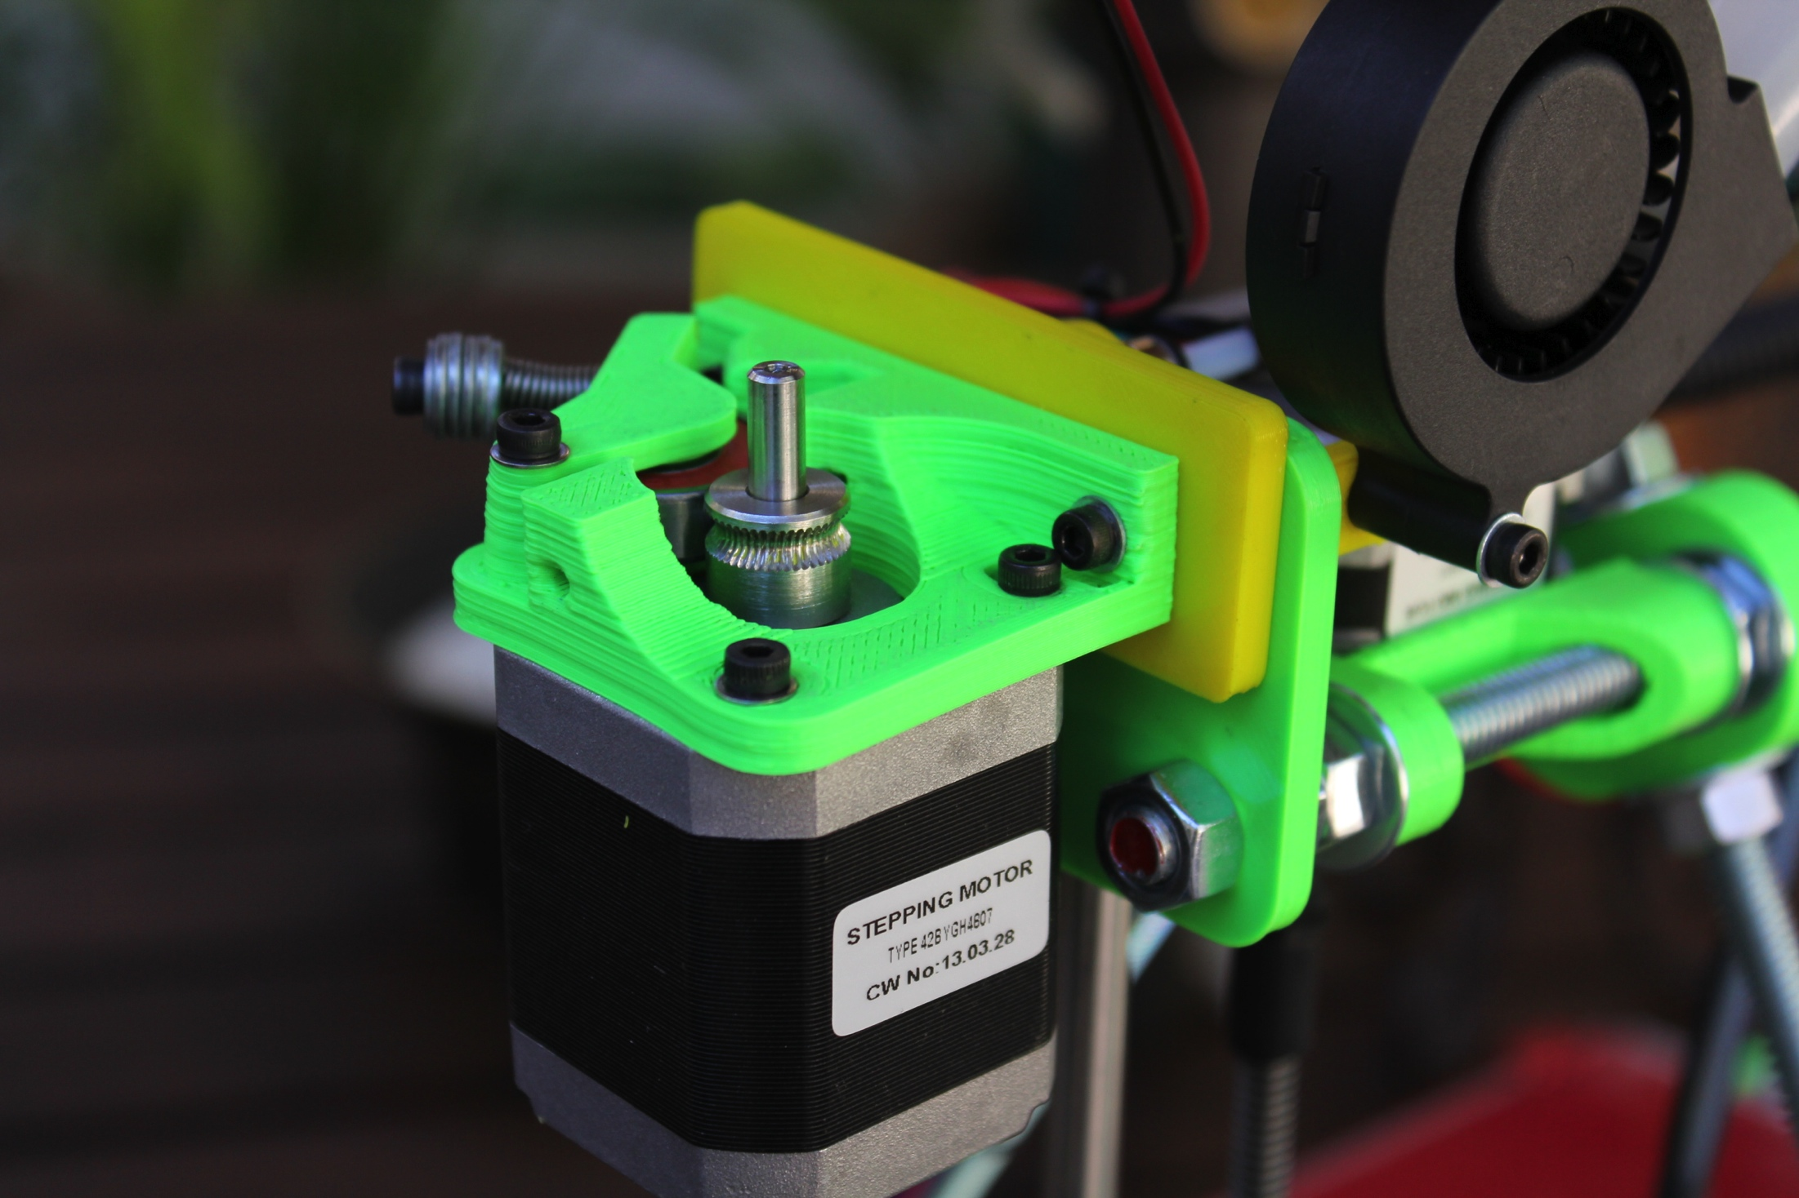
Bowden style Extruder
Removes moving mass
Looks cool
Faster prints
Direct drive

Slide 7
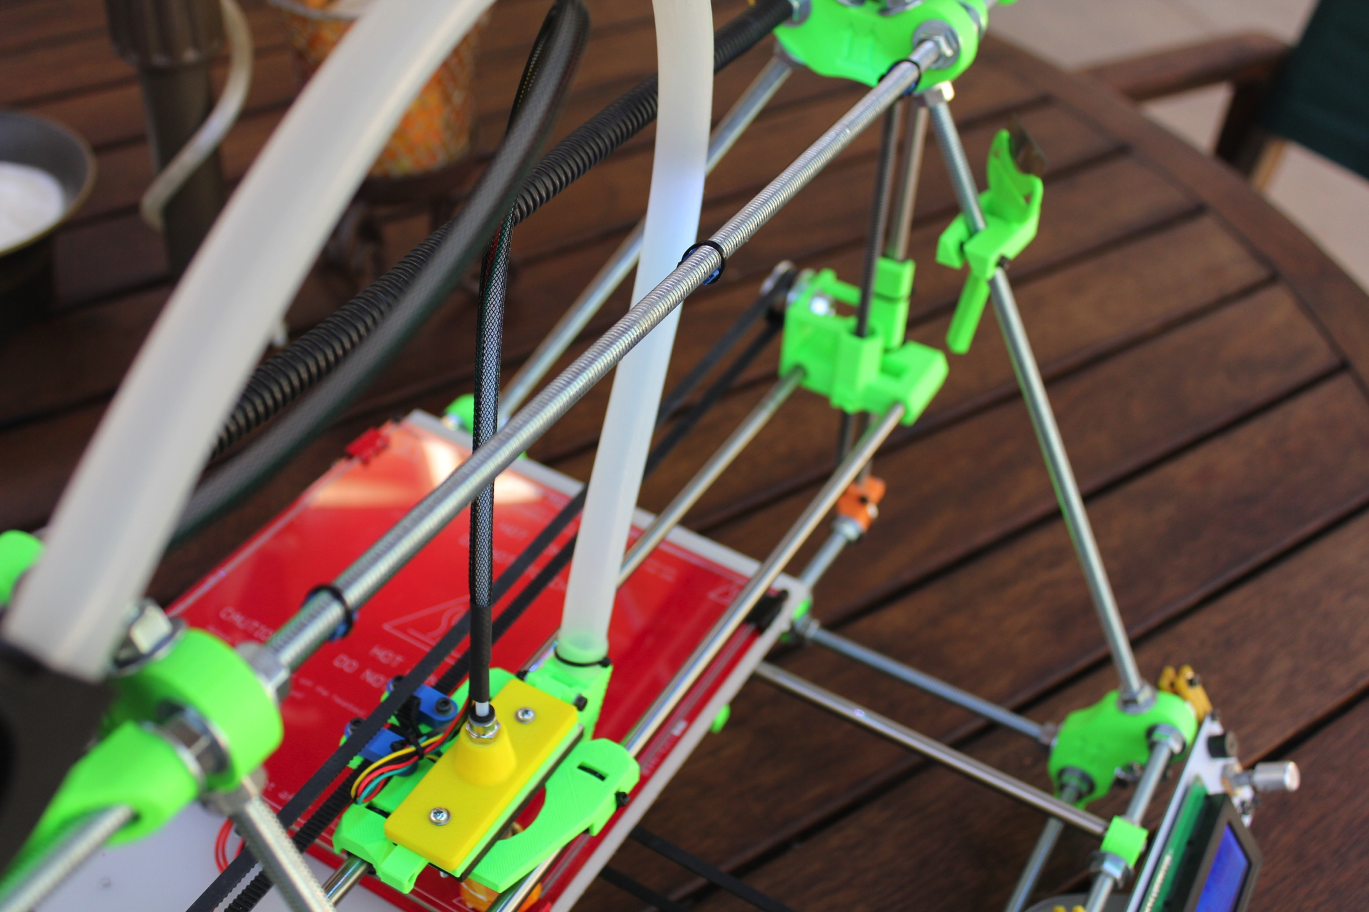
Remote fan
Takes in cold air
Still testing…..

Slide 8
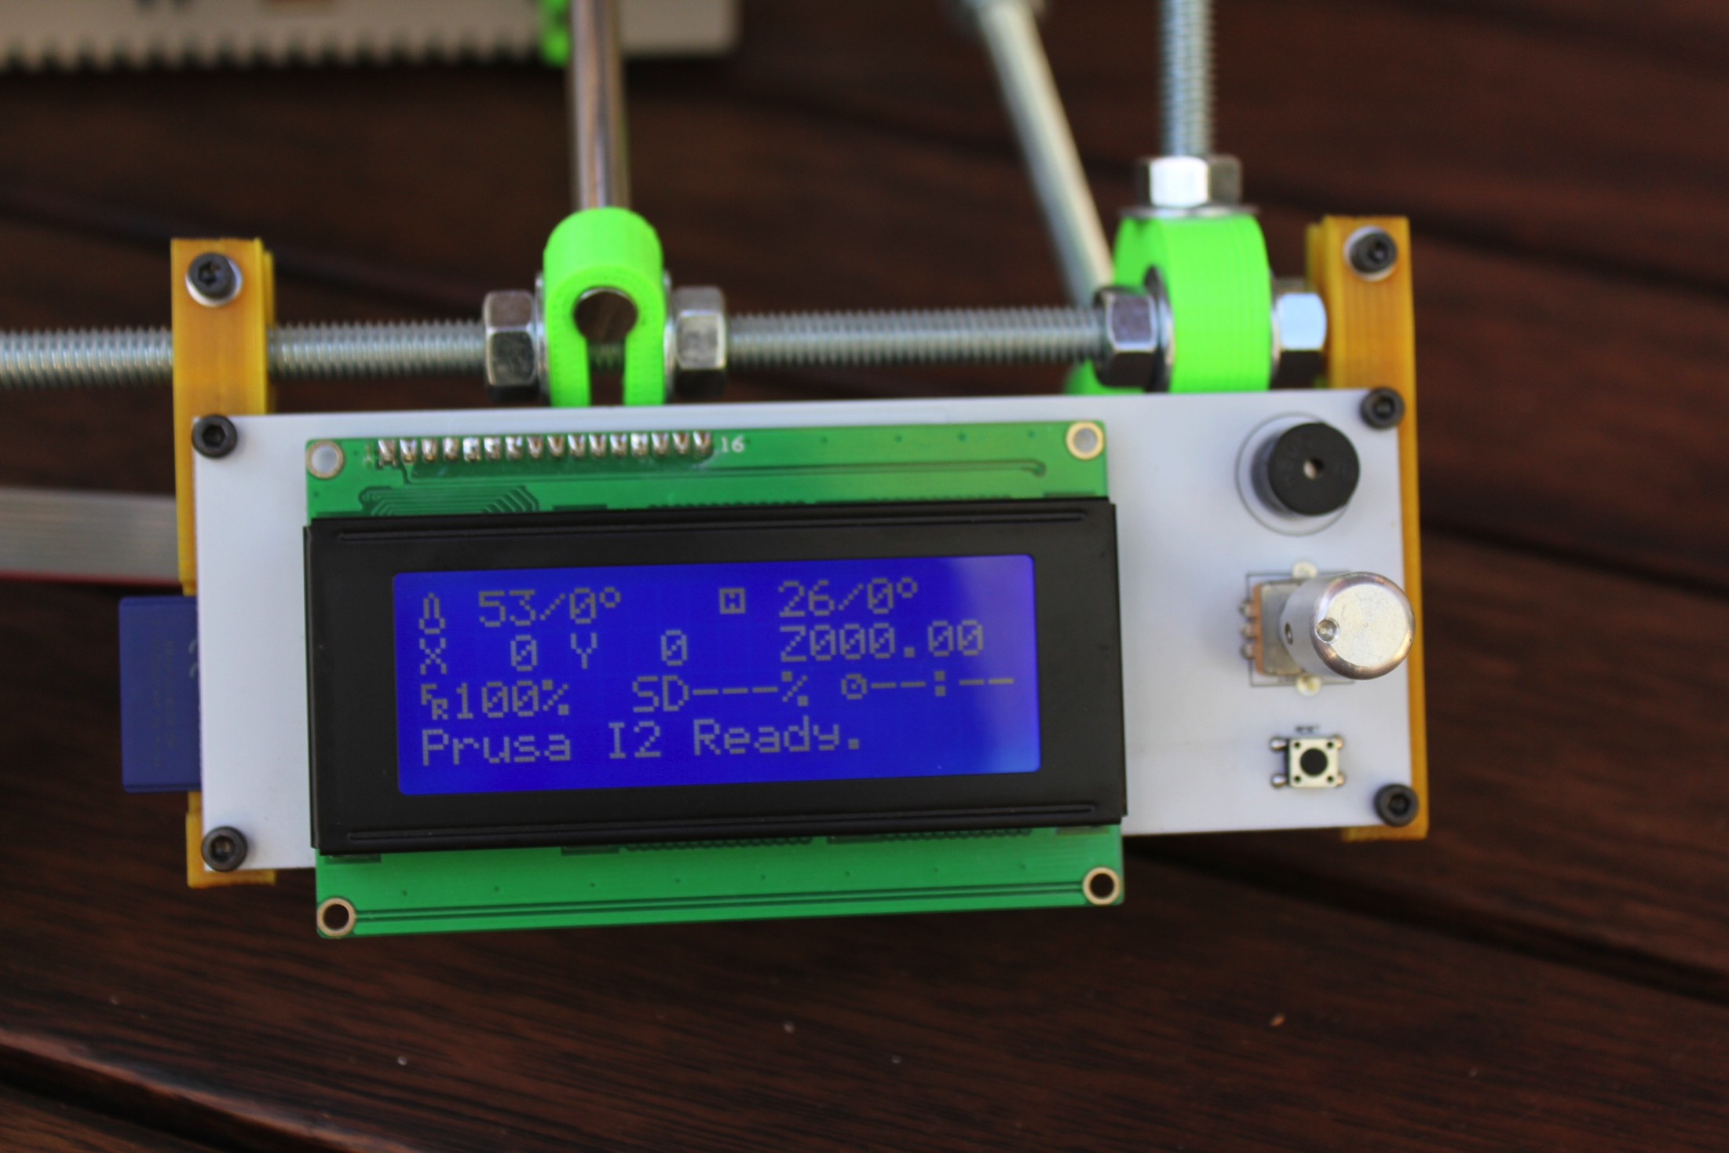
Lcd Display
Print without computer
Shows what is going on

Slide 9
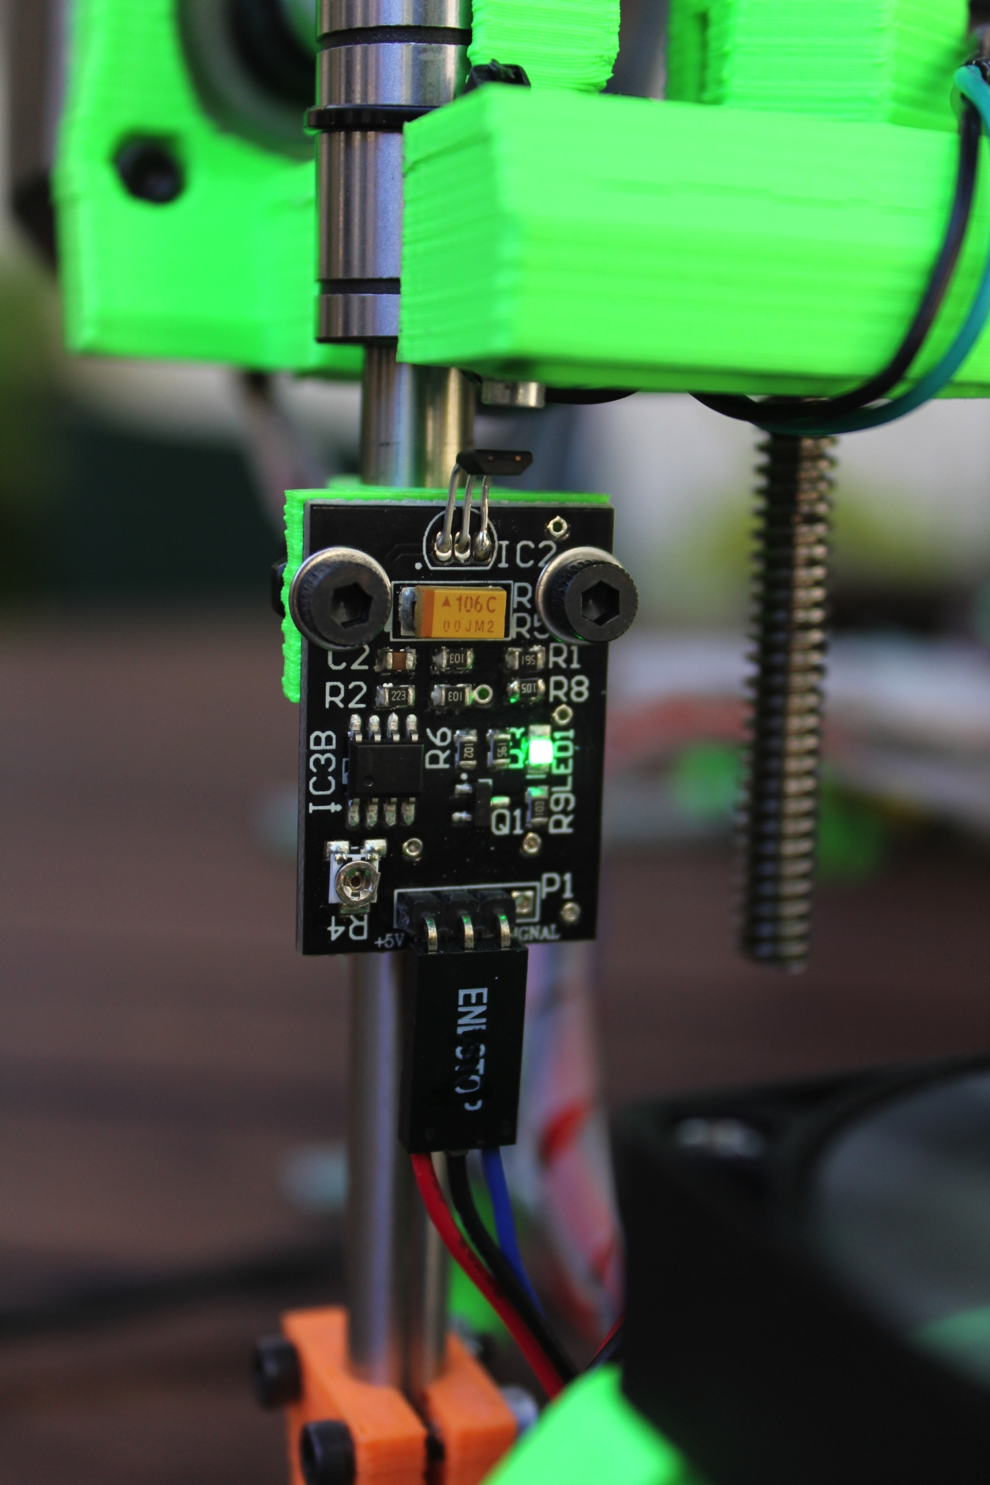
Hall Effect End stop
Hall effect end stop for z axis
Simple precise z height adjustment

Slide 10
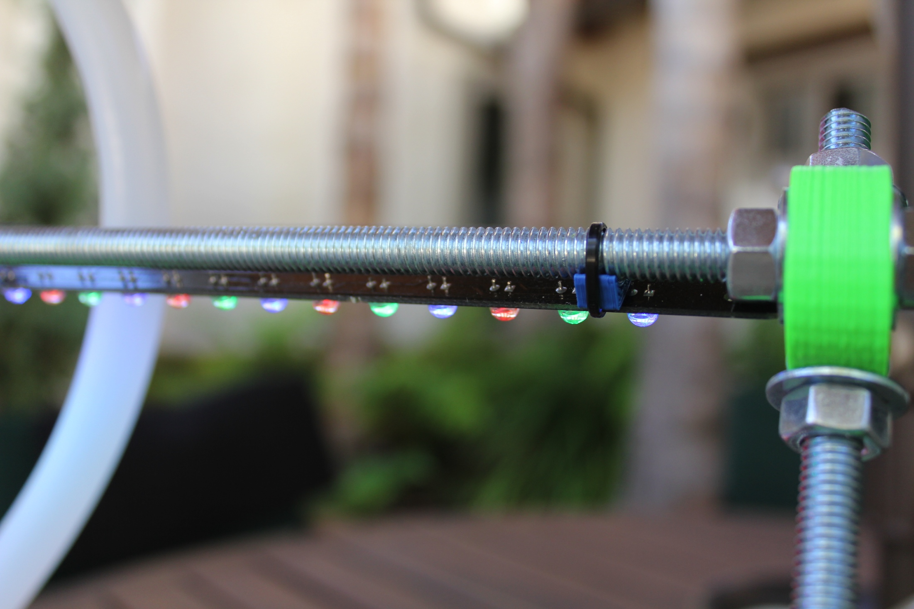
LED BAR MOUNT
Simple and works

Slide 11
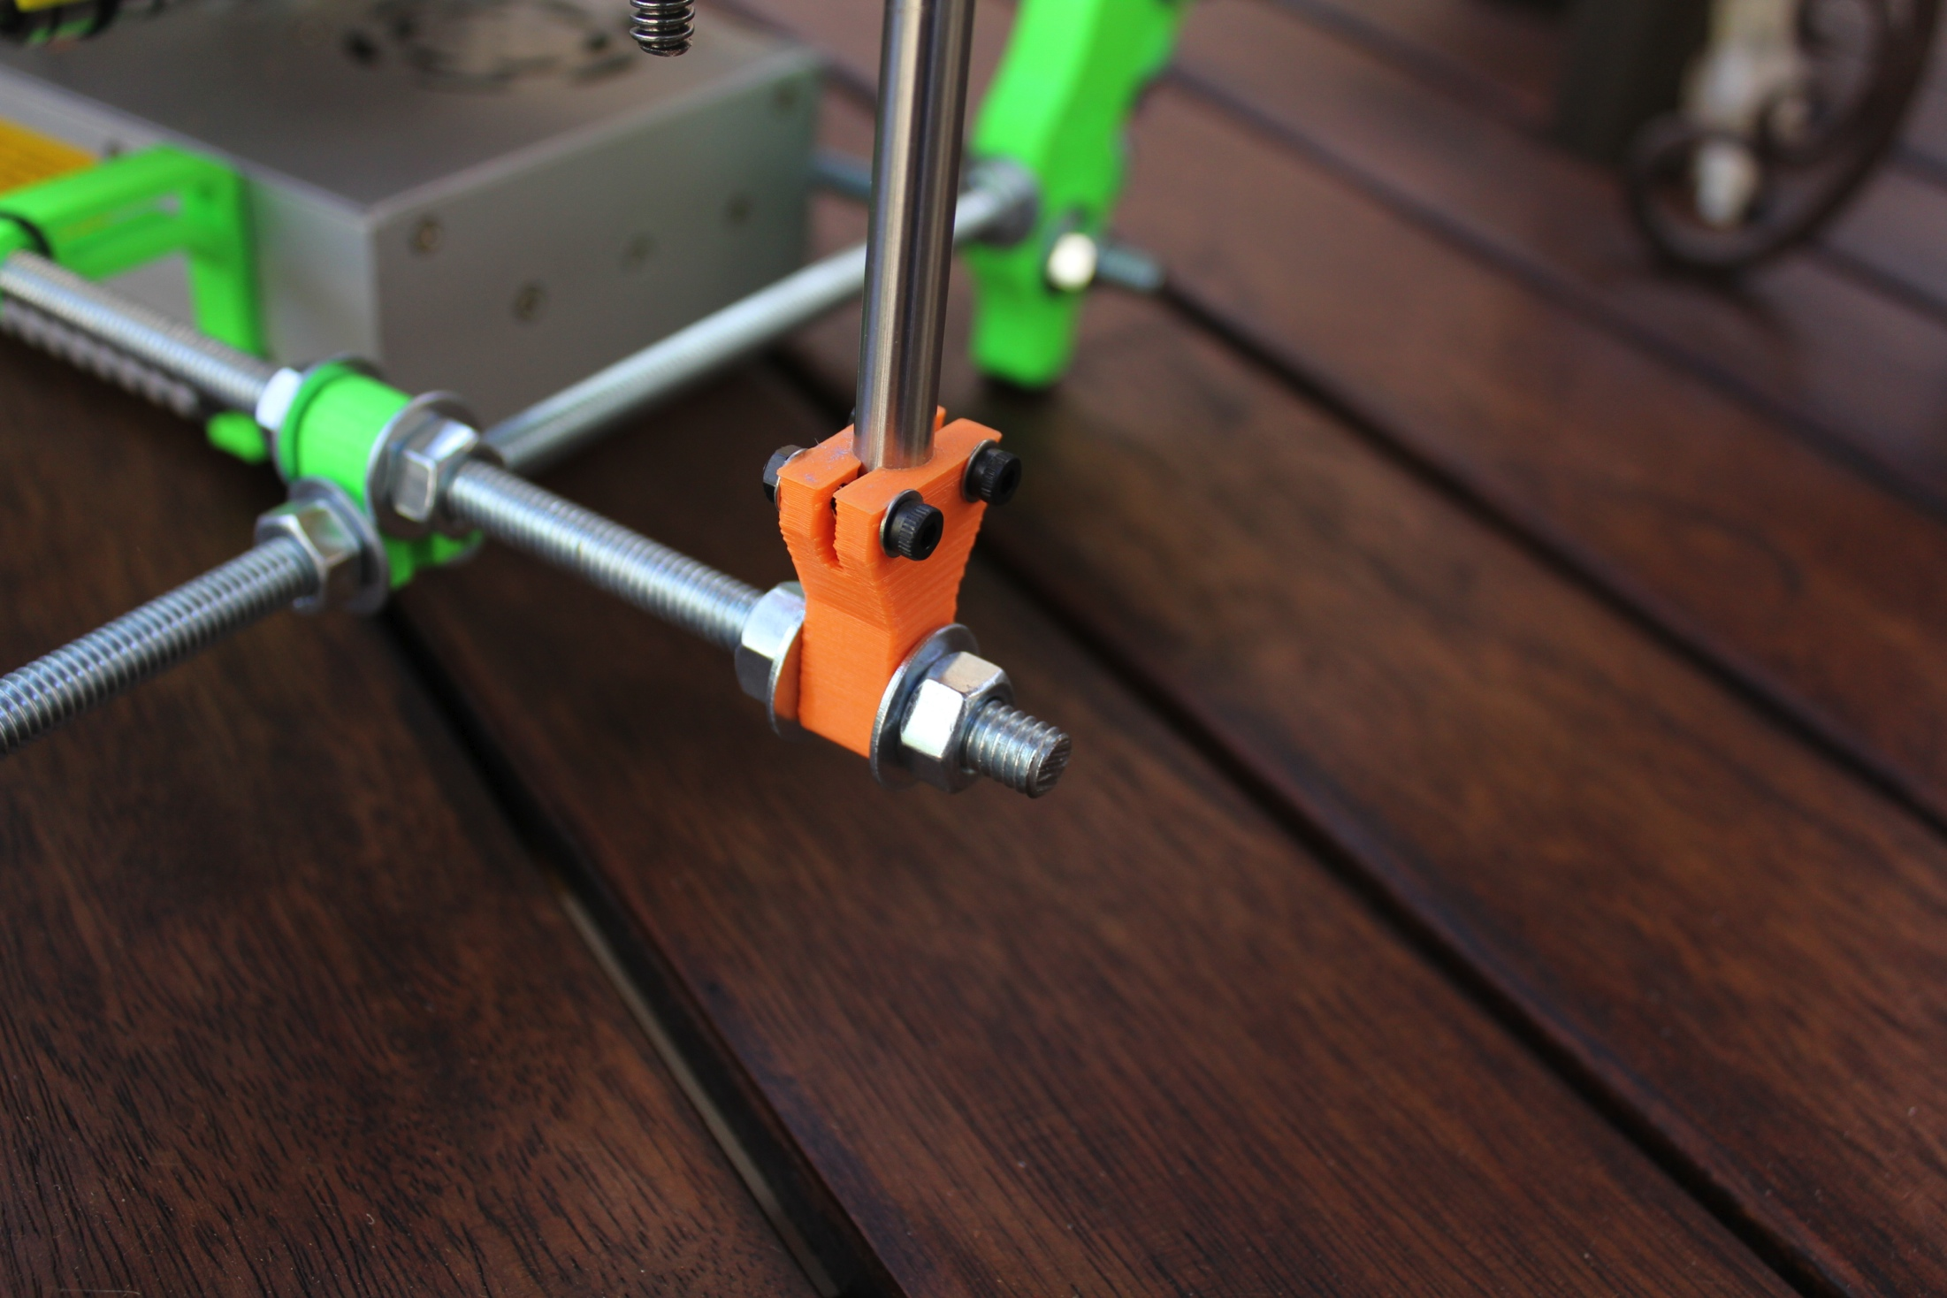
Better Z-rod clamp
Wanted a better way clamp the Z smooth rod

Slide 12
what is still needed
Power Switch
Change some of the menus on the LCD
Second Extruder for support material
Set up web server so it can be controlled from internet

Slide 13
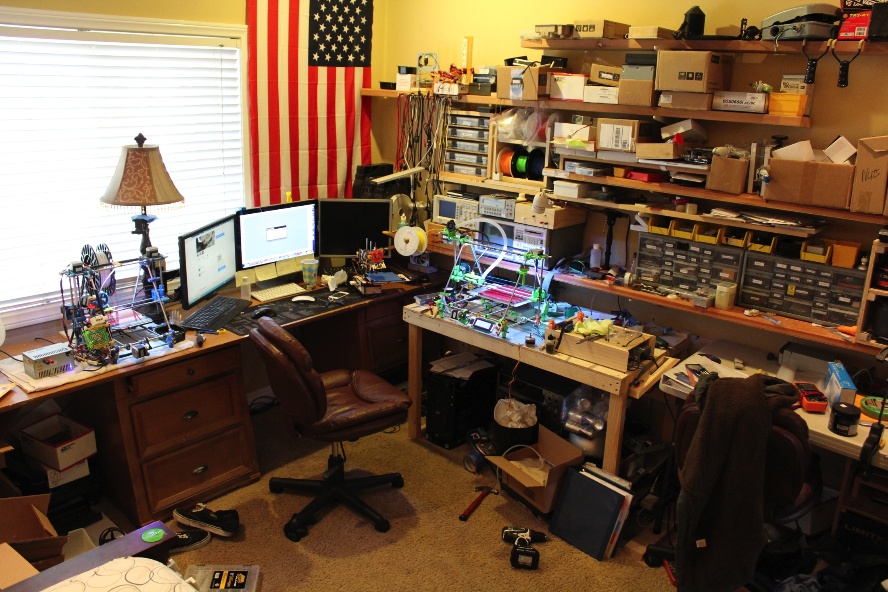
Printed and assembled in the Taylor knight lab

