Slide 1
Ukulele
An attempt at designing, printing, and assembling a fully functioning soprano ukulele.
Matt Wiedemeier
DESN 204

Slide 2
Sharpening my Axe

Slide 3
Suggestions

Slide 4
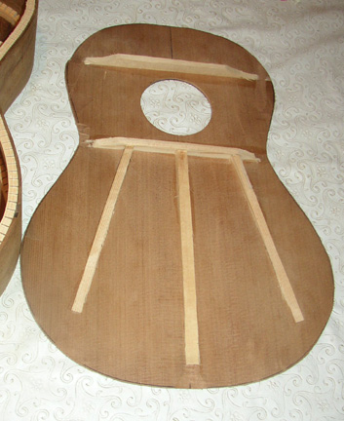
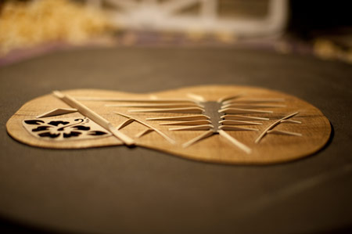
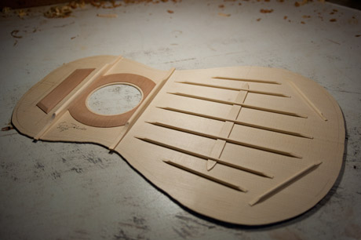
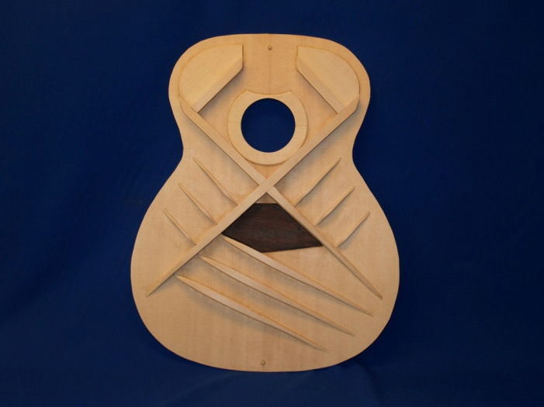
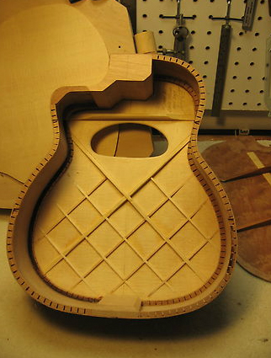
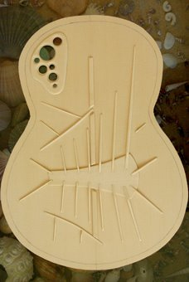
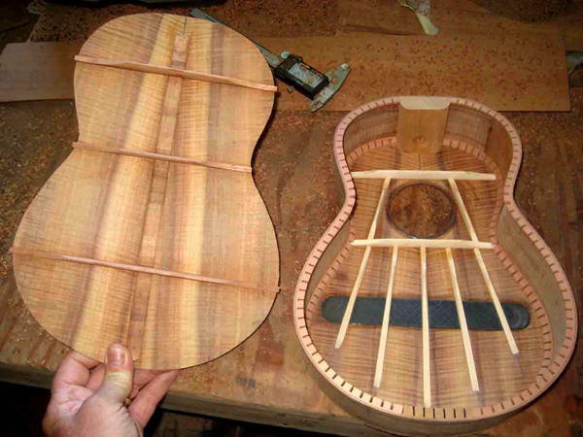
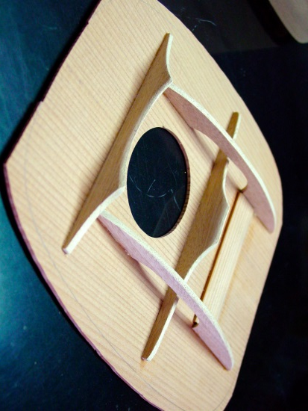
Soundboard Bracing

Slide 5
Soundboard

Slide 6
Bracing

Slide 7
Body

Slide 8
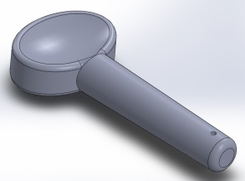
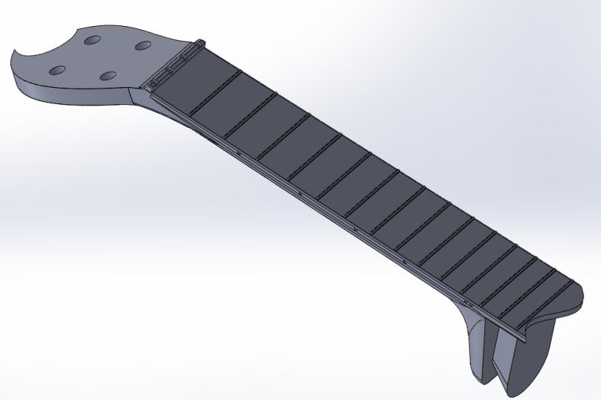
Neck

Slide 9
Assembly

Slide 10
Assembled

Slide 11
Brought to you by:

