Slide 1
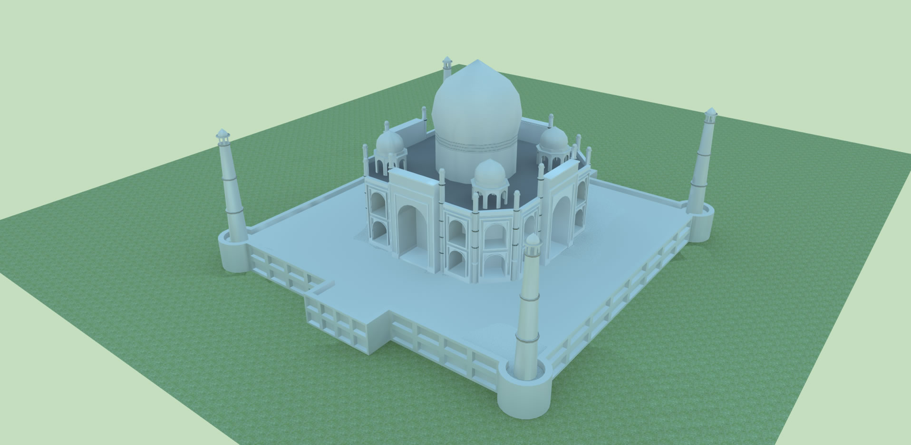
TAJ MAHAL
By antonio palomino

Slide 2
Digital Image

Slide 3
Brief History
The Taj Mahal is a white marble mausoleum located in Agra, Uttar Pradesh, India.
It was built by Mughal emperor Shah Jahan in memory of his third wife, Mumtaz Mahal.
Considered one of the seven wonders of the world.
Taj Mahal is regarded by many as the finest example of Mughal architecture, a style that combines elements from Islamic, Persian, Ottoman Turkish and Indian architectural styles

Slide 4
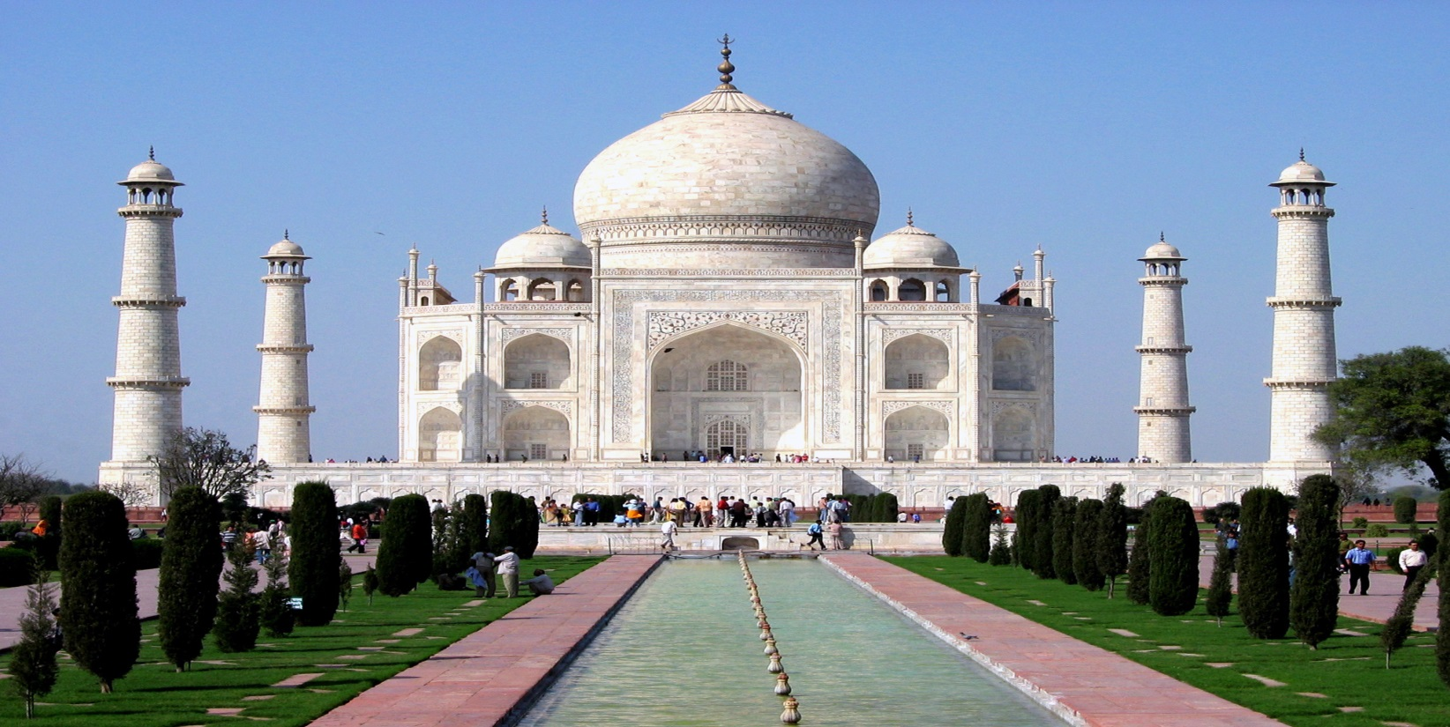
Taj Mahal
The construction began around 1632 and was completed around 1653, employing thousands of artisans and craftsmen.

Slide 5
Taj Mahal

Slide 6
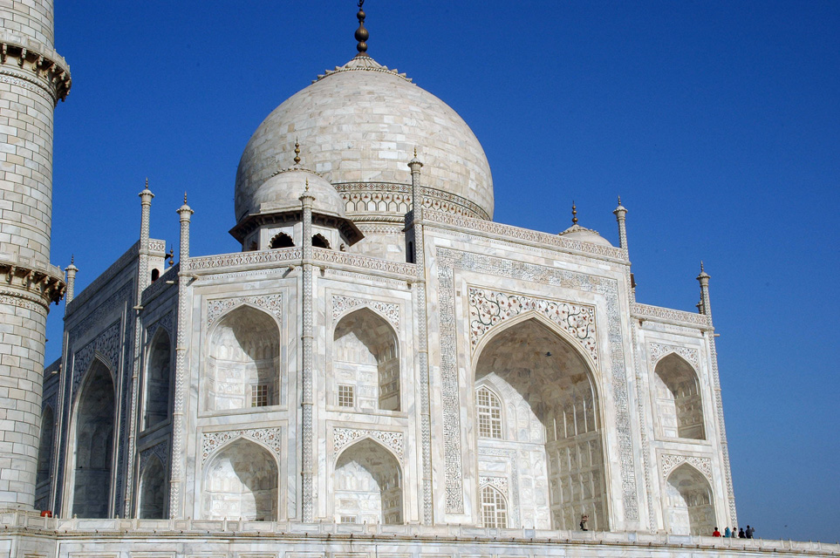
Taj Mahal Tomb
The tomb is the central focus of the entire complex of the Taj Mahal. This large, white marble structure stands on a square plinth and consists of a symmetrical building with an iwan (an arch-shaped doorway) topped by a large dome and finial. Like most Mughal tombs, the basic elements are Persian in origin.
The base structure is essentially a large, multi-chambered cube with chamfered corners, forming an unequal octagon that is approximately 55 metres (180 ft) on each of the four long sides

Slide 7
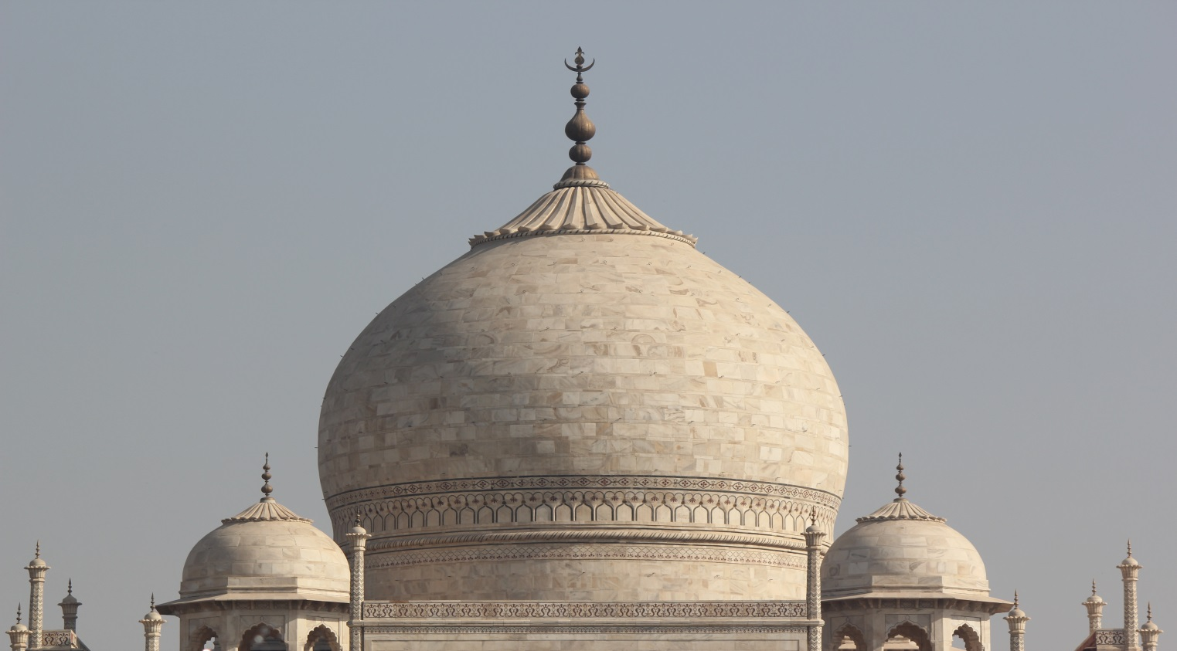
Dome
The marble dome that surmounts the tomb is the most spectacular feature. Its height of around 35 metres (115 ft) is about the same as the length of the base, and is accentuated as it sits on a cylindrical "drum" which is roughly 7 metres (23 ft) high. Because of its shape, the dome is often called an onion dome.

Slide 8
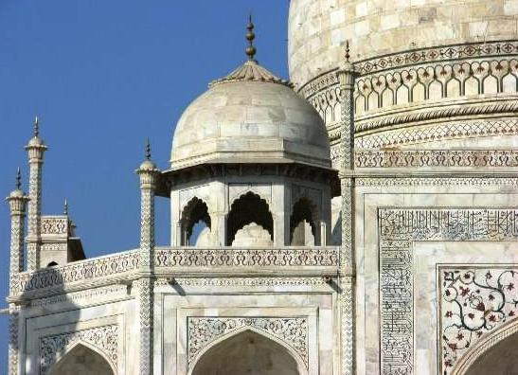
Chattri
The shape of the dome is emphasised by four smaller domed chattris (kiosks) placed at its corners, which replicate the onion shape of the main dome.

Slide 9
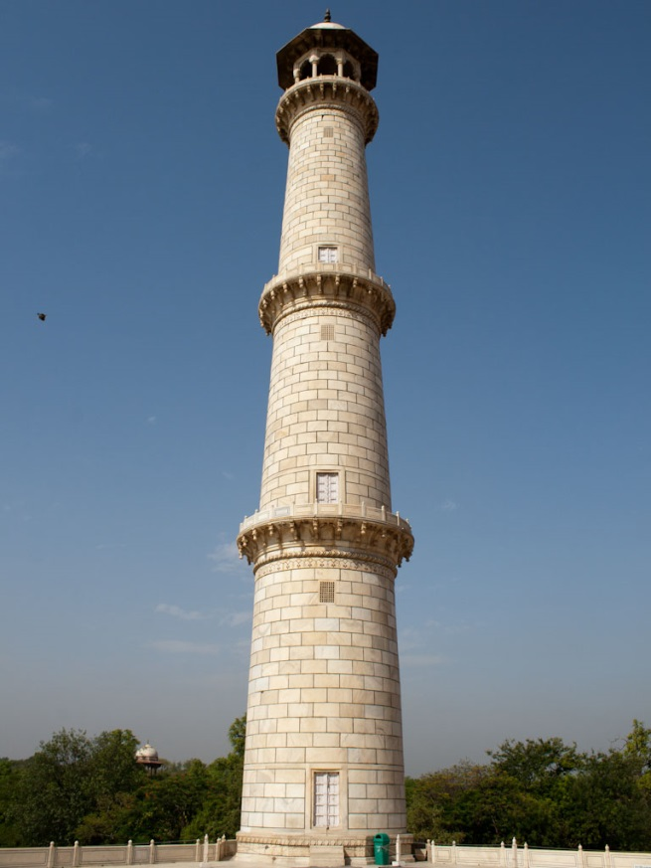
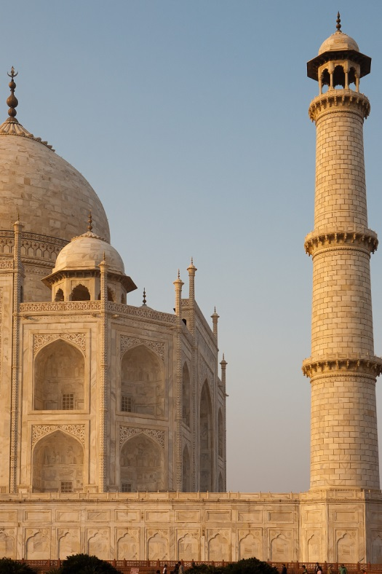
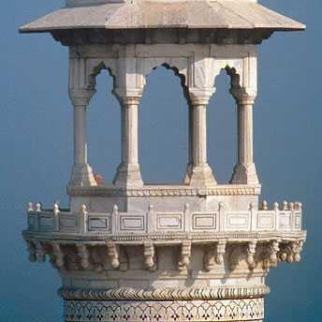
Minarets
The minarets, which are each more than 40 metres (130 ft) tall, display the designer's penchant for symmetry. They were designed as working minarets—a traditional element of mosques, used by the muezzin to call the Islamic faithful to prayer

Slide 10
SketchUp Model

Slide 11
Object

Slide 12
Dimension

Slide 13
UP!

Slide 14
UP!

Slide 15
Zcorp

Slide 16
Taj Mahal
The Taj Mahal is widely recognized as "the jewel of Muslim art in India and one of the universally admired masterpieces of the world's heritage"

