Slide 1
Career Pathways Priorities & Labor Market Opportunities
MiraCosta College
Early College Credit Workshop
January 11, 2018

Slide 2

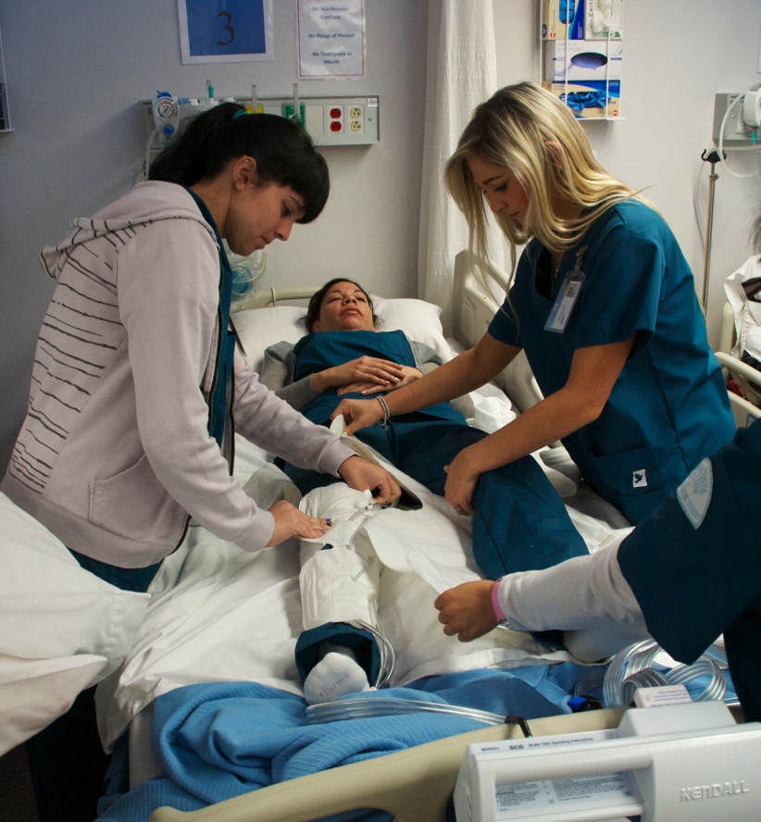
Career Pathways

Slide 3
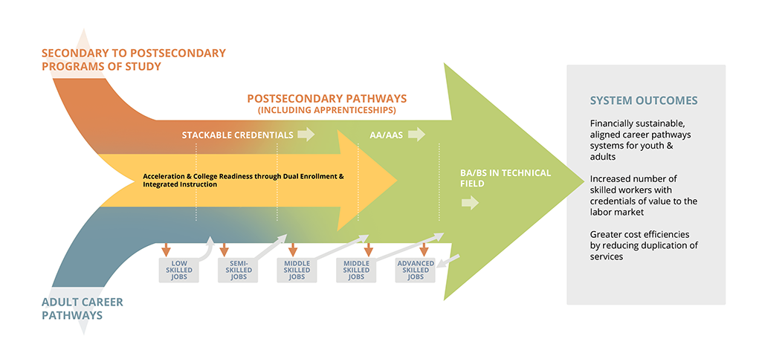
Integrated Career Pathways Model
Source: Perkins Planning Resource Network

Slide 4
Strong Workforce
Goal: to increase social mobility and fuel our regional economy with highly skilled workers (“Strong Workforce”)
What: “more and better” Career Education (or CTE)
    “More” students enrolled in programs leading to high-demand, high-wage jobs
    “Better”: more students completing or transferring, getting employed or improving earnings.
How? Target those CE programs that address training gaps in the region and lead to living wages.
Notes:
To develop more workforce opportunity and lift low-wage workers into living-wage jobs

Slide 5
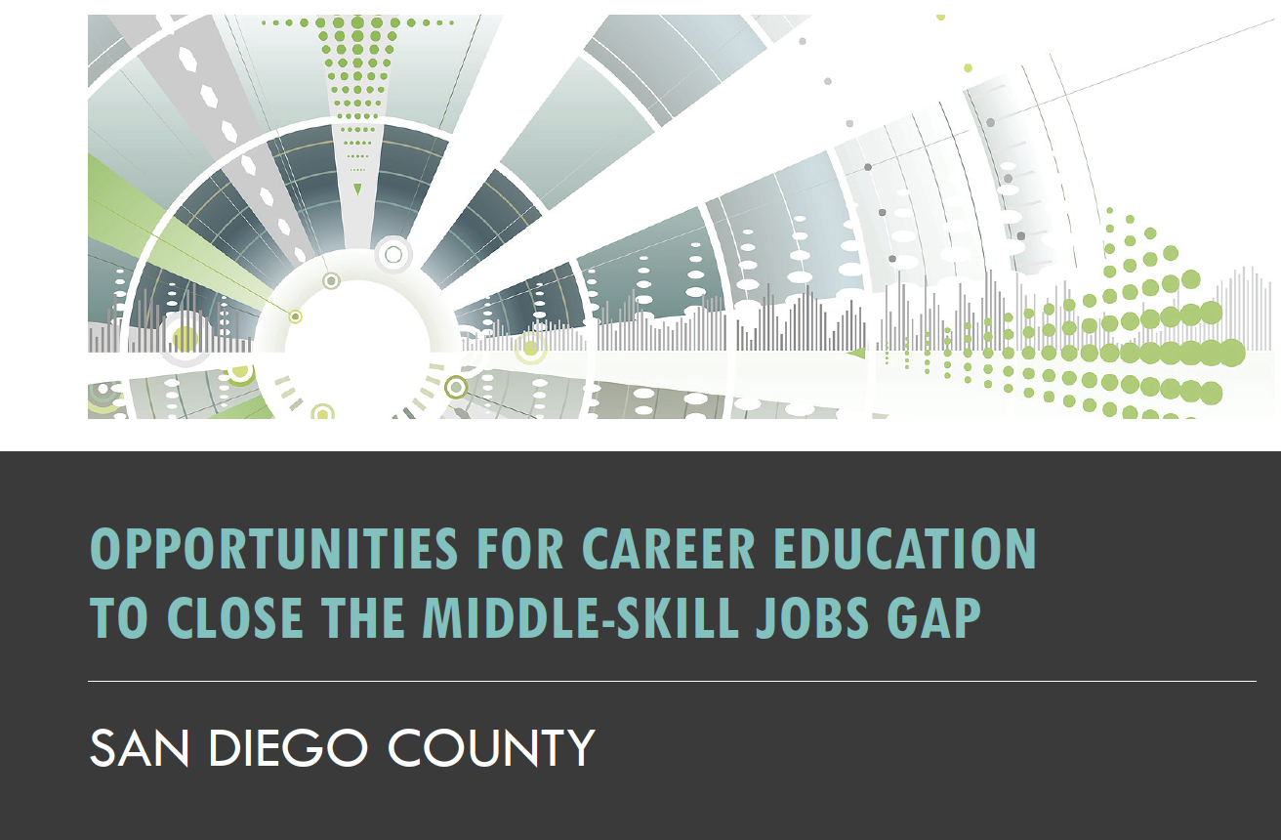
Labor Market Opportunities

Slide 6
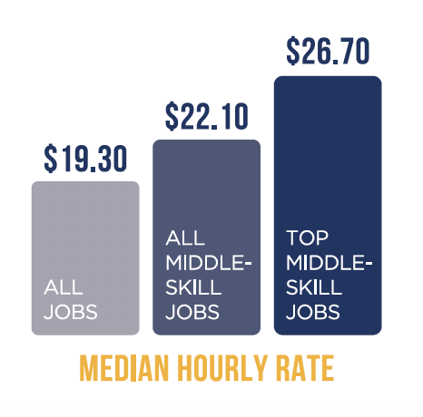
Jobs in San Diego County, 2017
1.5M Jobs
Source: Emsi. Job classifications defined by COE
Notes:
Military and unclassified jobs were removed
This is based on employer responses/surveys as to how many jobs there are in the market

Slide 7
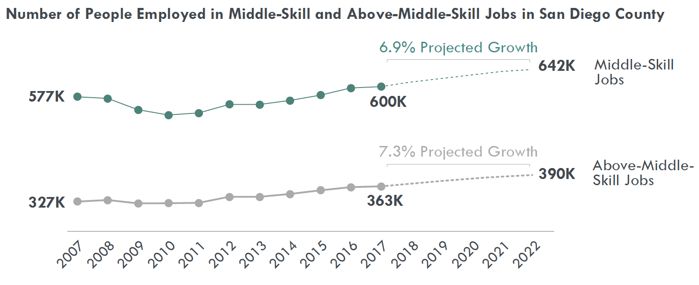
Above-middle-skill vs. middle-skill job market
Source: Emsi. Graph by COE

Slide 8
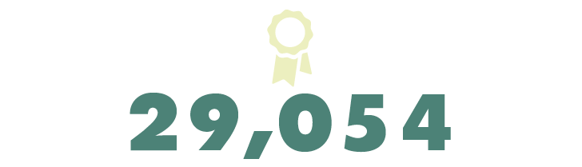
45,457
16,403
Demand
Supply
Gap

Slide 9
Priority & Emerging Sectors
Advanced Manufacturing
Advanced Transportation & Logistics
Business & Entrepreneurship
Global Trade
Health Care
ICT & Digital Media
Life Sciences & Biotechnology
Agriculture, Water & Environmental Technologies
Energy, Construction & Utilities

Slide 10
Key Takeaways
Emphasize the importance of “Career Education” and the middle-skill job market
Expose students early to in-demand jobs and the Priority & Emerging Sectors
Help students navigate program offerings in the region and online

Slide 11
MiraCosta’s Career Pathways Priorities

Slide 12
MiraCosta Strong Workforce Goals
Grow enrollment and persistence in Career Education (CE)
Help students complete degrees & certificates in a timely manner
Increase transfer rates for Career Education students
Improve programs & services so students are more prepared for work
Connect students to high-wage high-demand careers
Improve outcomes for underserved populations in Career Education
Notes:
To develop more workforce opportunity and lift low-wage workers into living-wage jobs

Slide 13
Create Pathways To High-demand High-wage Careers
Cybersecurity
Biotechnology & Biomanufacturing
Media Arts & Technologies (graphic design, web design, video production)
Engineering Technology
Computer Studies & Information Technology
Accounting
Business & Entrepreneurship
Sustainable Agriculture

Slide 14
Navigating Program Offerings with Career in Mind

Slide 15
Exposing students to middle-skill careers and CE programs
In-Demand Program Videos:
  Cybersecurity
  Biomanufacturing
  Architectural & Engineering Design
  Horticulture & Sustainable Agriculture
Newspaper articles
Comprehensive Marketing Campaign
  Emphasize hands-on education
109,000 views

Slide 16


Slide 17
Connecting Students to In-Demand Sectors
Provide work-based learning opportunities
  Internships
  Competitions (National Cyber League)
  Resume workshops
Connecting learning to industry certifications
Providing opportunities for access:
  Virtualization (NetLabs)
  Zero cost materials

Slide 18
Early College Credit Priorities

Slide 19
MiraCosta’s Goals
Comprehensive Master Plan - Goal V: MiraCosta Community College will be a conscientious community partner.
  Institutional Objective V.3: Increase the two-year high school capture rate in comparison to fall 2010.

Slide 20
Early College Credit Strategies
High school articulation agreements
Concurrent enrollment
Dual enrollment

Slide 21

What is Dual Enrollment?
“Dual enrollment” refers to an arrangement where high school students are enrolled in courses that count for both high school and college credit. These programs are also called “dual credit”.

Slide 22
Keeps students academically challenged through high school
Why Dual Enrollment?
Prepares students for college level courses
Exposes them to career opportunities
Offers them course choices that may be unavailable in high school
+allows students to progress to their next academic challenge while still in high school

Slide 23
Dual Enrollment vs. Concurrent Enrollment
Concurrent Enrollment – High school students take college classes on site at their high school or at a community college
Dual Enrollment – High school students take classes at their high school and meet graduation requirements while earning college credit

