Slide 1
Online Education Update
Jim Julius, Faculty Director, Online Education
Carlos Lopez, Dean, Math & Sciences
February 5, 2014

Slide 2
Presentation Outline
Key Terms
Important Data
Online Ed & MiraCosta’s Mission/Planning
Notable Accomplishments
In Progress / Next Steps

Slide 3
Key terms
Distance Education (DE) Class: >50% of instructional class time occurs outside of the classroom.
100% Online Class: The entire class may be completed online.
Hybrid Class: Some instructional time occurs outside of the classroom. May be DE or non-DE. May be entirely online except exams.
DE Program: A program where 50% or more of the required classes have been approved for offering as DE classes.

Slide 4
Courses
Online and Hybrid MiraCosta Course Sections, Fall
 | 2005 | 2006 | 2007 | 2008 | 2009 | 2010 | 2011 | 2012 | 2013
Online | 99 | 117 | 139 | 169 | 172 | 212 | 190 | 216 | 227
Hybrid |  |  |  |  | 36 | 15 | 63 | 75 | 83
In fall 2013, of 1371 credit courses:
310 were online or hybrid (22.6%)
1110 were available in Blackboard
55 were available in Moodle

Slide 5
For 2012-13: 20.5% of course enrollments and 17.1% of FTES are from DE classes

Slide 6
Miracosta Students Taking DE
 | 2009/10 | 2010/11 | 2011/12 | 2012/13
Percent of students taking at least one DE class | 32.7% | 37.8% | 42.1% | 44.3%
Percent of students taking only DE classes | 8.8% | 11.3% | 12.8% | 12.4%

Slide 9
DE Student demographics
Overall similar to student population
More likely to be a continuing MiraCosta student (44% vs 36%)
More likely to be between 25 and 44
  (36% vs 28%)
More likely to be female (64% vs 57%)

Slide 10
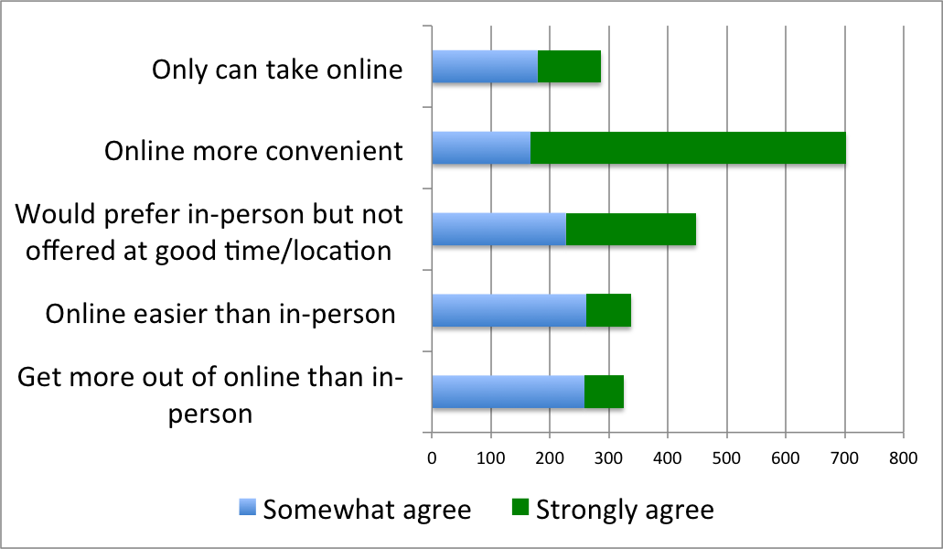
MCC student reasons for taking online classes (n=728)

Slide 11
Online Ed & MiraCosta’s Mission
Faculty, staff, and students affirm that DE is seen as integral to “providing educational opportunities” “to a diverse population of learners.”
MiraCosta student surveys reveal that many students could not have taken a course at all if it were not offered via DE
(2012: 40%; 2013: 45%)
Expanding online education’s mission focus from access to success

Slide 12
Online Ed Planning
First Online Education Plan written in 2011
Team of faculty, staff, and administrators currently closing this plan
Team will add student representation and develop a new 3-year plan in conjunction with current college-wide strategic planning and AIS’s technology planning efforts

Slide 13
Notable Accomplishments
Faculty Director of Online Education
Student Services Online
Faculty Development
AP 4105
DE in Program Review
Student Orientation to Online Learning

Slide 14
In Progress / Next Steps
Submitting a Substantive Change Proposal
Establishing a broadly shared vision for Online Education at MiraCosta College
Expanding resources supporting quality online education

Slide 15
Questions / Discussion

