Slide 1
Online Education Annual Report
Carlos Lopez | Dean, Math & Sciences
Jim Julius | Faculty Director, Online Education
October 1, 2014

Slide 2
Presentation Outline
Key Terms
Important Data
Notable Accomplishments
Online Education Planning
In Progress / Next Steps

Slide 3
Key terms
Distance Education: separate students & instructor, but regular/substantive interaction (Federal)
Distance Education (DE) Class: >50% of instructional class time occurs outside of the classroom. (state/ACCJC)
DE Program: A program where 50% or more of the required classes have been approved for offering as DE classes. (ACCJC)
100% Online Class: The entire class may be completed online. (MiraCosta)
Hybrid Class: Some instructional time occurs outside of the classroom. May be DE or non-DE. May be entirely online except exams. (MiraCosta)

Slide 4
Important MiraCosta DE data
 | 2009-10 | 2010-11 | 2011-12 | 2012-13 | 2013-14
Online + Hybrid course sections (Fall) | 208 | 237 | 253 | 291 | 310
% of FTES from DE | 12.6% | 14.8% | 16.2% | 17.1% | 17.2%
Students taking at least one DE course | 32.7% | 37.8% | 42.1% | 44.3% | 46.6%
Students taking only DE courses | 8.8% | 11.3% | 12.8% | 12.4% | 14.5%

Slide 7
Notable Accomplishments
Substantive Change approval with commendations
2011 Online Ed Plan closure
Student Orientation to Online Learning
MiraCosta selection for Online Education Initiative pilot
New 15-workshop sequence on online teaching

Slide 8
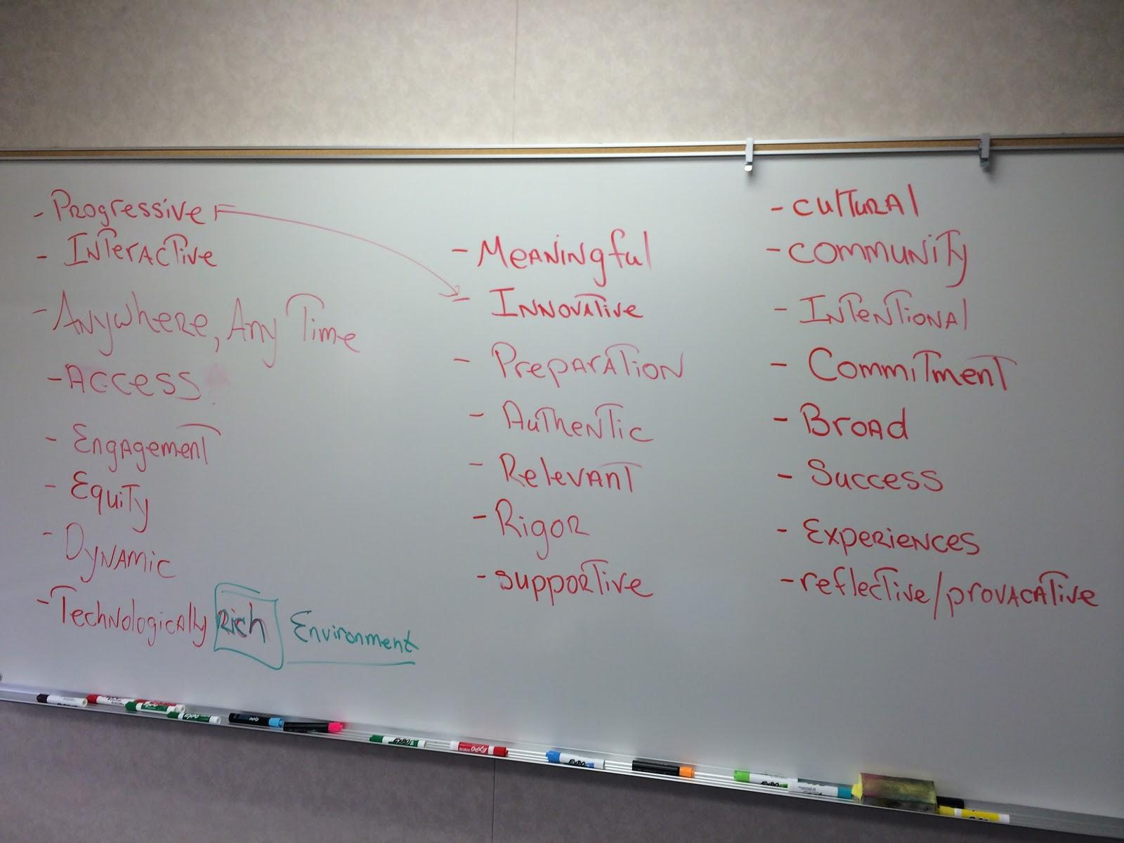
Online Education Planning

Slide 9
Draft Vision
MiraCosta’s Online Education leverages an increasingly rich array of teaching and learning resources, experiences, and environments. MiraCosta College will lead in providing effective and innovative Online Education as an integral means of equitable access and student success.
Draft Mission
MiraCosta College embraces student-centered, engaging, and accessible Online Education that meets student needs, enhances the learning experience, and broadens access to superior educational opportunities and support services.

Slide 10
In Progress / Next Steps
New 3-year Online Education Plan
Strategic & programmatic focus
Student success
Continuous improvement
Challenge to improve DE outcomes
Expanding resources supporting quality online education

Slide 11
Questions / Discussion

