Slide 1

Assessment of Course and Program Outcomes
Fall Flex Workshop
August 17, 2017
Joanne Benschop (SLO Coordinator)
John Thomford (Outcomes Assessment Committee faculty co-chair)
Notes:
John will introduce this slide and Joanne will finish with a description of her role as SLO Coordinator

Slide 2

Learning Outcomes Development Courses and Programs
Think SMART
  Specific
  Measurable
  Attainable
  Realistic
  Time-Bound
Notes:
Survey told us faculty wanted assistance in developing strong SLO’s

Slide 3
Guidelines for Program Outcomes-
Utilizing Bloom’s Taxonomy of Action Verbs
Notes:
Utilize operational verbs to facilitate evidence of learning-for PSLO’s we will be suing higher levels

Slide 4
Guidelines for Creating Program Outcomes
Program Outcomes-Direct
Program Outcomes-Indirect
Specific knowledge and skills you expect students to acquire as part of their educational experience in the program
Focused on demonstrable behaviors
Knowing, thinking, understanding, or appreciating is invisible and cannot be directly observed
Focused on student perception of academic experience
Notes:
Al Programs should have one Direct measure-and a second measure-either direct or Indirect

Slide 5
Guidelines for Creating
Program Outcomes
Preliminary Steps
Secondary Steps
Define the mission or goal of the program
Program goal related to College’s Mission
Focus on foundational courses within the program
Focus on capstone expectations
Focus on areas of concentration or emphasis within a program
Focus on relationship to academic discipline
Focus on observable skills
Notes:
Ideally Programs should have one direct measurement and one indirect measurement of student performance

Slide 6
Program Outcome- Directly related to Academic Discipline
General
Program Specific
Graduates of the Criminal Justice program will be critical thinkers
Graduates of the Criminal Justice program will be able to analyze a current issue in criminal justice, evaluate evidence, and construct an argument
Notes:
Focuses on observable and measurable outocmes related to the core course within the academic discipline. The program specific outcome demonstrates observable critical thinking skills related to the discipline.

Slide 7
Direct PSLO Assessments demonstrate observable abilities
Not Observable
Observable
Graduates of the BA program will think critically.
Graduates of the AA program will interpret, analyze, evaluate and construct arguments
Setting up an outcome in this manner also sets the evaluation criteria for your evaluation rubric!
Notes:
The focus should be on the students and what they should be able to demonstrate or produce upon
completion of the program. It is not possible to measure a student’s knowledge or understanding, but it is possible to measure how well a student solves a problem, presents an argument or gives a dance performance.

Slide 8
Program Outcomes-Communicate a Single Outcome
Multiple Outcomes
Single Outcome
Graduates of the psychology program will be lifelong learners who understand the concepts of psychology and can apply those concepts to the design and application of real research problems.
Graduates of the Psychology program will be able to design a research study.

Slide 9
Communicate A Single Outcome
“Students completing the BS in mathematics should be able to analyze and interpret data to produce meaningful conclusions and recommendations and explain statistics in writing”.
Notes:
Stop here for suggestions on modifications. A bundled statement for mathematics program outcome-how can we modify that? Students completing the BS in mathematics will be able to analyze and interpret statistical data.

Slide 10

No Capstone Course?
Identify the Core courses in your program
Review the SLO’s for each of these courses
Determine the most important SLO for each course
Synthesize those outcomes into PLO’s

Slide 11
Synthesizing Course SLO’s & Linking to PSLOs
Program SLO’s
Required C.O.R. CSLO’s
Students will be able to analyze the characteristics of interactions between two people.
Students will be able to analyze various group membership roles to determine which roles helped or hindered the group meet its goals
The student will be able to define specific social concepts as they pertain to the operation of social institutions
The student will be able to analyze research data (e.g. SPSS, Excel)
  The student will understand the relevance of the theories and methods of communication
The student will be able to define specific social concepts as they pertain to the operation of social institutions
Analyze research data and communicate research findings
Notes:
Any comments on the program outcome statements?

Slide 12
Program Learning Outcomes Checklist
Can be directly measured and learned
Maps to curriculum
Relies on action verbs in future tense
Should be simple and not compound
Are useful to identify areas to improve
Describes what students are intended to do, know or produce
Notes:
Map to curriculum-but framed in terms of the program instead of one specific course-Active

Slide 13
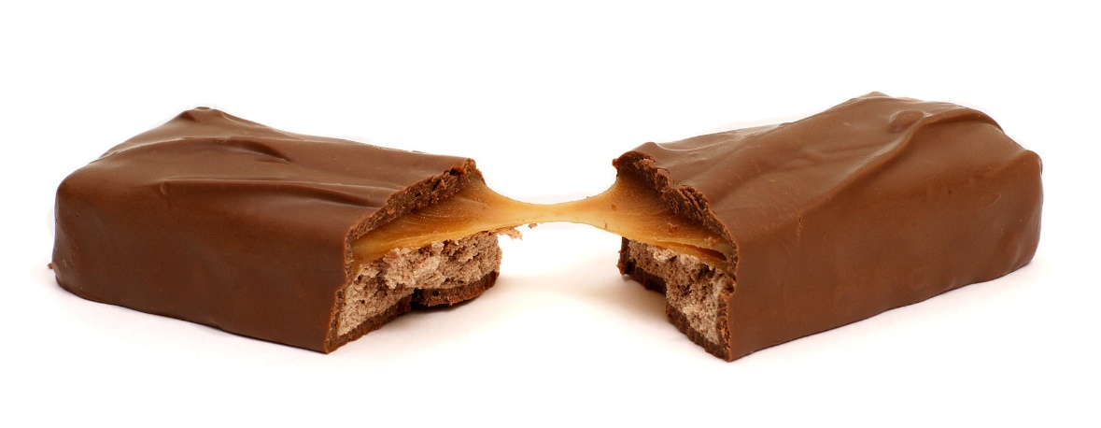
Two Parts to SLO’s
Outcome Statement
Assessment
Statements of overarching knowledge, skills, abilities, or attitudes that students should acquire in a program.
What students will know, be able to do, or be able to demonstrate when they have completed the course.
Determine how well learning expectations are being met.
Means of assessment are connected to the SLOs

Slide 14

Program SLO Assessment Methods
Direct Assessment Methods
Ask students to demonstrate learning
Indirect Assessment methods
Measure students’ perception of their experience in a program
Embedded assessments
Standardized tests
Portfolios
Capstone course or Final Project/Presentation
Surveys
Focus Groups
Exit Interviews
Reflective essays
  Derived from University of Connecticut’s SLO website
Notes:
Embedded assessments, can be assessing a program outcome related to the assessment (example research paper graded for content and style-evaluated for PSLO of locating and evaluating web based information)
Indirect measures: Data obtained can address strengths and weaknesses of the program and/or assess relevant concepts, theories, or skills.

Slide 15
Guidelines for Selecting Assessment Methods
Collect information that will answer the program’s questions
Use multiple methods to assess each student learning outcome
Include both indirect and direct assessment methods
Include both qualitative and quantitative methods
Choose methods that allow the assessment of both strengths and weaknesses
Utilize capstone courses or “second-year” projects/assignments to directly assess student learning outcomes

Slide 16
When should assessments be performed?
Course: Required-6 year cycle
Program: Required 6 year cycle
Considerations:
Is assessment occurring to actually improve student learning and classroom teaching?
Level of course
Frequency of course offering
Opportunities to collect and analyze data as a faculty group

Slide 17
Evaluation of assessments
Method: Rubrics
A scoring guide that describes criteria to evaluate student work: Performances, presentations, papers, journals, artwork, etc
Strengths: Helps to precisely define faculty expectations
Assists students in clarity on how they will be graded
Describe what students will do to demonstrate their learning (criteria)
Possible levels of achievement (standards)

Slide 18
Reporting/Documenting
TracDat is the storehouse database for all evaluations of SLOs.
https://tracdat.miracosta.edu/tracdat/

Slide 19
Closing the Loop
Learning Outcome
Expectations: what we expect students to know, do, and be when they leave a course, program or institution.
5) Interpret results,
identify, and implement revisions to pedagogy, curriculum, programs, criteria or outcomes.
1) Design Assessment:
Goals, outcomes, evidence, criteria and standards (ex. rubrics)
•
4) Collect,
review and analyze evidence of student learning
2) Publicly
share outcomes, criteria and standards
•
Results: The knowledge,
abilities, and/or attitudes students demonstrably possess at the conclusion of a learning experience.
3) Provide
intentional learning experiences (curriculum & pedagogy)
Based on Driscoll & Wood, 2007

Slide 20
FAQ’s – We will try to answer
How do certificate and degree program SLOs differ?
What if I don’t have a Program SLO because my department does not offer a degree/certificate?
What is mapping of SLOs?
Your Questions?????

Slide 21
Sources
www.asu.edu/oue/outcomes.html
Mage, R. E. (1997). Making instruction work or skillbloomers: A step-by-step guide to designing and developing instruction that works, (2nd ed.). Atlanta, GA: The Center for Effective Performance, Inc.
Mager, R. E. (1997). Preparing instructional objectives: A critical tool in the development of effective instruction, (3rd ed.). Atlanta, GA: The Center for Effective Performance, Inc.
Pohl, Michael. (2000). Learning to think, thinking to learn: Models and strategies to develop a classroom culture of thinking. Cheltenham, Vic.: Hawker Brownlow.
Tarlinton (2003). Bloom’s revised taxonomy. http://www.kurwongbss.qld.edu.au/thinking/Bloom/bloomspres.ppt.
University of Illinois, Center for Teaching Excellence (2006). Bloom’s taxonomy. www.oir.uiuc.edu/Did/docs/QUESTION/quest1.htm

