Slide 1
Evolution of a Program Assessment
Liberal Arts Degree

Slide 2
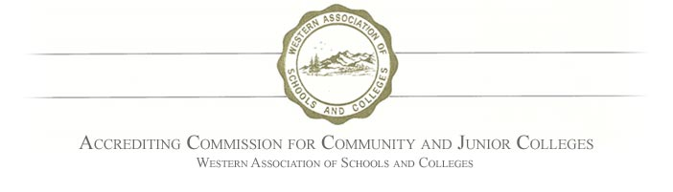
Accreditation requirements
Develop and Assess Program Outcomes
Institutional Dialogue
Degree Program =General Education courses and Major courses
Outcome must be tied to what students should can do upon completion of a program
Develop an assessment method that captures Program completers
Faculty assess and analyze if program outcomes are being met
Faculty make modifications to assessment and/or curriculum based on assessment results

Slide 3
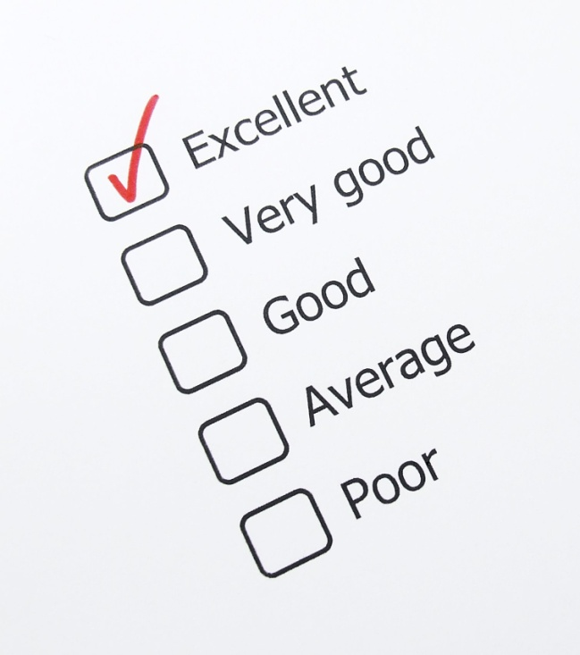
Liberal Arts Degree
One broad Program outcome connected to MiraCosta’s ILOs and GE outcomes-All Emphasis
Critical thinking
Effective communication
Intellectual Skills
Preparation for further study

Slide 4

Assessment Method
Indirect measure of learning outcome
Considerations
No capstone course
No common course in each area of emphasis
Most courses for this program derive from the general education patterns
Students report their perception of how well a given learning outcome has been achieved
Survey method was chosen as most expedient and practical

Slide 5


Liberal Arts Program Assessment
Faculty Evaluation and Analysis
Assessments conducted: Summer, Fall 2011, Spring 2012
Faculty review and analysis; Revise program outcome; refine/add assessment method
  Modified survey questions; distribution method streamlined
  added Triangulation of CSLO data (selected GE gateway courses)

Slide 6

Graduation Petitioners spring 2013
Liberal Arts AA degree: n=367
  Applied Health, Nutrition & Kinesiology: 20
  Arts & Humanities: 80
  Business & Technology: 3
  Creative & Applied Arts: 7
  Math & Sciences: 100
  Multicultural Studies: 2
  Social & Behavioral Sciences: 155

Slide 7

Liberal Arts Program Completers
Survey Results
Effective Communication- 90% of students responding perceived that MiraCosta courses had improved their ability to effectively communicate
Productive Work Habits- 89% of students perceived that they had improved their ability to apply productive work habits 9defined as
Critical Thinking- 97% students perceived that they improved their Critical Thinking skills during their coursework at MCC
Prepared for further Study- 95.8% of students perceived that at Miracosta they had developed skills that would assist them in achieving future education goals or requirements.
Met University transfer requirements -84% of students responded yes

Slide 8
Linking Liberal Arts assessment to ISLO’s and GELO’s
Institutional Learning Outcomes
General Education Learning Outcomes
Knowledge, skills, abilities and attitude students can demonstrate after completing experience as a MiraCosta student
ISLO’s overlap with Liberal Arts program outcomes (critical thinking, effective communication, productive work habits, etc)
Program at MiraCosta with highest amount of completers
Knowledge, skills, abilities derived from completing general education courses or a GE program
GELO’s overlap with Liberal Arts program outcomes (critical thinking, effective communication, productive work habits, etc)
Liberal Arts degree primarily composed of GE courses

Slide 9
Institutional Dialogue
Linking Liberal Arts Assessment to ISLO’s
ISLO Assessment Focus Group and Course Triangulation- Any Program completer invited to participate in assessments outside of classroom context
Group Communication-Activity assessed against Communication rubric; Scoring (Out of 4.0 points) Participation: 3.5; Collaboration: 3.5; Speaking: 3.8; Listening: 3.8
Productive Work Habits-Assessment based on participation and on-time attendance-94%
Critical Thinking-Individual Activity - 15% of the students met minimum achievement levels skills using Watson-Glaser CT assessment
Course SLO Analysis (triangulation)-93% of students assessed in 34 gateway courses that emphasize critical thinking met minimum achievement levels

Slide 10

Institutional Dialogue
Critical Thinking assessments
  Do courses that emphasize CT skills really have one or more CSLOs and assessments that test CT skills?
  Are we challenging our students with CT assignments?
  Are students practicing and implementing their CT skills in our courses?
  Are our assessments valid and results measurable?

Slide 11
Linking Liberal Arts Program Assessment to GELO’s
Faculty formulating Critical Thinking outcome per GE area
Developing common rubric to assess that outcome
Faculty to design or use existing assessments that can be graded with common critical thinking rubric
Assessment to be administered to LA completers and all others in a GE course: Assessing LA program and GELO’s simultaneously

Slide 12
Institutional Dialogue
Linking Liberal Arts assessment to other Programs
Programs with few Completers:
Develop assessment question related to your program outcome-
Add on to Liberal Arts degree
This survey sent only to your Program completers; but you must assess and evaluate
Collaboration required with OIE to distribute survey; department scores results

Slide 13
Institutional Dialogue
Linking Liberal Arts assessment to other Programs
Programs with no Degrees or Certificates
Focus on a high ranking GE or ISLO for your courses (critical thinking, effective communication?
Faculty collaboration on common definition GE or ISLO (as it pertains to your course offerings)
Develop one assessment per course based on this collaboration? Higher standard of critical thinking, is it reasonable to lower minimum achievement levels?
Faculty dialogue: Evaluate, discuss, modify curriculum as needed; Enter data into Program Review
Discuss unofficial “programs” (Tidepools) that are effectively meeting ISLO/GELO’s- how can they be assessed?(Exit Interviews, inter-departmental faculty reviewing work)

