Slide 1
SLOs What is New and Due in the Assessment Process: A focus on continued improvement in academic year 2012-2013
Flex workshop presented 8/13/12
John Thomford
SLO Coordinator
NOTE: For reference, hyperlinks to resources are printed in green type in this presentation!

Slide 2
2 of 5 Institutional Goals directly relate to Outcomes Assessment
Goal II. MiraCosta Community College District will become the institution where each student has a high probability of achieving academic success.
Goal III. MiraCosta Community College District will institutionalize effective planning processes through the systematic use of data to make decisions.
Notes:
Introductory background slide

Slide 3
Hierarchy & Relationship of Outcomes
Institution
Mission &
ISLOs
IS
PSLOs
IS
CSLOs
BAS
AUOs
BAS
Objectives
SS
AUOs
SS
SSLOs & SAOs
Office of the President
Notes:
Introductory background slide

Slide 4
1. Develop/Refine CSLOs or PSLOs:
The SLO
Cycle
2. Develop assessment methods, benchmarks of achievement, evaluation methods
6. Implement refinements &/or
action plans.
5. Determine Refinements Needed. Develop action plans intended to improve student success
3. Assess and Evaluate SLOs
4. Invested faculty Collect, Discuss, & Analyze Data
Report results in Annual Program Review

Slide 5
Where we are
Fulfillment of the recommendations from ACCJC has removed us from sanction
Specifically related to the SLO Assessment Process –
we have minimally achieved Proficiency standards set by ACCJC

Slide 6
ACCJC Evalution Rubric – Proficiency
Element 1:
Student learning outcomes and authentic assessment are in place for courses, degrees and programs.
Element 5:
Appropriate resources continue to be allocated and fine-tuned.
Element 6:
Comprehensive assessment reports exist and are completed & updated on a regular basis.
Element 2:
Results of assessment are being used for improvement and further alignment of institution-wide practices.
Element 7:
Course student learning outcomes are aligned with degree/certificate student learning outcomes.
Element 3:
There is widespread institutional dialogue about the assessment results & identification of gaps
Element 8:
Students demonstrate awareness of SLO goals and purposes of courses and programs in which they are enrolled.
Element 4:
Decision making includes dialogue on the results of assessment and is purposefully directed toward improving student learning.

Slide 7
Sustainable Continuous Quality Improvement (SCQI)
(to support student learning)
• Processes are ongoing & systematic • Pervasive and robust dialogue
• Evaluation of our processes at all levels
• Evaluation and fine-tuning of organizational structures • Student learning improvement is a visible priority • Learning outcomes are specifically linked to program reviews.

Slide 8
- Goals for Spring 2013 – to meet ACCJC status report criteria for Proficiency
Continue to address and fulfill Proficiency Standards
Prepare to validate data and statements that will be made in the ACCJC Status Report which is due March 15, 2013; criteria are now explicitly outlined in a fillable form
Move toward achieving Sustainable Continuous Quality Improvement (SCQI)

Slide 9
How do we achieve this?
Develop PSLO calendar for each degree & CoA
Update 6-year CSLO calendar
Assess / Re-assess →Record & Recommend (close loop)
Integrate CSLOs into curriculum (e.g. assignments)
Modify / Create New PSLOs → SLO AC
Update ADM’s (matrices)

Slide 10
How do we achieve this?
Widespread Inst’l. Dialogue - Meet to discuss PSLOs relevance to overall program & how they will channel into the 5 ISLOs (Institutional Learning Outcomes)
Integrate Instructional Services and Student Services SLOs & SAOs where applicable
Begin to assess ISLOs
Review self-study from report to ACCJC to determine that action plans were implemented

Slide 11
Academic Programs
Title 5 definition of a Program: A cohesive set of courses that result in a certificate or degree.
For Program Review, some colleges define programs to include courses in a specific discipline.
How your department defines it will determine how your PSLO and assessment are written.
As of August, 2012 MCC offers
62 AA degrees (including 7 degrees in Liberal Arts)
56 Certificates of Achievement

Slide 12
PSLOs
Assess a student’s ability to integrate learning from individual courses into a coherent whole.
Assess program completers.
Identifying program completers may be difficult.
Number of program completers may be few each year.
Notes:
Joanne should address these issues.

Slide 13
Assessing PSLOs at MCC
All AAs and CoAs currently have 1 or more PSLOs written. They are housed in TracDat and ready for data entry.
There are various methods of measureable assessment (e.g. Liberal Arts, Math, Auto)
Number of completed assessments will not be known until the evaluation results are entered into TracDat by each department.

Slide 14
Entering PSLO evaluation data in TracDat.
Reference the TracDat manual for detailed instructions.

Slide 15
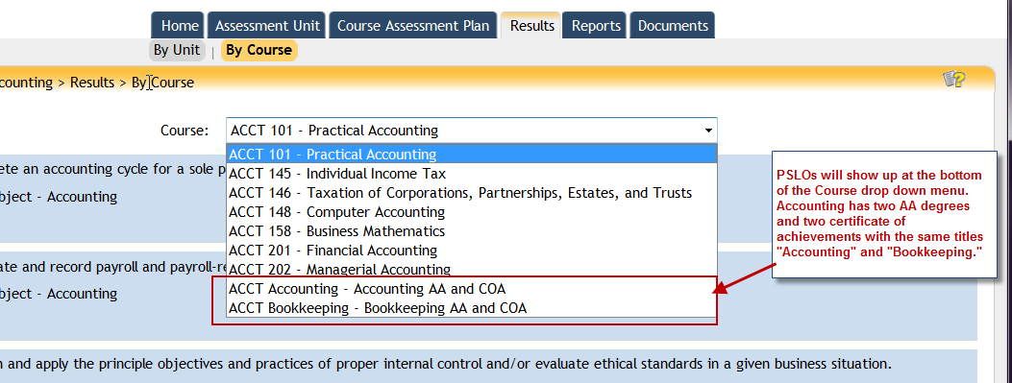
http://www.miracosta.edu/instruction/slo/downloads/TracDat_User_Manual.pdf

Slide 16
Work Reduction
Standardized assessments
Standardized evaluation rubrics
Data recording grids* prior to entering data into TracDat
Collaborative evaluation of assessments among faculty
Incorporating assessments into exams
* Hyperlink to a sample grid

