Slide 1

The Odyssey of SLOs
An Epic Journey of Assessment, Improvement and faculty Engagement at MiraCosta College
 | John Thomford, Faculty Co-Chair, Outcomes Assessment Committee, Biology Professor Joanne Benschop, Student Learning Outcomes Coordinator, Articulation Officer Jonathan Fohrman, Administrative Co-Chair, Outcomes Assessment Committee, Dean of Arts & International Languages

Slide 2
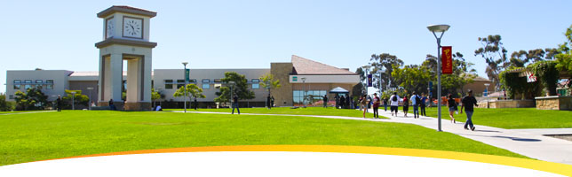
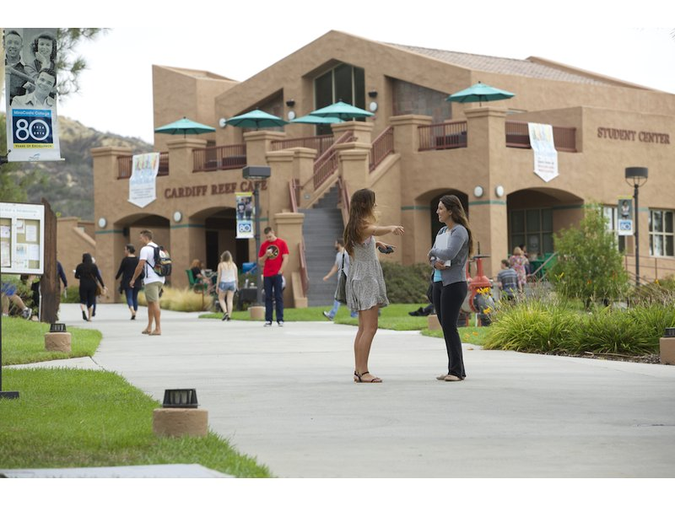
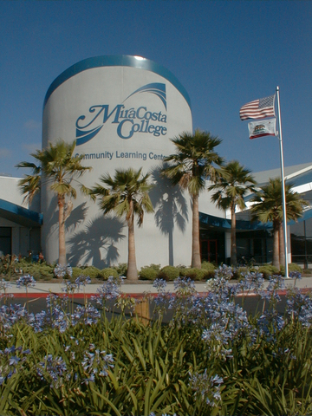
Oceanside Campus
Credit Enrollment: 14,773
Noncredit Enrollment: 2,479
# PSLOs: 122
#CSLOs: approx. 900
(774 in GE courses)
San Elijo Campus
Community Learning Center
Notes:
JT

Slide 3
Outcomes History
2008: GELOs and CTELOs adopted
2008: CSLOs developed
2008: Assessment calendar created
2010: ISLOs adopted
2011: Specific program outcomes created
2016: GELOs & CTELOs merged
2017:Core Competencies developed
by Outcomes Cmte.
by SLOAC
By OAC
Notes:
JT

Slide 4
The Evolution of Institutional Assessment at MiraCosta College
2011-2016: Administration of the Liberal Arts Survey
2012-2016: Focus Groups
2014-2016: SURF Assessments
2016-present: Total Reboot
Notes:
Joanne: JF and I agreed that the info about the LA grad survey revision should not be on this slide.

Slide 5
Survey Assessment Liberal Arts Degree 2011-2013
Program with the highest number of completers; modeled after the GE areas
Questions focused on student’s perception of the MiraCosta experience
Survey distributed online
Advertising, Invitations and Gift card incentive
First survey-43% response rate
Notes:
I will get other response data and put that in.

Slide 6
Initial Liberal Arts Survey 2012-2013

Slide 7
Survey Assessment-Refined Associate Degree 2014-2016
Broadened the survey to all students applying for degree
Improved outreach efforts Clarified survey questions
Defined the learning outcomes

Slide 8
Associate Degree Survey-Refined 2016
Before= upon college entry
After= nearing graduation
Notes:
We modified survey to include a definition of each outcome, to include question about how many units were actually completed at MiraCosta
Survey modified to ask students if outcome skills were greater as they were leaving MiraCosta or if they were about the same.

Slide 9
ISLO Surveys at your College?
What is your interest/experience?
How have you used the data?
Questions for us?

Slide 10
Focus Group Assessment
Focus Groups- 2012-2015
Faculty Led Assessment activities
Invitation sent to all graduation petitioners
Food, Drawing for iPad
Faculty development of structure and assessment activities
Staff support
Teamwork/ Group Communication Skills- Direct
Critical Thinking-Direct
Productive Work Habits- Direct
Perception of MiraCosta College Experience-Indirect

Slide 11

Focus Group 2014
Group Communication- The activity was assessed against Communication rubric (score out of 4)
Notes:
Joanne: show the data and maybe define each category (e.g. what did we consider Participation?, etc. )

Slide 12
Focus Groups Assessment Lessons Learned
Provide clear information: directions, time, place, purpose
Randomize seating
Communicate that we value their feedback
Design activities to align clearly with ISLO’s
Define ISLO’s for students
Set up protocols with staff
Train faculty prior to the focus group sessions
Keep notes for next year’s event and new committee members
Questions?
Notes:
Animation added to see if audience has questions. It will fly in after you review the info in black .

Slide 13
Faculty Evaluation of Assessments
Increased faculty understanding
Promoted collegial dialogue
Refined/Improved the assessments
Generated Ideas for new assessments
Helped to close the loop
Notes:
This slide is redundant to #29. JT Closing the loop-Evaluate after each experience- make revisions, assess again
Everyone not in whole hearted agreement-but they did see that progress was being made in terms of assessment

Slide 14

Instructional Division Participates in Institution-wide Direct Assessment
SURF

Slide 15
GE Faculty-derived Rubric
0 - student was not assessed
1 - NOVICE: by the end of the semester, the student did not demonstrate the ability to define and analyze problems in this discipline (does not meet minimum achievement level)
2 - APPRENTICE: by the end of the semester, the student had developed some skill at defining and analyzing problems in this discipline but the student needs further work to fully develop this skill. (does not meet minimum achievement level)
3 - PRACTITIONER: by the end of the semester, the student demonstrated the ability to consistently define and analyze problems in this discipline. (meets achievement level)
4 - EXPERT: by the end of the semester, the student demonstrated exceptional ability to define and analyze problems in this discipline. (exceeds anticipated achievement level)

Slide 16
Institution-Wide ISLO Assessment
Benchmark
Notes:
John will add data to complete one or two slides; based on ILO report.

Slide 17
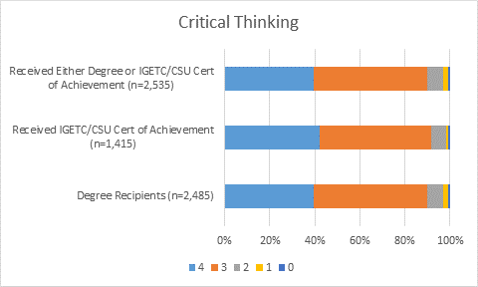
Graduating Students 2015

Slide 18
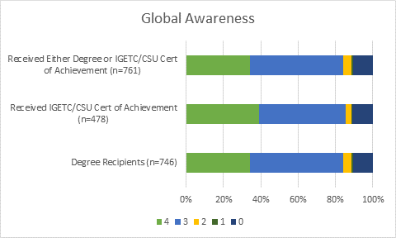
Graduating Students 2015

Slide 19
Why was it time for a change?

Slide 20
Need for Greater Clarity, Cohesion, & Meaningfulness
Separate sets of overlapping institutional & general education outcomes created layers, but also had gaps in certain areas while being too narrow in places.
Replaced existing GELOs and ISLOs with Core Competencies (adapted from the AAC&U LEAP Outcomes)
Data being collected was hard to interpret and/or not actionable
New team-based, direct assessment methodology
Revised approach to indirect assessment
Notes:
Jonathan

Slide 21
Need for Greater Capacity and Participation Out with the old, in with the new…
Old Committee:
Senate committee
Faculty members only
Admin & staff resources
Exclusive focus on Instruction
New Committee:
Governance committee
Institution-wide membership
Faculty-Admin Co-Chairs
Institution-wide focus
Notes:
John will introduce this slide and Joanne will finish with a description of her role as SLO Coordinator

Slide 22
2014: Accreditation standard II.A.11: A Focus on Degree Programs
communication competency,
information competency,
quantitative competency,
analytic inquiry skills,
ethical reasoning,
the ability to engage diverse perspectives, and
other program-specific learning outcomes.
Notes:
Jonathan

Slide 23
How did we know the change was needed?
Collegial Dialogue & Internal Evaluation
ACCJC Std. 1.B.1. “The institution demonstrates a sustained, substantive and collegial dialog about student outcomes…”
External, collegial evaluation (pre-site visit)
We just did…

Slide 24
College-Wide Dialogue and Input
January 2014 All College Day: “Learning that Lasts”
January 2014 Academic Senate Retreat: “Continuing the Conversation”
October 2015: “Spooktacular Assessment Day”
April 2016: “Last Outcome Standing” Workshops
May 2016: Employee Survey
2016-2017: Governance discussions & approvals of new Core Competencies

Slide 25
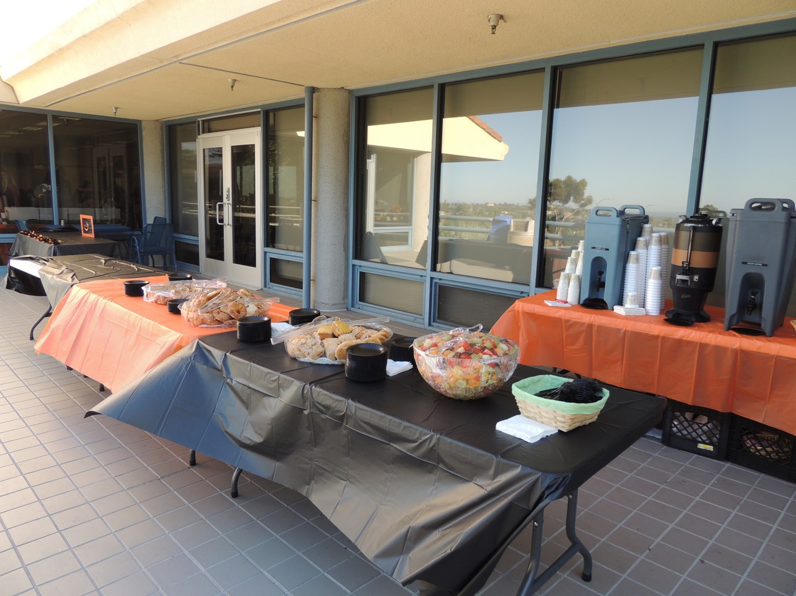
How did we do it?

Slide 26
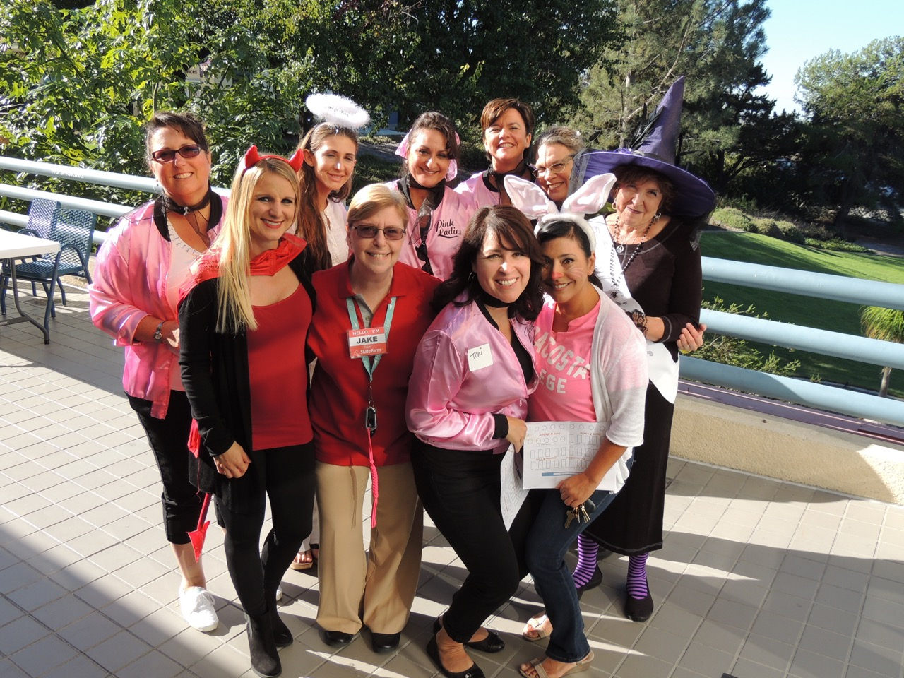
How did we do it?

Slide 27
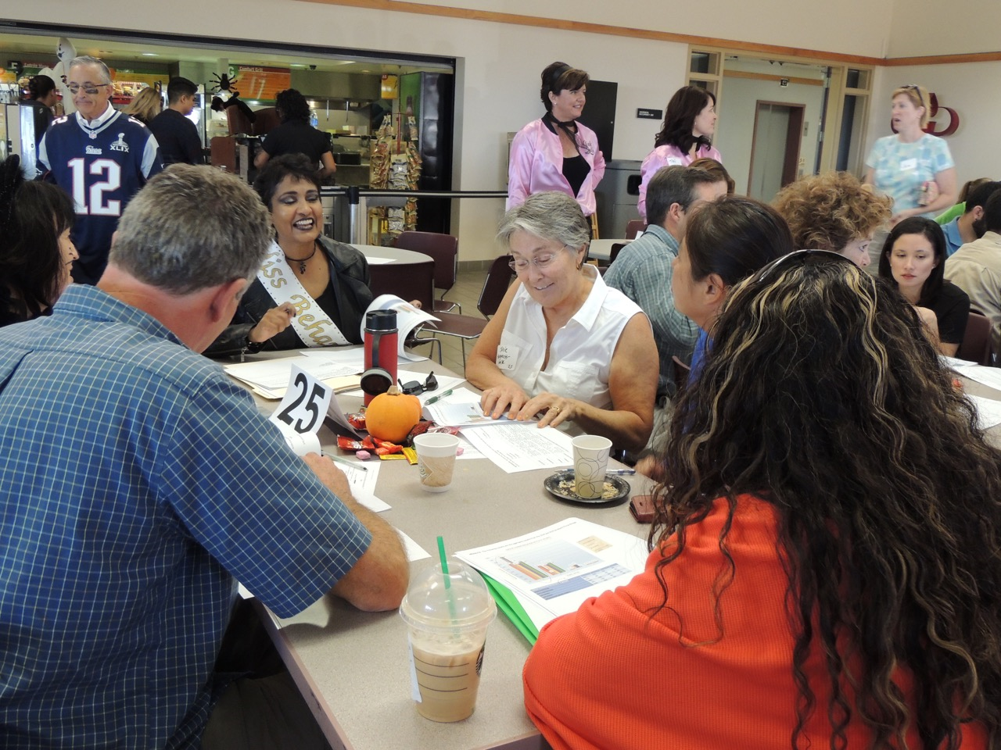
How did we do it?

Slide 28
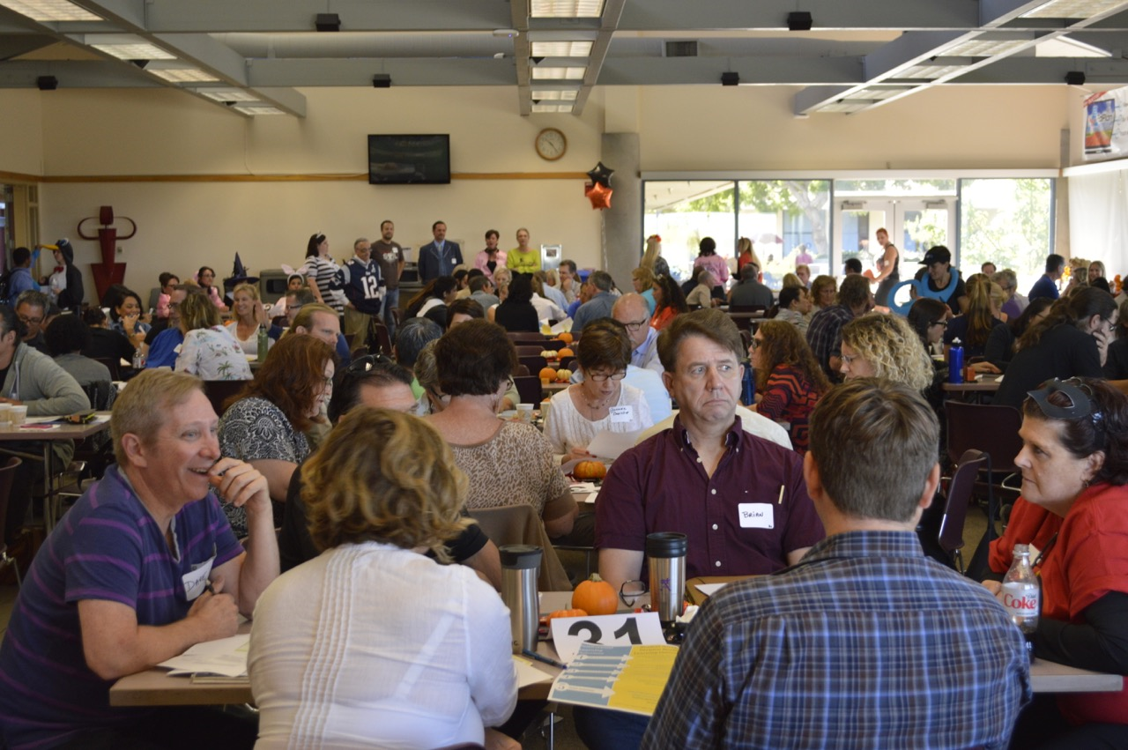
How did we do it?

Slide 29
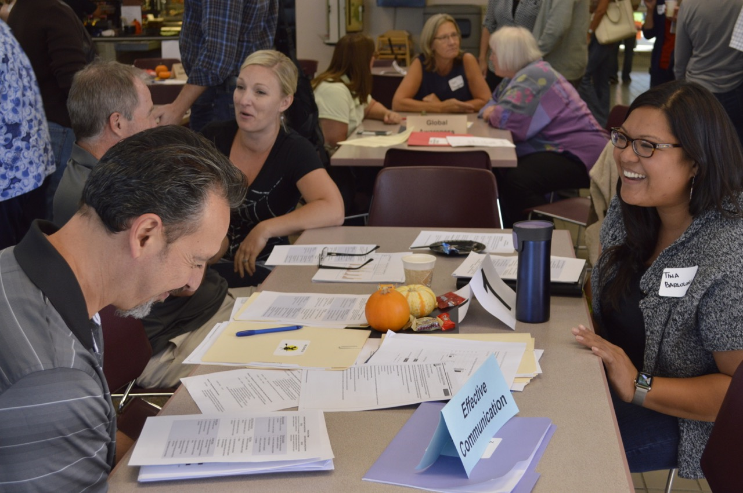
How did we do it?

Slide 30
2015-2016 The College Faculty, Staff and Administrators Weigh in on the Adoption of New ILOs
October 2015: Assessment Day
Merge the GELOs and ILOs
Models evaluated
April 2016: Breakout sessions
Options explored
Blend GELOs with ILOs
LEAP Outcomes as a model (Liberal Education and America’s Promise)
https://www.aacu.org/leap
https://www.aacu.org/leap/essential-learning-outcomes
May 2016: Faculty Survey
Blended model favored integrating into the LEAP Outcomes

Slide 31
Adopting the AAC&U LEAP Outcomes & VALUE Rubrics
No reinventing the wheel – national models based on extensive analysis and wide input
21st Century outcomes in the LEAP align to NEA’s “Four C’s”, WASC Sr.’s “Big Five,” & ACCJC Standards 2.A.11. & 2.A.12.
Broad LEAP statements allow alignment across the institution, and were readily adapted & fine-tuned
Detailed VALUE rubrics compliment LEAP’s broad, overarching nature

Slide 32
The Core Competencies
Notes:
Thomford

Slide 33
Why call them Competencies?
Competencies are measurable skills and abilities which demonstrate applied learning.
The use of “competencies” instead of “outcomes,” is in keeping with current recommendations of the statewide Academic Senate, and in tune with the intent to prepare students for twenty-first century challenges.
Notes:
John

Slide 34
We defined the CCs:
The MCC Core Competencies (formerly designated ISLOs) describe the broad learning outcomes students should have gained when completing transfer preparation (60 units including CSU or IGETC general education) or a degree, and through their exposure to different support and enrichment programs and services. Courses and programs map/align to these larger outcomes.

Slide 35




& we made them inclusive for ALL programs
And . . . .
students gain exposure to some, but not necessarily all of them, from educational experiences that don’t encompass completion of a degree or transfer pattern.
GE

Slide 36
MiraCosta College Core Competencies
INTRO:
Upon commencement of studies and progressing toward the completion of an educational goal, MiraCosta College students prepare for twenty-first century challenges by gaining:
CATEGORIES
1. Knowledge of Human Cultures and the Physical and Natural World (a program specific category) and:

Slide 37
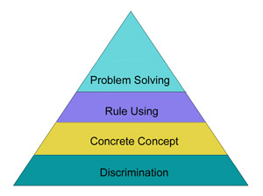
MiraCosta College Core Competencies
2. Intellectual and Practical Skills:
Inquiry, analysis and independent thinking
Critical and creative thinking
Quantitative literacy and problem solving
Information literacy
Written communication skills and
oral communication skills
Integration of knowledge

Slide 38
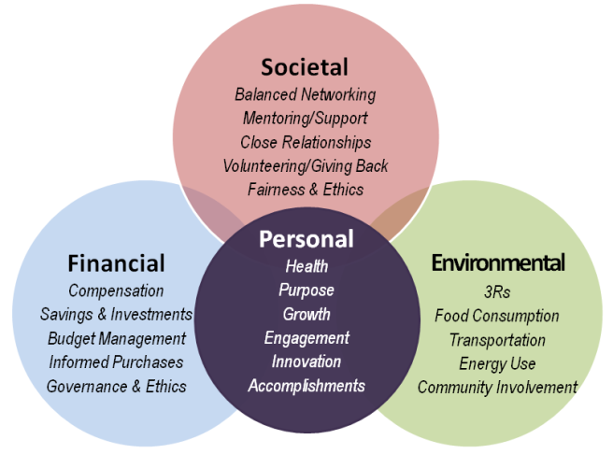
MiraCosta College Core Competencies
3. Personal and Social Responsibility and Efficacy, including
Civic knowledge and engagement – local and global
Intercultural competence and respect for diverse perspectives
Teamwork and collaborative skills
Ethical reasoning and action
Goal-setting / project-planning
and completion
Skills for ongoing personal,
academic, and professional
growth

Slide 39
Current Plans

Slide 40
Preparing for First Assessment (Spring 2018)
Map/Align CSLOs to CCs in TracDat
Provide training opportunities for mapping the CCs through flex workshops
Recruit faculty to assist with the development of
the assessment (& training for consistent use of the rubrics)
the evaluation
review the process through discussion and survey of participating faculty, administrators & staff
the documentation in collaboration with the Office of Research, Planning & Institutional Effectiveness (RPIE)
Student Services participation through surveys
Have you used a similar approach? What has worked at your campus?

Slide 41
Next Steps
Report results to the College
Institution-wide discussion of the process
Integrated Planning:
Outcomes Asmt., Program Review, Budget & Planning
Professional development
Alignment of course, program, and service area outcomes to the Core Competencies
Continuous improvement of assessment and reporting practices
Implementation of new assessment methodologies
Improvement of student learning & outcomes!

Slide 42
THANK YOU!!
HAPPY FRIDAY!!!

