Slide 1
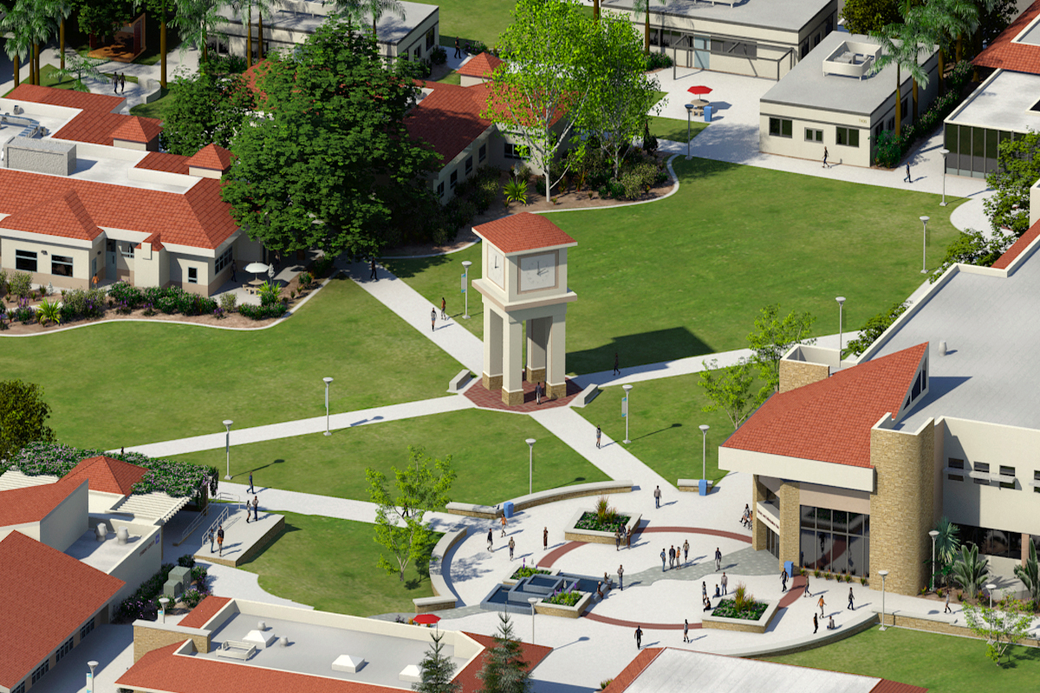
MIRACOSTA COMMUNITY COLLEGE DISTRICT
FACILITIES MASTER PLAN UPDATE | MAY 18, 2016
PHASE TWO:
Board of Trustees Presentation

Slide 2
Facilities Master Plan Review & Questions
Community Learning Center
San Elijo Campus
Oceanside Campus
1
Sustainability Goals & Guidelines
2
Security Master Plan
3
Schedule & Cost
4

Slide 3
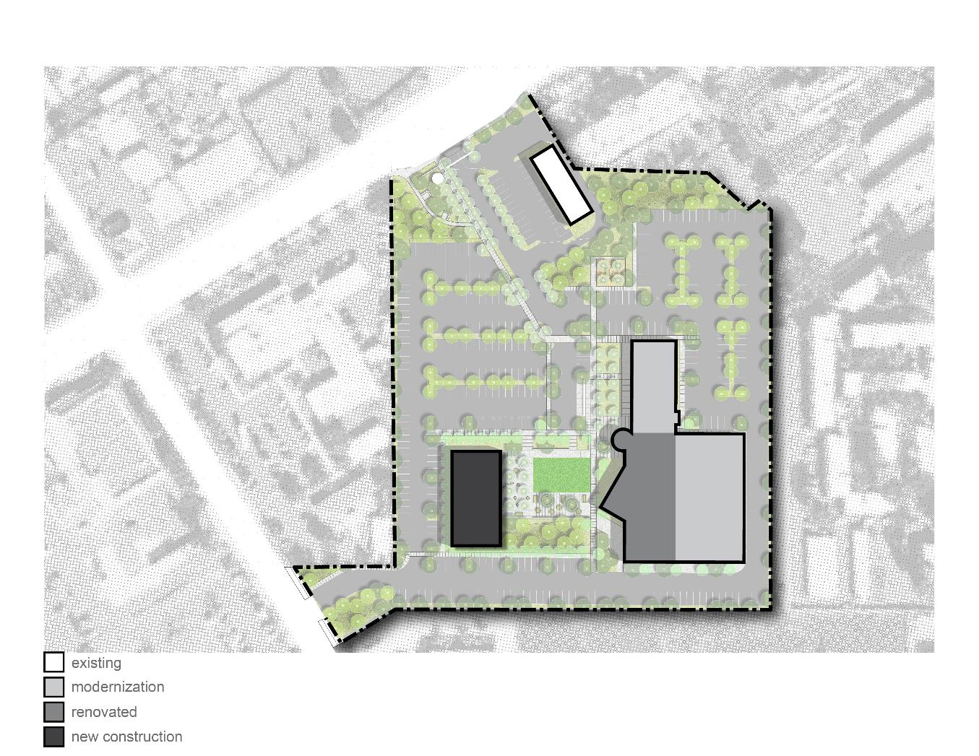
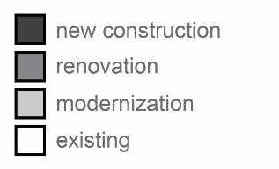
Community Learning Center
Existing Building Area
43,360 GSF
Demolition
-4,500 GSF
SBDC (old fast food restaurant)
Building C (Temporary Building)
Arby’s
New Construction
9,300 GSF
Student Resource Building
Final Building Area
48,160 GSF
Bldg.
B
Delta
+4,800 GSF
(11% increase)
Student
Resources
Quad
Bldg. A
Renovation
7,000 GSF
Student/Faculty Spaces & Tutoring Space
Modernization
19,000 GSF
Classrooms

Slide 4
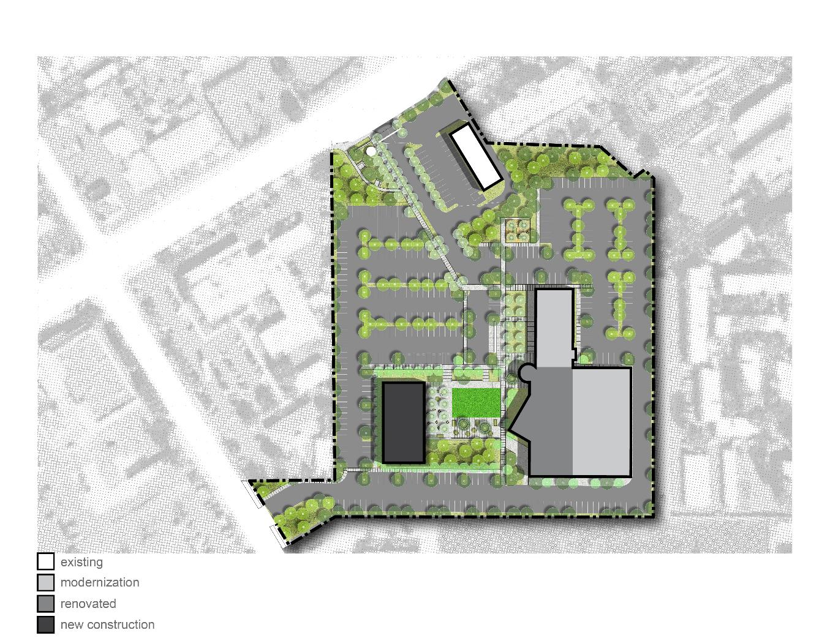
Community Learning Center
Town Square
Entry
A
New entry / gateway
Arby’s
F
Parking
F
117,300 GSF
Reconfigure Parking & Pave Dirt Lot
Add 120 parking spaces
B
Bldg.
B
E
Site Improvements
0.8 Acres (10% of Site)
Campus Quad
Outdoor Space Refresh w/ Drop-Off
Bioswale / Native Plantings
Student
Resources
Bldg. A
D
Infrastructure & Building System
Natural Gas Utility Pipe Repairs
Mechanical Systems Upgrades
Notes:
Infrastructure & Systems:
Natural gas line improvements
New hot water boiler and pump @ building A
New heat pumps @ buildings A&B
HVAC Controls
Replace rooftop package units @ building B
Overall Acreage: 7.7 acres

Slide 5
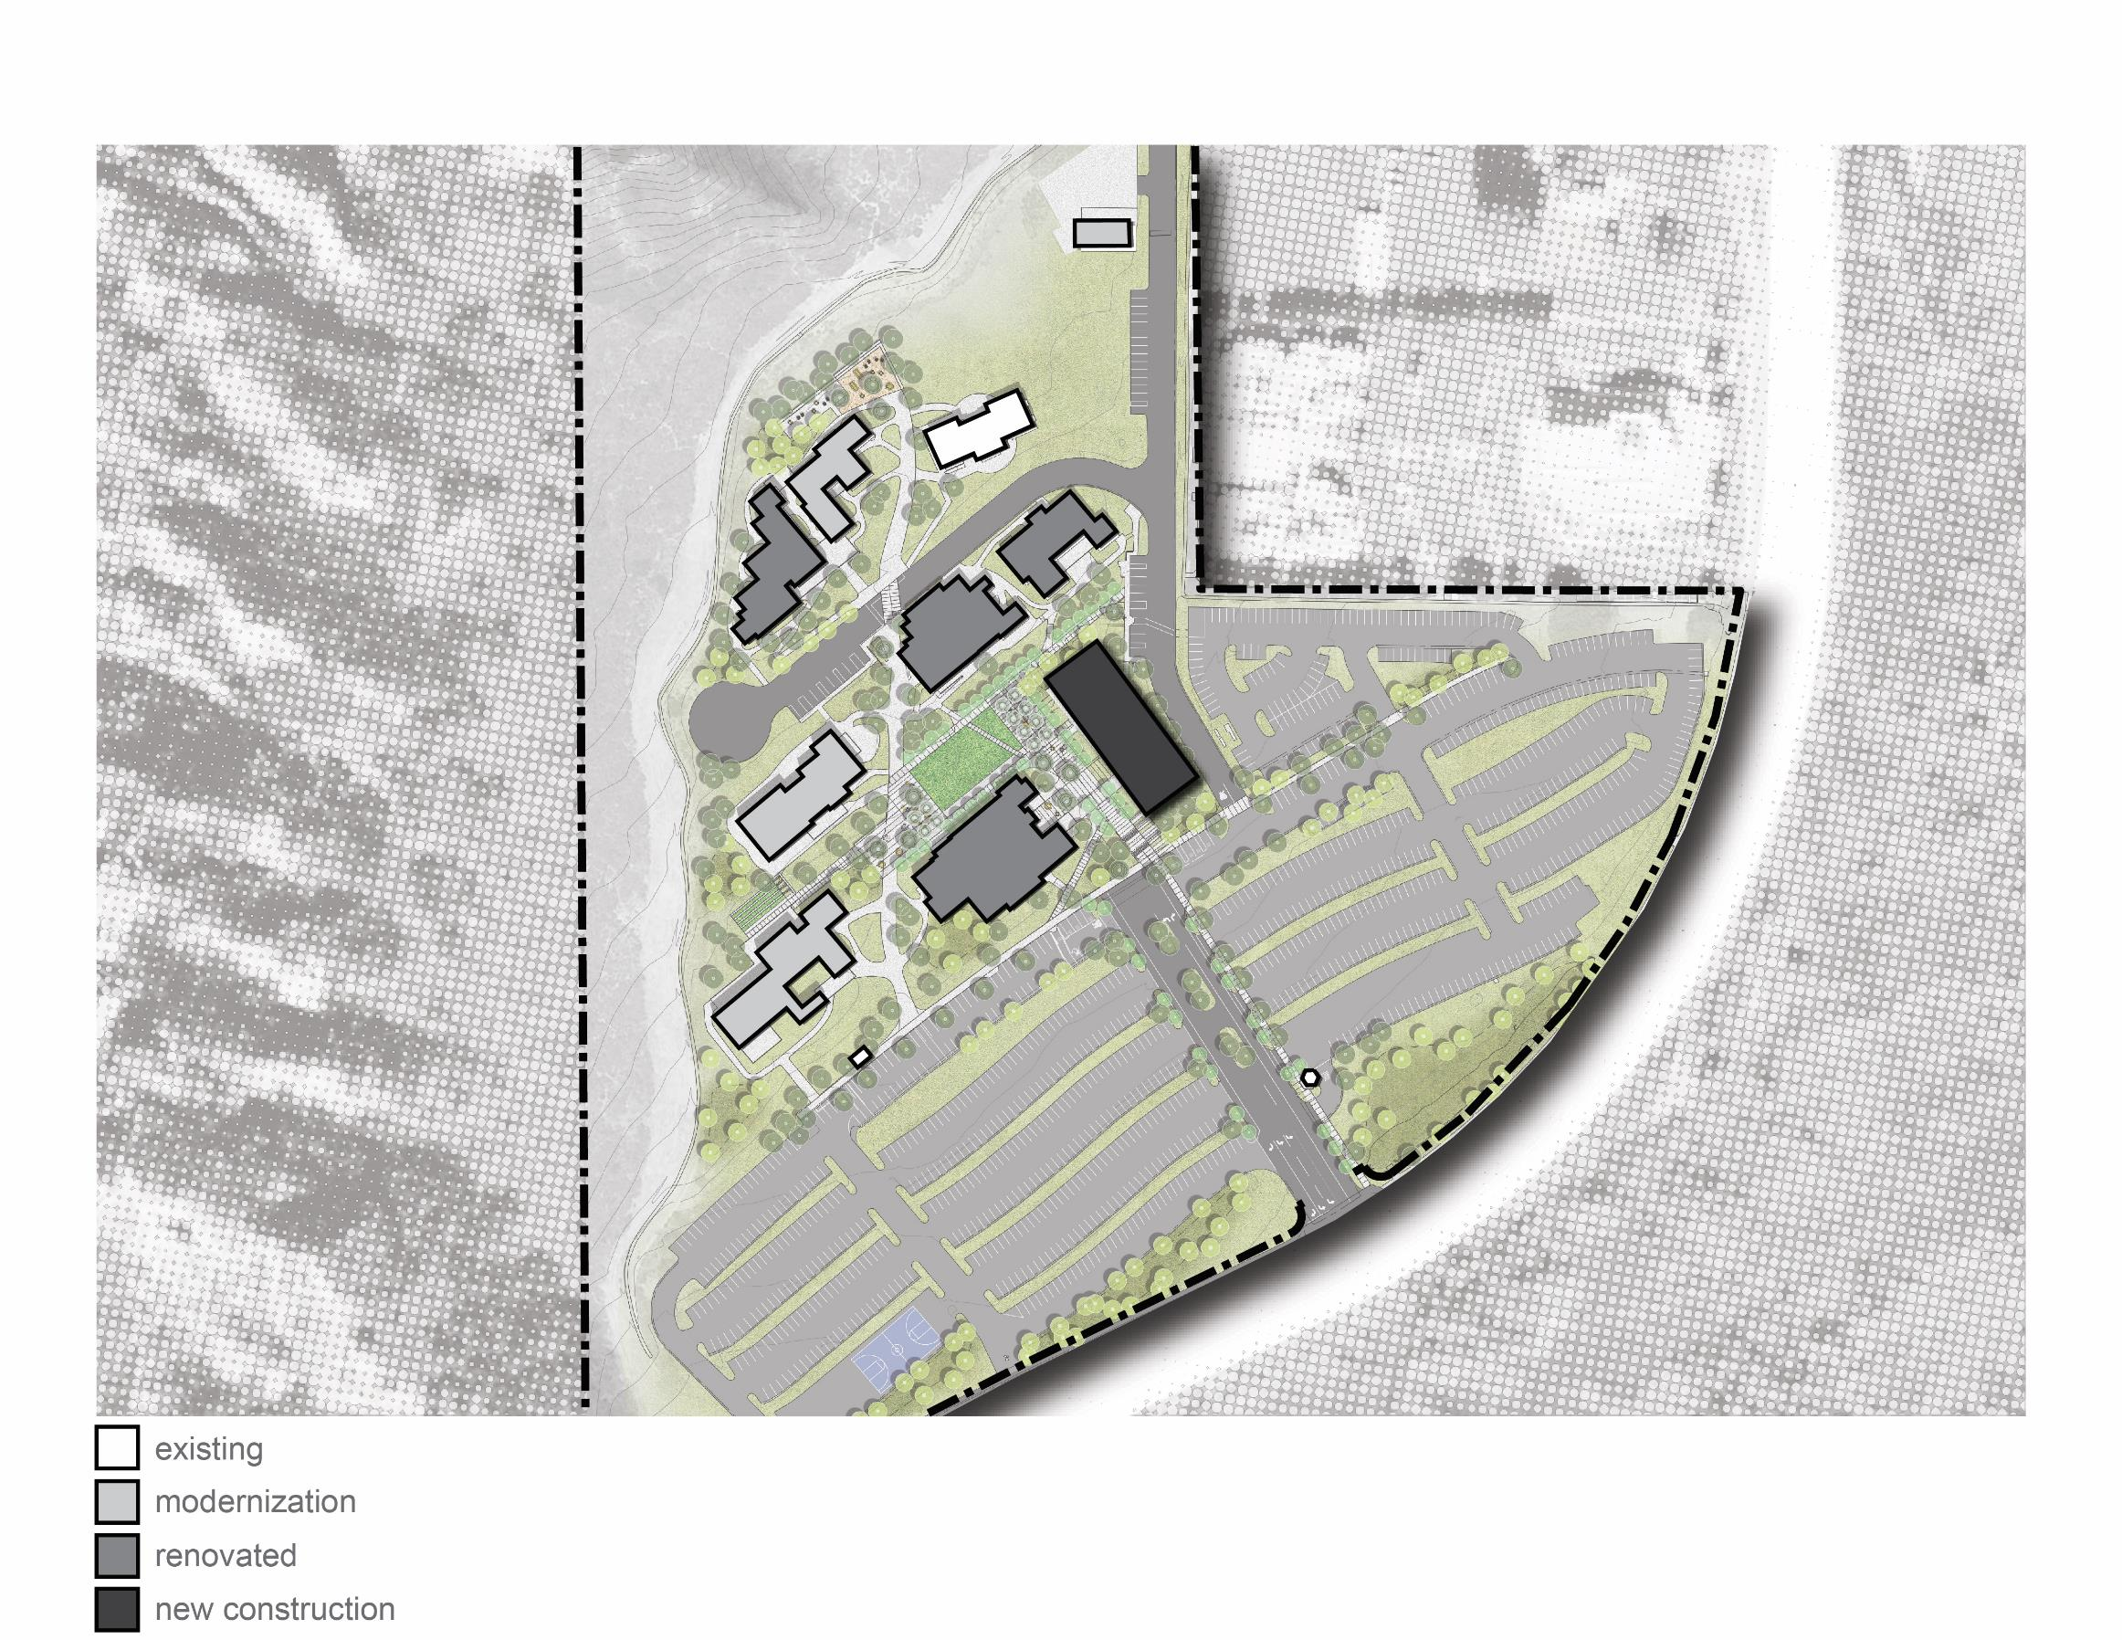
San Elijo Campus
Existing Building Area
72,134 GSF
Demolition
-4,000 GSF
Building 800 (non-functional space)
New Construction
11,300 GSF
Student Services / Administration Building
Student
Center
Final Building Area
79,434 GSF
Delta
+7,300 GSF
(10% increase)
Services
Quad
Renovation
35,800 GSF
Library
Building 400 (Science Labs)
Building 500 (Computer Labs)
Library (Includes Tutoring)
Student Center
Modernization
23,900 GSF
Classrooms & Labs

Slide 6
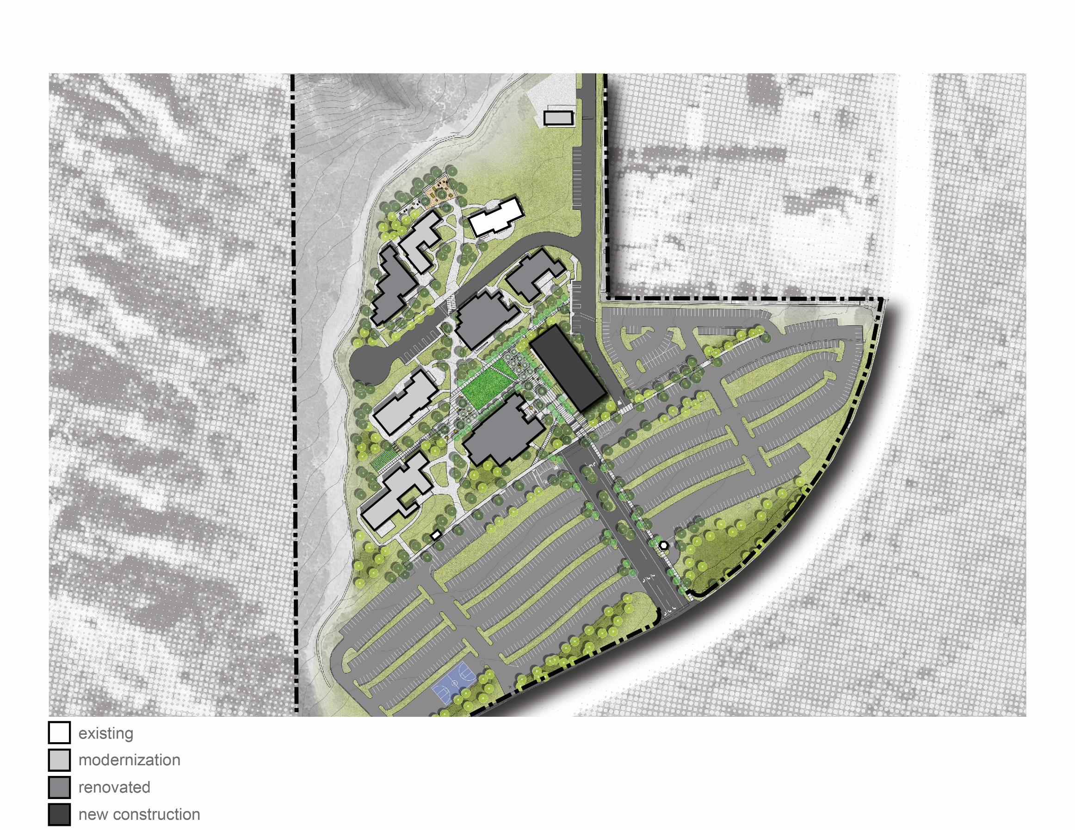
San Elijo Campus
Entry
D
New monument sign
Parking
0 SF
No changes to parking
E
Student
Center
Site Improvements
4.6 Acres (7% of site)
New Entry Plaza
Create Campus Quad
Outdoor Learning Spaces
Improved Landscape & Paving
Bioswale / Native Plantings
Services
C
B
Library
Infrastructure
Underground Storm Water & Sewer Pipe Repairs
Natural Gas Utility Pipe Repairs & Earthquake Valves
Replace Outdated Heat Pumps (building mechanical system)
F
A
Notes:
According to industry standards, campus has extra parking capacity. According to student and faculty/staff, parking is good and not an issue.
Design Goals:
Reduce Turf Spaces
Enhance Native Habitat
Address Stormwater Run-off and Erosion
Create Useable Outdoor Spaces
Enhance Campus Identity
Total Acreage: 64 acres

Slide 7
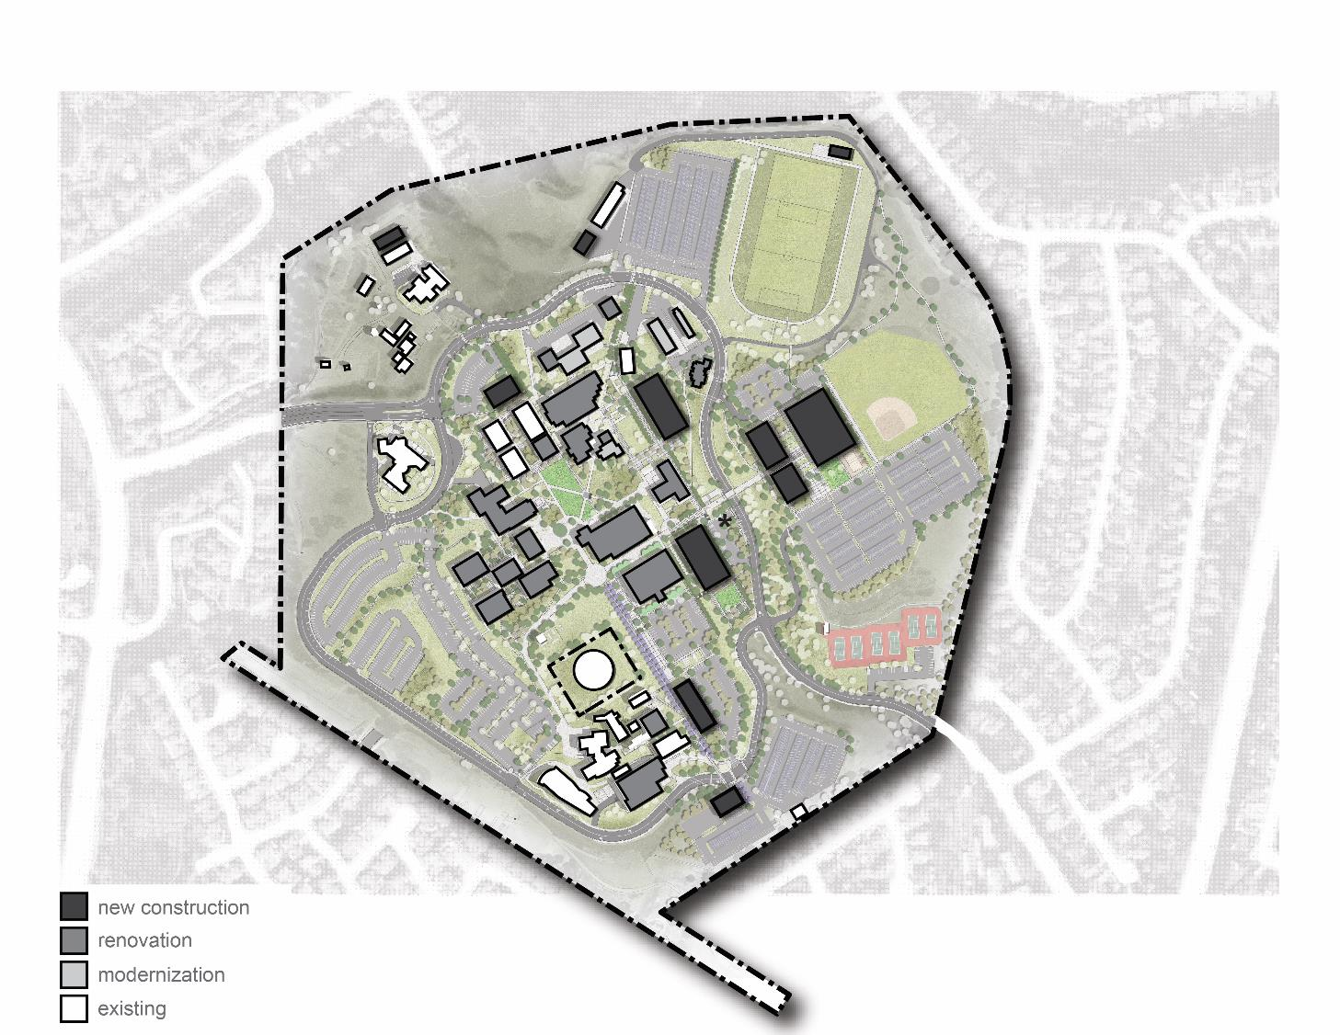
Oceanside Campus
Academic Hubs
STEM (Science, Technology, Engineering & Math)
Allied Health / Health & Wellness
Arts
Communications
Letters & Humanities
LETTERS
STEM
HEALTH
Library
Services
COMM.
Admin
Each Academic Hub has:
Classrooms/Labs
Student Study & Collaboration Space
Offices & Meeting Space
Useable Outdoor Space
ARTS

Slide 8
Oceanside Campus
New Construction
NEW
EXISTING
NET / DELTA
Student Services Building (includes Veterans Center)
All Existing Functions & Personnel
Growth for Additional Staff / Programs
New Food / Coffee Cart
Gym Complex
Gym Replacement
New Multipurpose & Kinesiology Studios
Offices & Locker Rooms
Wellness Center
Allied Health Building
Classrooms, Labs & Offices
New Study Space for Students
Science Building
Biotechnology Labs & Offices (replaces existing & adds lab)
Chemistry Labs (replaces existing & adds labs)
New Classrooms
29,900 GSF*
9,140 GSF
39,040 GSF
35,340 GSF
26,700 GSF
8,600 GSF
20,450 GSF
7,900 GSF*
12,550 GSF
20,600 GSF
9,400 GSF*
11,200 GSF
*GSF for individual program elements estimated based on efficiency ASF to GSF calculations estimated

Slide 9
Oceanside Campus
New Construction
NEW
NEW
EXISTING
NET / DELTA
Arts / Media Building
Relocated Media Arts Labs & Offices, & Art Gallery
New Classroom
New Study Space for Students
New Food / Coffee Cart
Campus Police Building
Offices & Police Operations
Meeting / Classroom
Resource Center Building
Large, Flexible Event Space
New Study Space for Students
ELI Program
Misc. Buildings
Purchasing Building (temporary building replacement)
Greenhouse (replacement)
Athletic Field Restrooms/Support
10,470 GSF
6,100 GSF*
4,370 GSF
6,925 GSF
1,440 GSF
5,485 GSF
6,860 GSF
1,000 GSF*
5860 GSF
9,650 GSF
9,050 GSF*
600 GSF
*GSF for individual program elements estimated based on efficiency ASF to GSF calculations estimated
TOTAL:
149,340 GSF
91,490 GSF*
57,850 GSF

Slide 10
Oceanside Campus
Renovation
Modernization
Vacated Student Services Space
Classrooms & Labs
Student Study / Collaboration Space
Office / Work Environments
Professional Development Center (Building 4400)
Student Center, Theater & Library (partial)
Library
Facilities & Maintenance, 4200 & 4300
Classrooms & Labs at 4000
Offices at Building 4700
Total Modernization: 68,370 GSF
Demolition
Buildings Past Useful Life
Temporary Buildings
Gym Complex, Bldgs. 5000, 5100, 5200
Safety & Security / Functionality issues
Police Station
Buildings: 1000, 1200, 2000, 2100, 3000, 3100, 3200, 3300, 3400, 3500, 3601, 3700, 4000, 4100, 4400, 4500, 4600, 4800
Total Renovation: 157,995 GSF
Total Demolition: 54,950 GSF

Slide 11
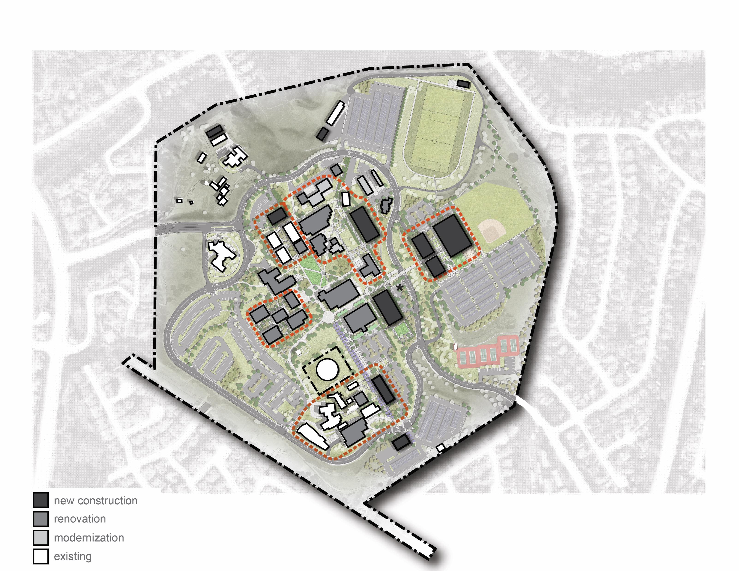
Oceanside Campus
Improved Fields
STEM
Letters
Health
New Baseball Field
RC
Science
Gym
Allied
New Student Parking
Comm.
Library
Services
Admin
Arts
Notes:
Note buildings getting renovated & modernized

Slide 12
Oceanside Campus:
Comm.
Library
Services
Admin
New Student Parking
Arts
Theater
Arts
Police

Slide 13
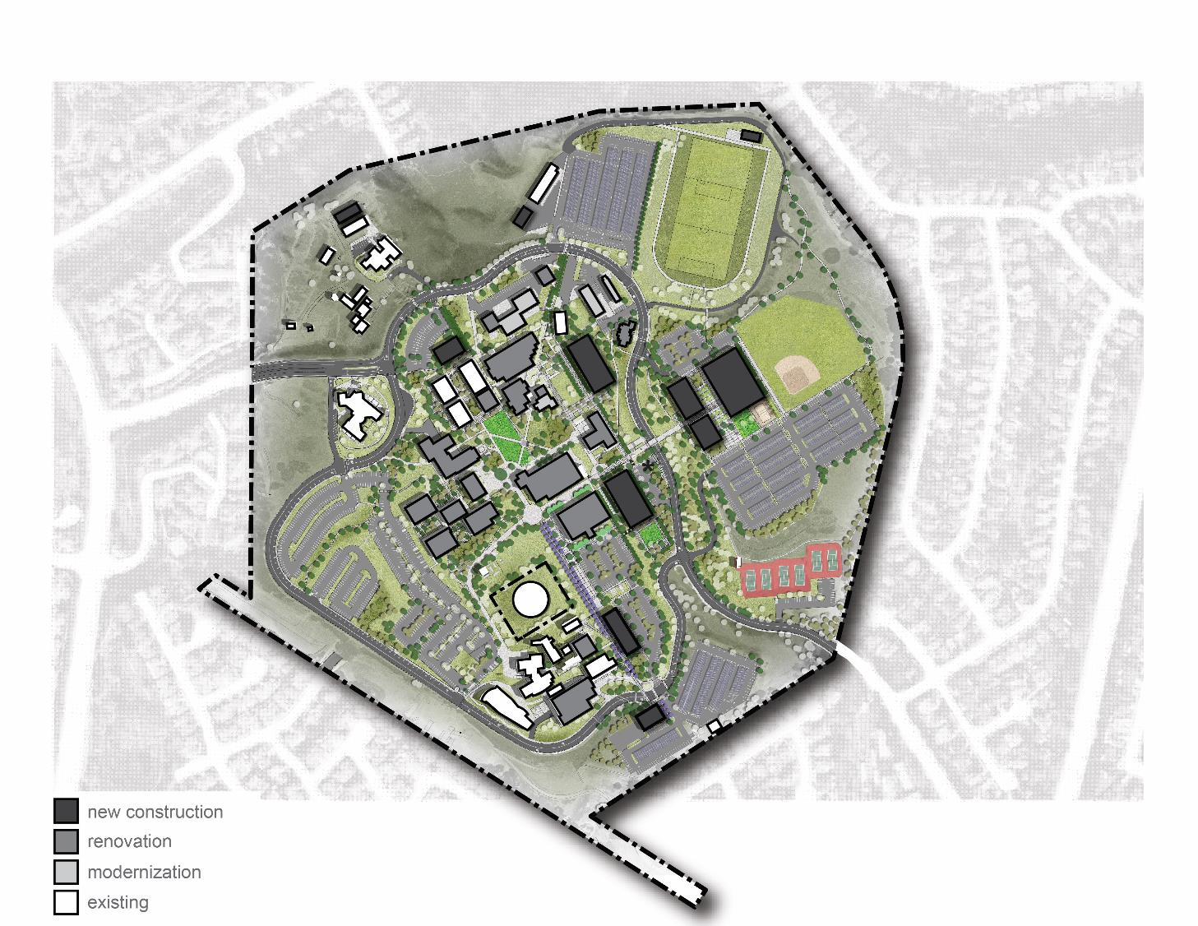
Oceanside Campus
Parking
356,000 GSF new
Adding 545 parking spaces
(2) New Student Lots
New Visitor Parking lot
Expanded & Reconfigured lots
Site Improvements
Library
18.5 Acres (15% of campus area)
Services
Admin
Create Outdoor Instructional Space
Reduce turf areas (water usage)
Enhance identity of academic hubs
Quad Improvement Project
Pathway Improvements
Athletic Fields

Slide 14
Community
Learning Center
Oceanside
San Elijo
Final Building Area by Type
Final Building Area by Type
Final Building Area by Type
4%
14%
14%
25%
27%
38%
40%
31%
30%
45%
19%
15%
New Construction
Renovation
Remaining
Modernization
Notes:
Summary slide for all three sites:
Demo, renovate, modernize, new and net new
Site improvements

Slide 15
Facilities Master Plan Review & Questions
Community Learning Center
San Elijo Campus
Oceanside Campus
1
Sustainability Goals & Guidelines
2
Security Master Plan
3
Schedule & Cost
4

Slide 16
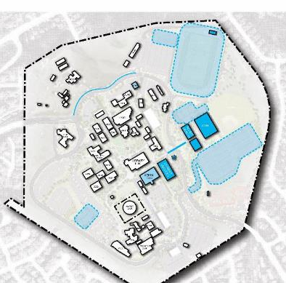
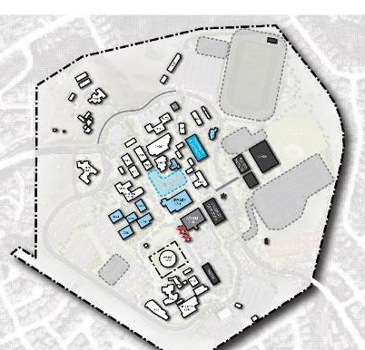
Phasing
CLC: 2 phases
SEC: 2 phases
OCN: 3 phases

Slide 17
Cost Estimate Information
Based on either design-bid-build or construction-manager-at-risk procurement method.
Building Costs
Sitework Costs
New Construction: $460 to $520 per square foot
Renovation: $200 to $300 per square foot
Modernization: $100 to $150 per square foot
Parking: $15 to $20 per square foot
Athletic Fields: $15 to $18 per square foot
Site Improvements: $20 to $35 per square foot
Construction Costs (75%)
Soft Costs (25%)
Building Cost
Sitework Cost
Furniture, Fixture & Equipment
Swing Space
Construction Contingency
Professional Services & Other Fees
Architectural/Engineering
Project Management
Permitting, Inspection & Testing
Geotechnical & Survey
Contingency
Project Costs
(100%)

Slide 18
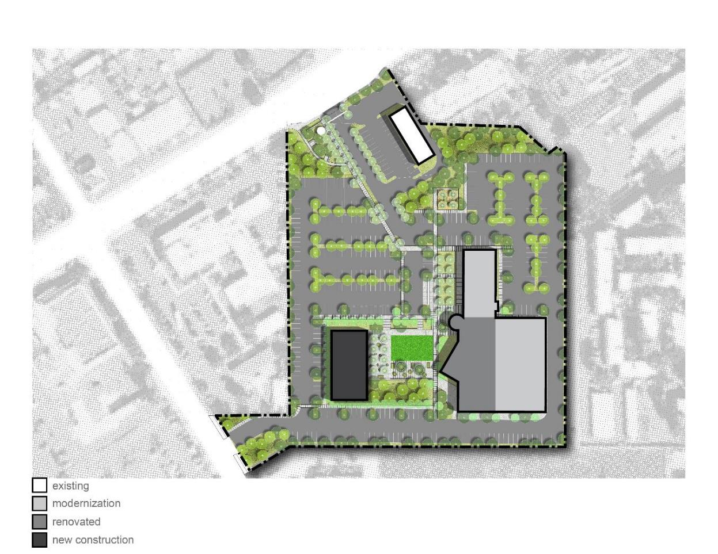
Community Learning Center: Project Cost Summary
Building Projects
$17,254,000
Site Projects
$5,426,000
Subtotal:
$22,680,000
Escalation (over 4 years)
$4,248,000
Total:
$26,928,000

Slide 19
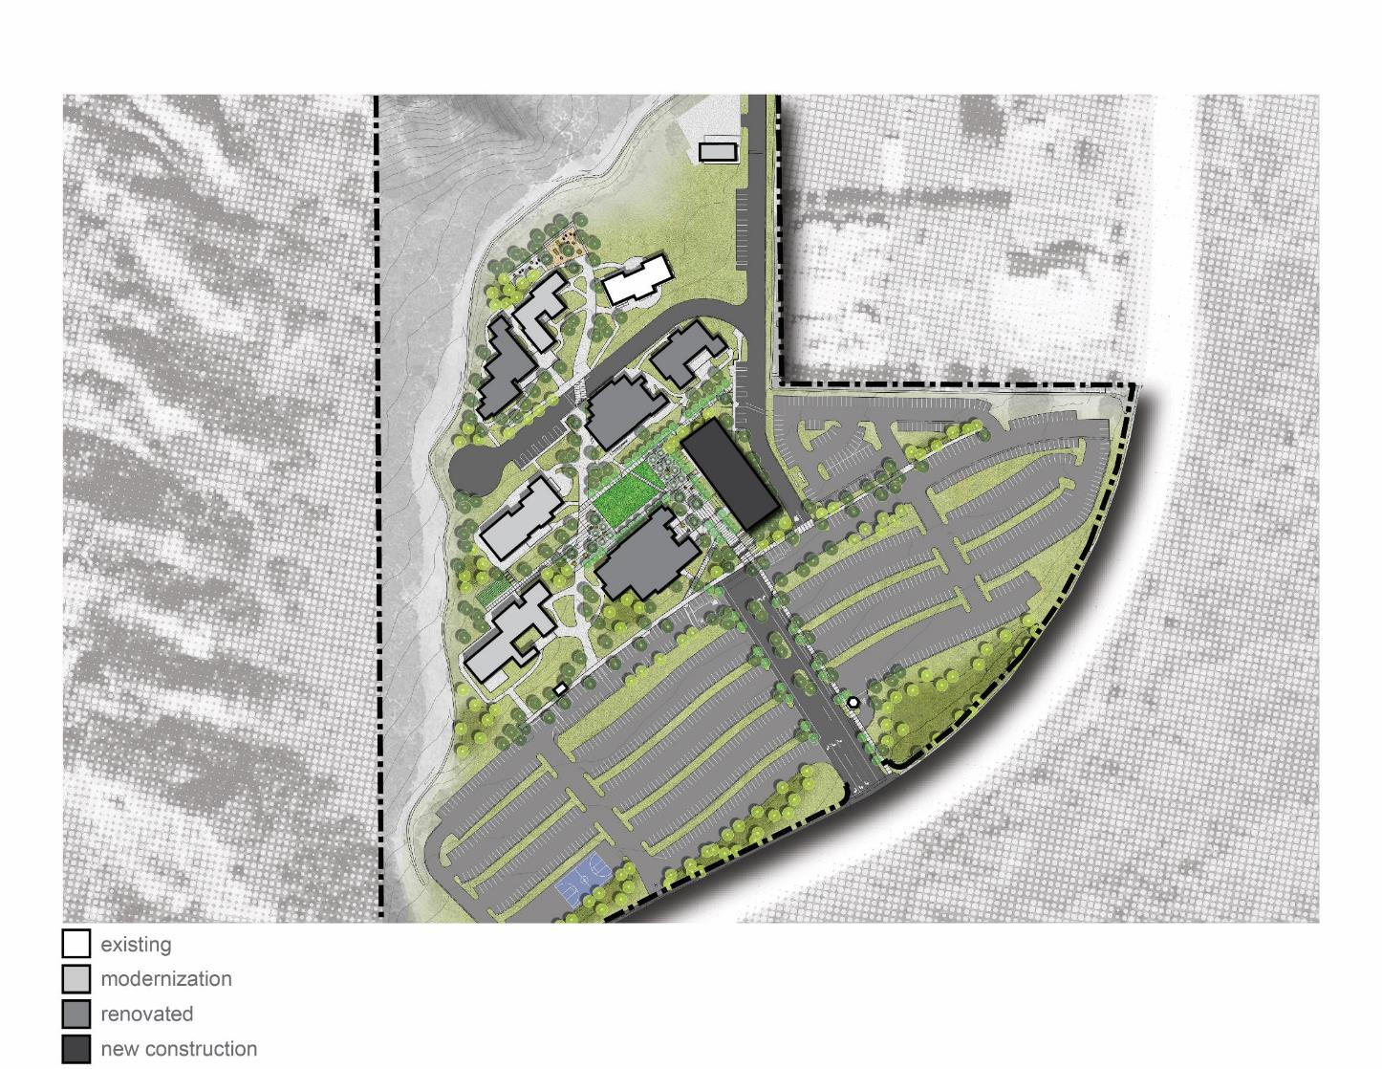
San Elijo Campus: Project Cost Summary
Building Projects
$30,062,000
Site Projects
$6,461,000
Subtotal:
$36,523,000
Escalation (over 4 years)
$6,678,000
Total:
$43,201,000

Slide 20
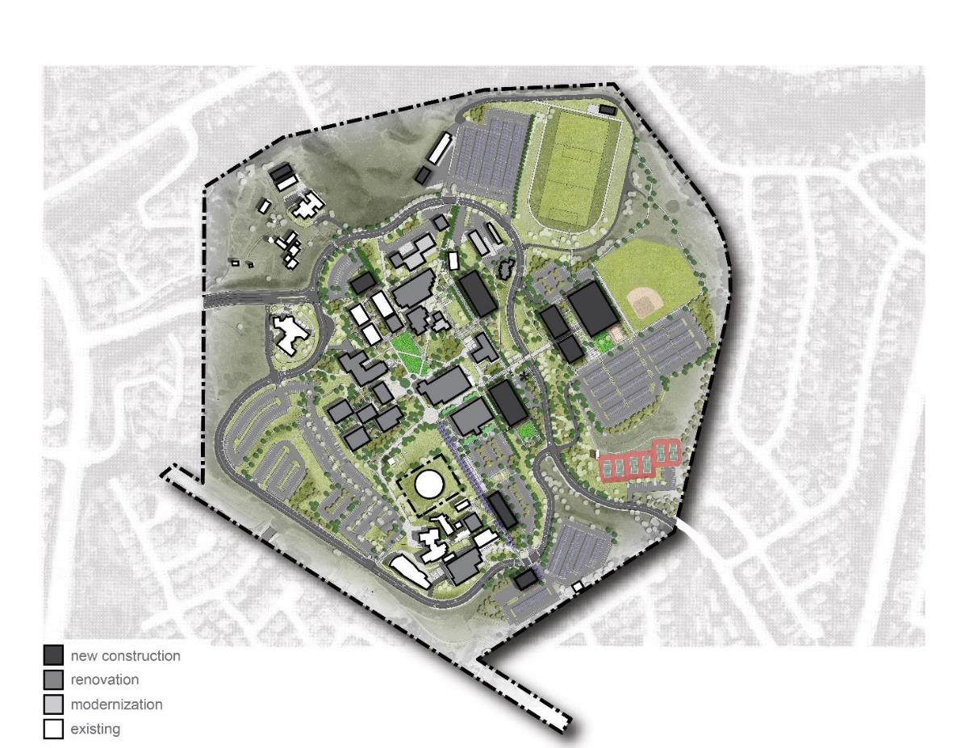
Oceanside Campus: Project Cost Summary
Building Projects
$235,076,000
Site Projects
$63,226,000
Subtotal:
$298,302,000
Library
Services
Escalation (over 7 years)
$86,843,000
Admin
Total:
$385,145,000

Slide 21
District-Wide Project Cost Summary
Community Learning Center
$26,928,000
San Elijo Campus
$43,201,000
Oceanside Campus
$385,145,000
*
Total:
$455,274,000
*Indicated cost:
Is for the build out the Facilities Master Plan Only
Does not include district-wide planning contingency.

