Slide 1

Financial Aid Study Abroad
Summer 2022

Slide 2
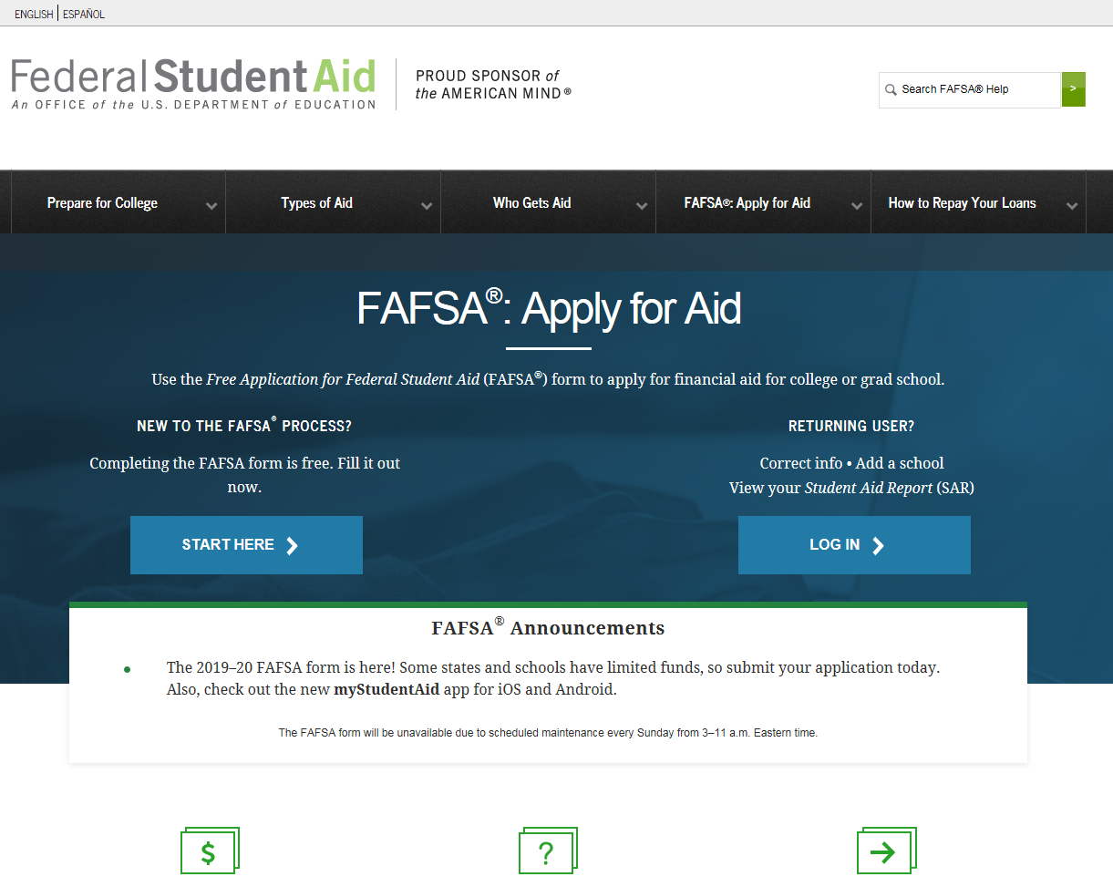
FAFSA
FREE APPLICATION for FEDERAL STUDENT AID
fafsa.gov
Notes:
U.S. Citizen or Eligible Non-Citizen
Social Security Number (not through DACA)
High School Diploma, GED, or the equivalent
Use it to apply for federal & state aid

Slide 3
When to Apply
For Summer 2022
The 2021-2022 FAFSA is available NOW until June 30, 2022
https://studentaid.gov/
For Summer 2023
The 2022-2023 FAFSA/CADAA will be available October 1, 2022
Apply for scholarships early
Notes:
must complete an application for each child every year
Available October 1
Some scholarships open Dec or Jan, apply even if you don’t know if your accepted

Slide 4
Scholarships
MiraCosta Scholarships
https://miracosta.edu//scholarships
Gilman Scholarship https://www.gilmanscholarship.org/
AFIS Scholarships
https://www.aifsabroad.com/financial-aid/
San Diego Foundation
Local organizations
FastWeb

Slide 5

Types of Financial Aid
California College Promise Grant (CCPG)
Federal Pell Grant
Federal Direct Student Loans
MiraCosta Scholarships
Private Scholarships
Federal Programs
State Programs
Institutional Programs
Notes:
Iraq and Afghanistan Service Grant: not eligible for Pell based on EFC but meet the remaining Federal Pell elig. requirements, and parent/guardian was a member of the U.S. armed forces and died as a result of military service performed in Iraq or Afghanistan after the events of 9/11, and are under 24 or enrolled in college at least part-time at the time of your parent’s or guardian’s death.
CCC - Promise Programs
UC - Blue + Gold Opportunity Plan
CSU - State University Grant

Slide 6
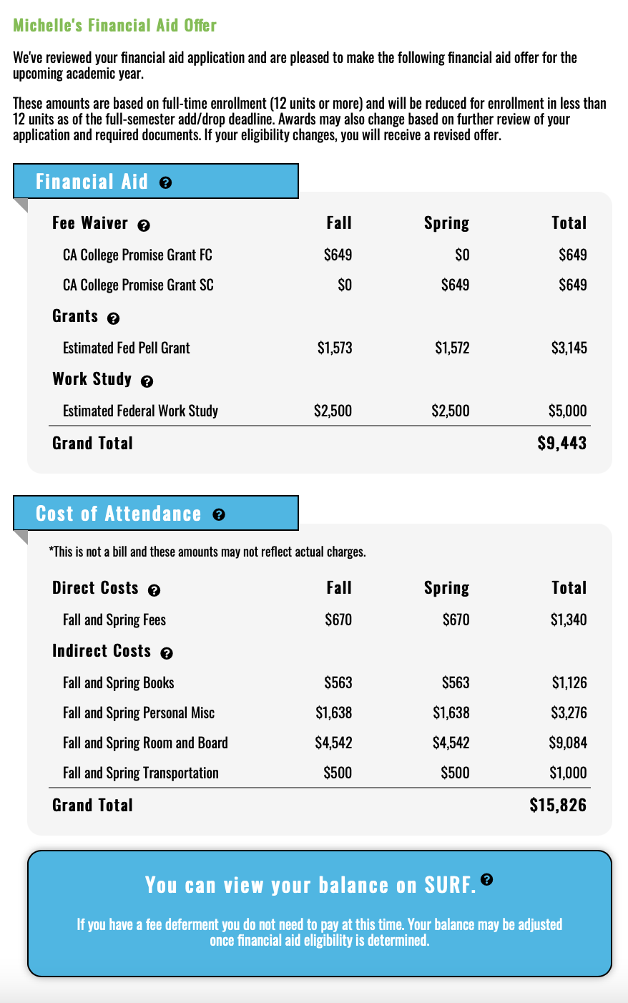
Notes:
Award notifications are sent to students, not parent
Summary of Aid – Grants - Waivers– Work-study – etc
Will have next step
Talk about COA

Slide 7
You may receive financial aid for a study-abroad program,
if you meet the aid eligibility criteria.
Fall 2021 | Spring 2022 | Summer 2022
12 Units (FT) | 12 Units (FT) | 6 units
$3,248 | $3,247 | $1,623
50% of Pell used | 50% of Pell used | Additional 25% available
100%
Student A had a zero EFC and was enrolled full time for the Fall and Spring semesters.
Notes:
empowering and an exciting one that opens up countless opportunities
ery real concern over cost

Slide 8
You may receive financial aid for a study-abroad program,
if you meet the aid eligibility criteria.
Fall 2021 | Spring 2022 | Summer 2022
6 units (PT) | 6 units (PT) | 6 units (PT)
$1,624 | $1,624 | $1,624
25% of Pell used | 25% of Pell used | Additional 25% available
50%
Student B had a zero EFC and was enrolled part time for the Fall and Spring semesters.
Notes:
empowering and an exciting one that opens up countless opportunities
ery real concern over cost

Slide 9
MiraCosta College Financial Aid Office
miracosta.edu/financialaid
(760) 795-6711
mccfinaid@miracosta.edu

